Slide 1

Web Development
IT125
Spring Term 2017
Marymount University
School of Business Administration
Professor Suydam
Week 13
Web Promotion & JavaScript Introduction
(Chapters 13 & 14)

Slide 2
Week 13 Agenda
Mini-Project 4 Grading Critique
Mini-Project 5 Set-up
Chapter 13 – Web Presence
Chapter 14 – JavaScript Introduction

Slide 3
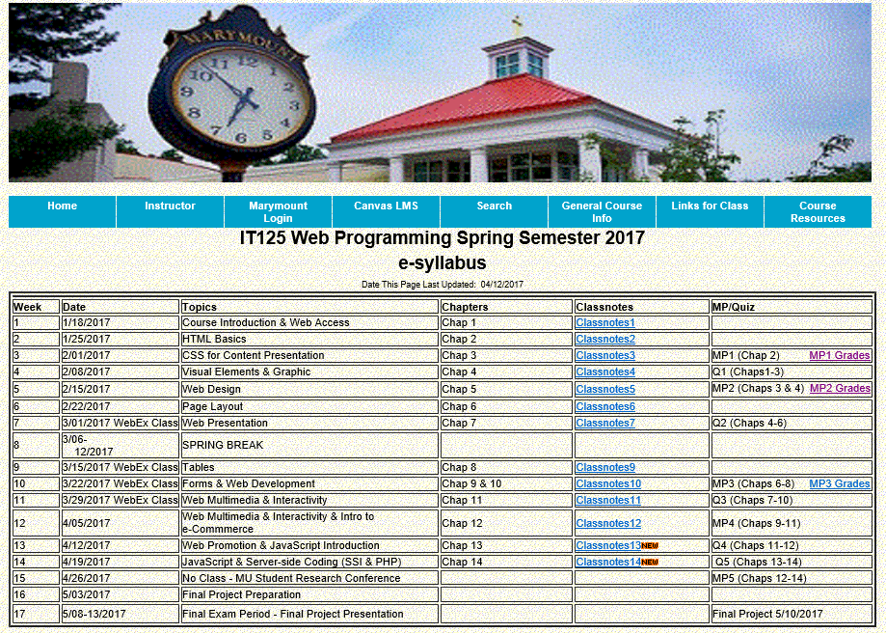
Course Schedule

Slide 4
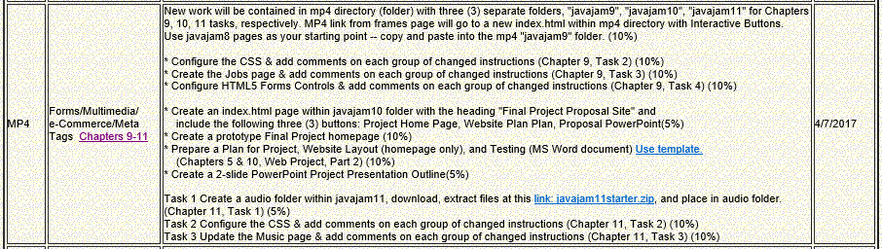
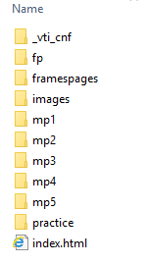
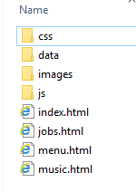
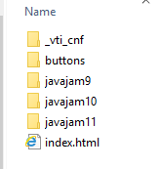
MP4

Slide 5
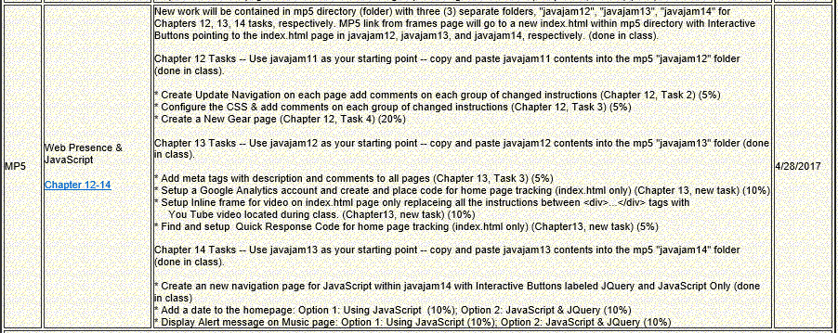
MP5 Setup

Slide 6
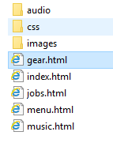
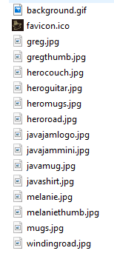
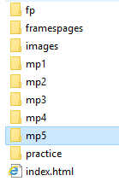
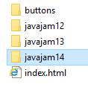
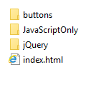
MP5 Setup
new
new
new
freshstart12

Slide 7
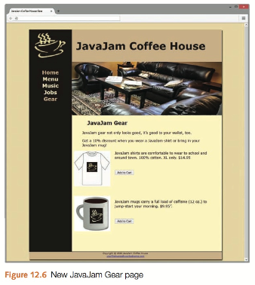
MP5 Chapter 12
Task 1: Setup javajam12 directory (folder). Copy the javamug.jpg, javashirt.jpg, and herocouch.jpg images from the chapter 12 folder in the student files and save them to your javajam12 images folder.
Task 2: Update the Navigation on Each Page.
Add a new list item and hyperlink in the main navigation area that displays the text “Gear” and links to the file gear.html. See Figure 12.6 for an example of the navigation area. Save the file.
Task 3: Configure the CSS (place after table instructions of css).
Add a new style rule to configure a class named clearleft that has a 1em margin and will clear a left float.
Configure a new id named #herocouch with 250px height that displays the hero-couch.jpg image in 100% of the background. Use the #heroguitar id as a guide as you code the styles.
(place after #heroguitar)
Task 4: Create the New Gear Page. One way to be productive is to create pages based on your earlier work. Use the Music page (music.html) as a starter
Save the file as gear.html.
This will give you a head start and ensure that the pages on the website are similar. Perform the following modifications:
a. Change the page title to an appropriate phrase.
b. Assign the div to an id named herocouch.
c. Change the text within the h2 element to “JavaJam Gear”.
d. Delete the contents and HTML elements within the main element that are below the h2 element.
e. Place each sentence below in a separate paragraph: JavaJam gear not only looks good, it’s good to your wallet, too. Get a 10% discount when you wear a JavaJam shirt or bring in your JavaJam mug!
f. Configure an image element to display the javashirt.jpg graphic. Assign the image to the floatleft class.
g. Configure the following text in a paragraph: “JavaJam shirts are comfortable to wear to school and around town. 100% cotton. XL only. $14.95”
h. Code a line break tag below the paragraph. Assign the line break tag to the clearleft class.
i. Configure an image element to display the javamug.jpg graphic. Assign the image to the floatleft class.
j. Configure the following text in a paragraph: “JavaJam mugs carry a full load of caffeine (12 oz.) to jump-start your morning. $9.95”.
.clearleft { margin: 1em; clear: left; }
#herocouch { background-image: url(../images/herocouch.jpg);
background-size: 100% 100%;
height: 250px; }

Slide 8
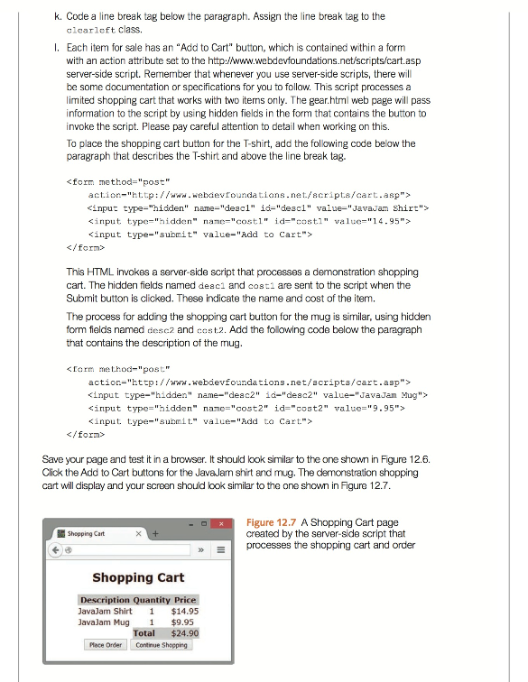
MP5 Chapter 12
<form method="post"
action="http://www.webdevfoundations.net/scripts/cart.asp">
<input type="hidden" name="desc1" id="desc1" value="JavaJam Shirt">
<input type="hidden" name="cost1" id="cost1" value="14.95">
<input type="submit" value="Add to Cart">
</form>
<form method="post"
action="http://www.webdevfoundations.net/scripts/cart.asp">
<input type="hidden" name="desc2" id="desc2" value="JavaJam Mug">
<input type="hidden" name="cost2" id="cost2" value="9.95">
<input type="submit" value="Add to Cart">
</form>

Slide 9
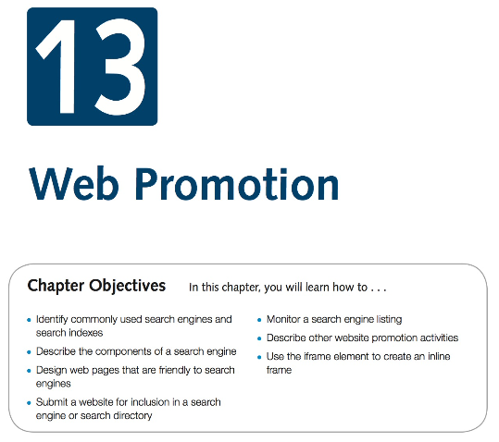
Week 13 Chapter 13
Download Chapter 13 Student Files, save and UnZip to your practice folder

Slide 10
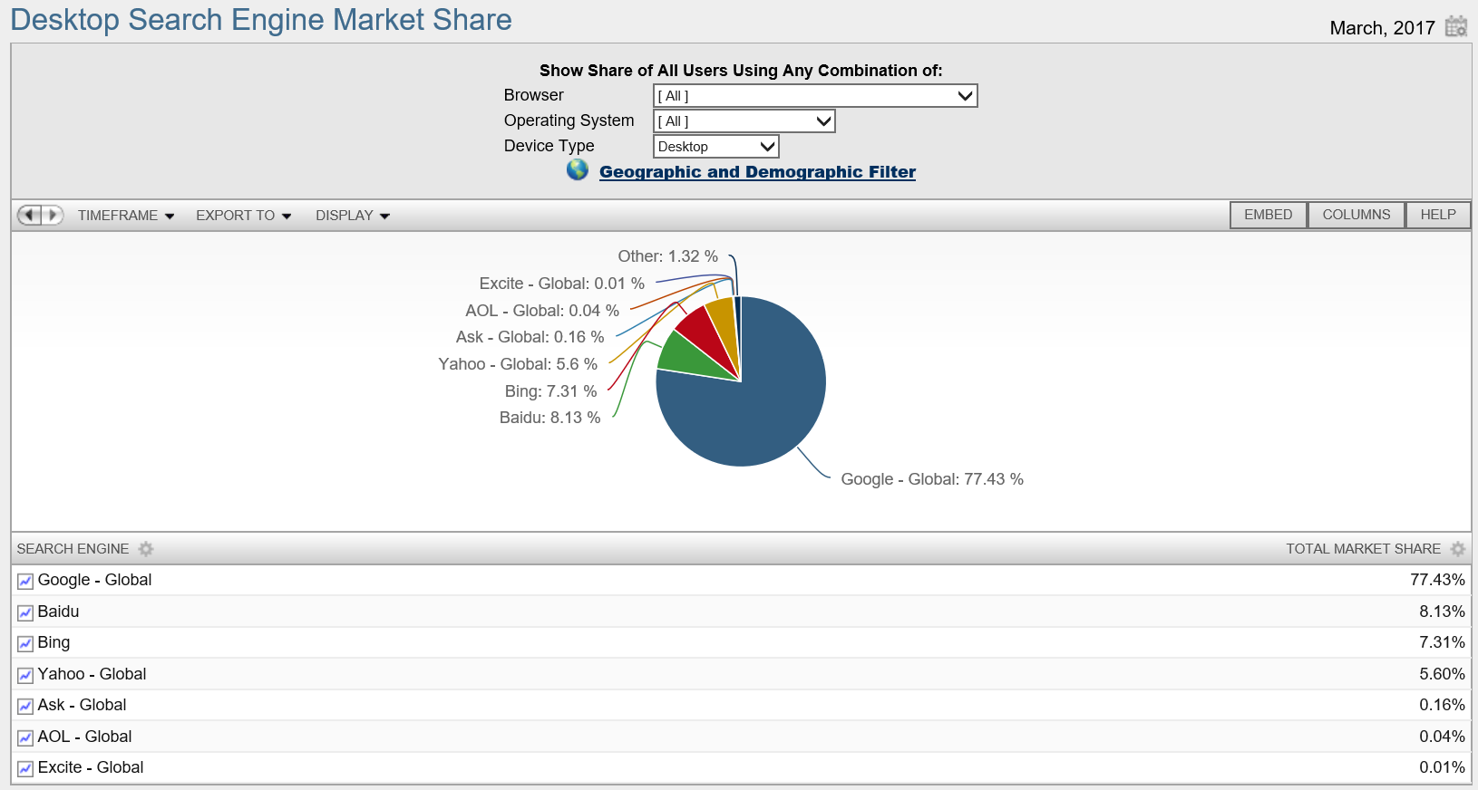
Popular Search Engines
Source: netmarketshare.com

Slide 11
Search Engines
Components
  Popular Search Engines:
    Google http://www.google.com
    Bing http://bing.com
  Search engines use the following components:
    Robot or “spider”
    Database (also used by search indexes)
    Search form (also used by search indexes)
Search Engine Robot
  Also called a spider or bot
    A computer program that follows hyperlinks and “walks” the Web -- accessing and documenting web pages.
    Categorizes the pages and stores information in a database.
  May access the following components of web pages:
    title
    meta tag keywords & meta tag description
    text in headings
    other text on the page
    Hyperlinks
Database
  Database: A collection of information organized so that its contents can easily be accessed, managed, and updated.
  Database Management Systems (DBMSs): Configure and manage database (Oracle, MySQL, Microsoft SQL Server, IBM DB2)
  Search Engine Database: Contains information about web pages

Slide 12
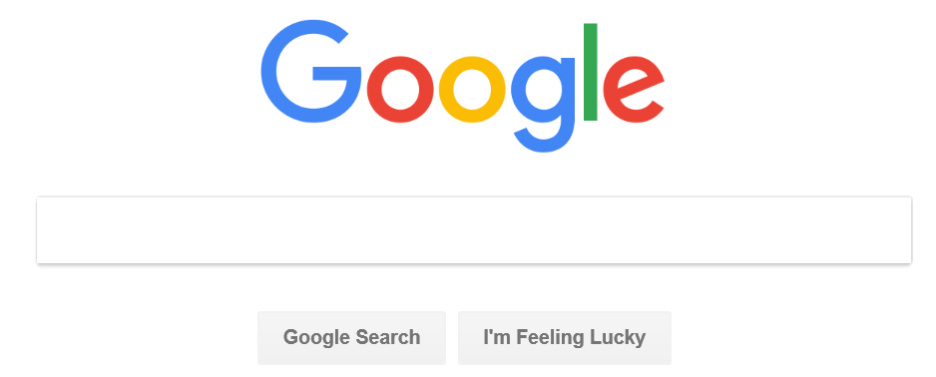
Search Engine Search Form
The part you are most familiar with!
The search form is the graphical user interface (GUI) that allows a user to request a word or phrase to search for.
The visitor to the search engine types words (called keywords) related to their search into the text box.
When the form is submitted, the data typed into the text box is sent to server-side processing that searches the database using the keywords you have entered.
The search results (also called a result set) is a list that contains information such as the URLs for web pages that meet your criteria.

Slide 13
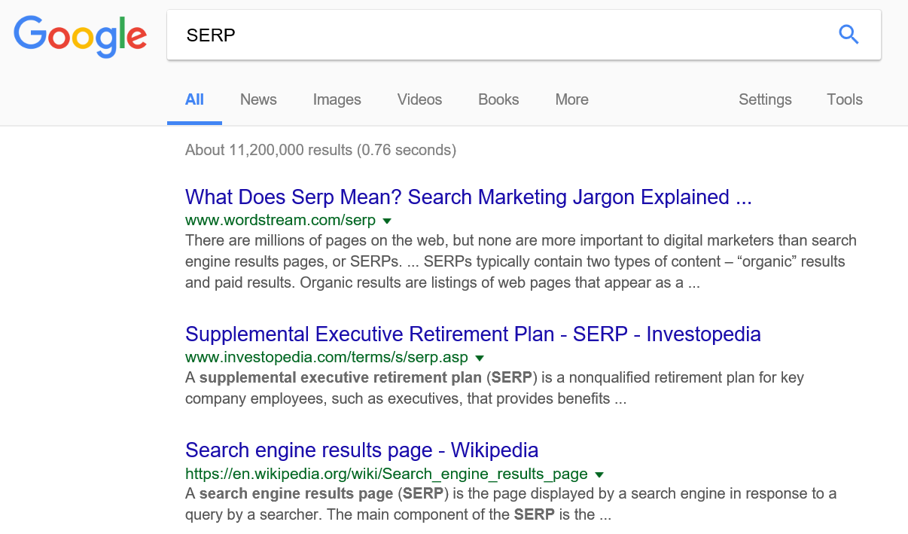
Search Engine Results Page (SERP)
A list of items that describe web pages matching the search terms. Each item contains a link to a page along with additional information that might include the page title, a brief description, the first few lines of text, the size of the page, and so on.
The order the web page items are displayed in the SERP may depend on:
  paid advertisements
  alphabetical order
  link popularity
Each search engine has their own policy for ordering the search results.

Slide 14
Designing Web Pages for Promotion
Keywords
  Terms and phrases that people may use when searching for your site.
  Words or phrases that describe your web site or business.
  Create a list of them
  Include common misspellings
Description
  What is special about your web site that would make someone want to visit?
  25-30 words -- inviting and interesting
  Some search engines will display your description in the SERP
Description meta tag element
  A stand-alone tag
  Placed in the head section
  Attributes: name, content
  General Form: <meta name=“description" content="value">
  Example: <meta name="description" content="Acme Design, a
  premier web consulting group that specializes in
  E-commerce, website design, website development,
  and website re-design.">

Slide 15
Search Engine Optimization (SEO)
Determine keywords
Page Title
  Include the company and/or website name
  Include selected keywords as appropriate
Heading tags - Include keywords
Text on page includes keywords
Linking
      Provide text navigation hyperlinks
      Verify that all hyperlinks are functioning
Page Layout - Use CSS for page layout
Images & Multimedia
    Configure meaningful alternate text
    Be aware that text and hyperlinks contained within multimedia may not be accessed by search engine robots
Valid Code
    Validate HTML
    Validate CSS
Content of Value
    Follow Web Design Best Practices
    Well-organized
    Meaningful & useful to your target audience

Slide 16
Listing in a Search Engine
General
  Wait until your site is finished
  Don’t submit “under construction” Web sites!
  Locate the “Add URL” or “Submit Your Site” page for a search engine
  Follow the directions and fill out the form
  A robot from the search engine will visit your website and index it
  Allow several weeks and test the search engine to see if your site is listed
Preferential Placement
  Offers vary: Example: Google’s AdWords http://www.google.com/adwords
  Commonly used acronyms:
    CPC – Cost Per Click (PPC – Pay Per Click)
    The price you are charged if you have signed up for a paid sponsor or ad program and a visitor clicks on a link to your Web site.
    CPM – Cost Per Impressions
    Your cost for every 1000 times that your ad is displayed on a web page (whether or not the visitor clicks on your ad).
    CTR – Click Through Rate
    The ratio of the number of times an ad is clicked on to the number of times an ad is viewed.
    For example if your ad was shown 100 times and 20 people clicked on it, your CTR would be 20/100 or 20%.

Slide 17
Mapping Your Site
HTML Site Map Web page
  Used by visitors and accessed by search engines.
  Example: http://webdevbasics.net/sitemap.html
XML Sitemap file
  Accessed only by search engines
  List of Web pages with URL, last date updated, frequency of update, and priority indicators
  See http://google.com/support/webmasters

Slide 18
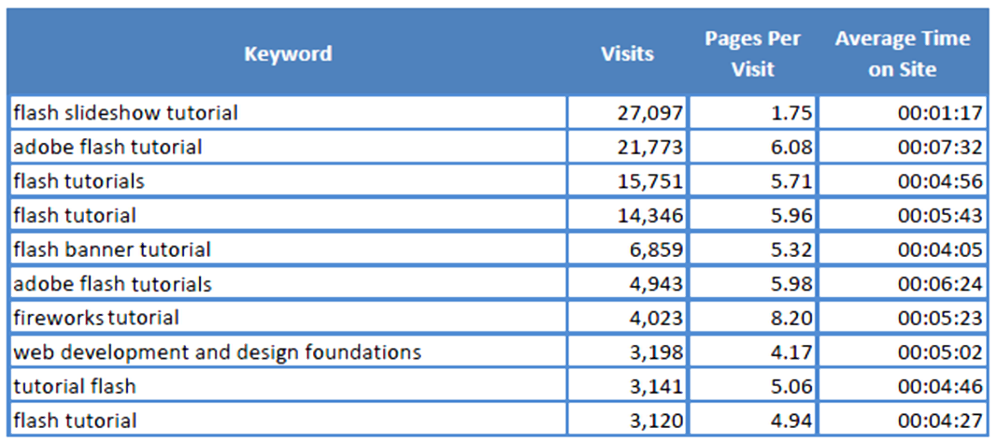
Monitor Search Engine Listings
Web Analytics:
  "the measurement, collection, analysis and reporting of Internet data for the purposes of understanding and optimizing Web usage."
Analyze web site logs

Slide 19
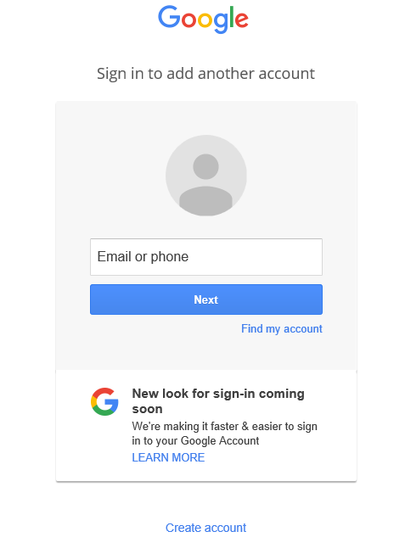
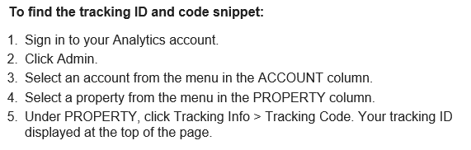
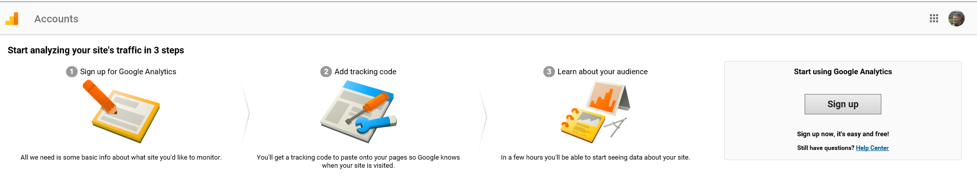
Google Analytics
Google: Google Analytics
Create an account using your marymount.edu email address
Sign in: https://www.google.com/analytics/web/provision/?authuser=0#provision/SignUp/

Slide 20
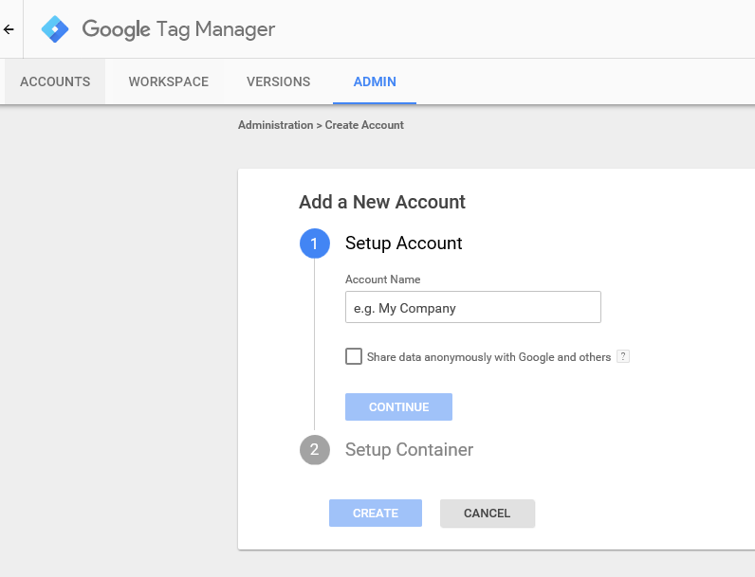
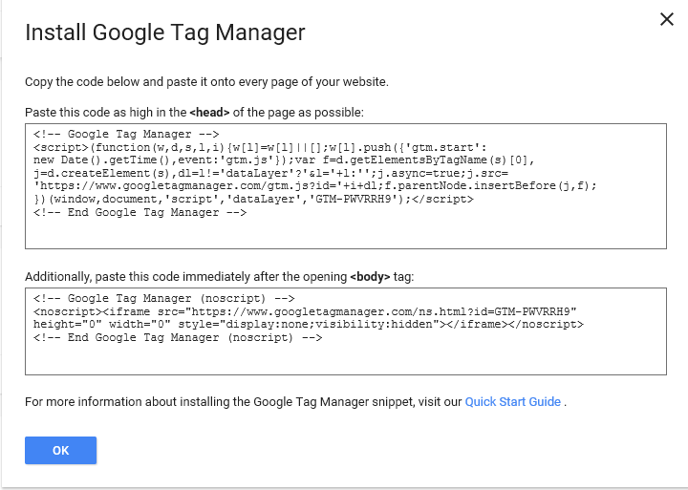
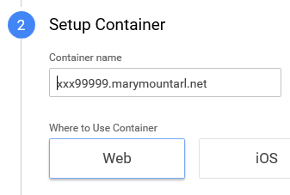
Google Analytics
https://tagmanager.google.com/?authuser=0#/admin/accounts/create
Simple name (e.g., “it125Demo”
URL to your it125 site

Slide 21
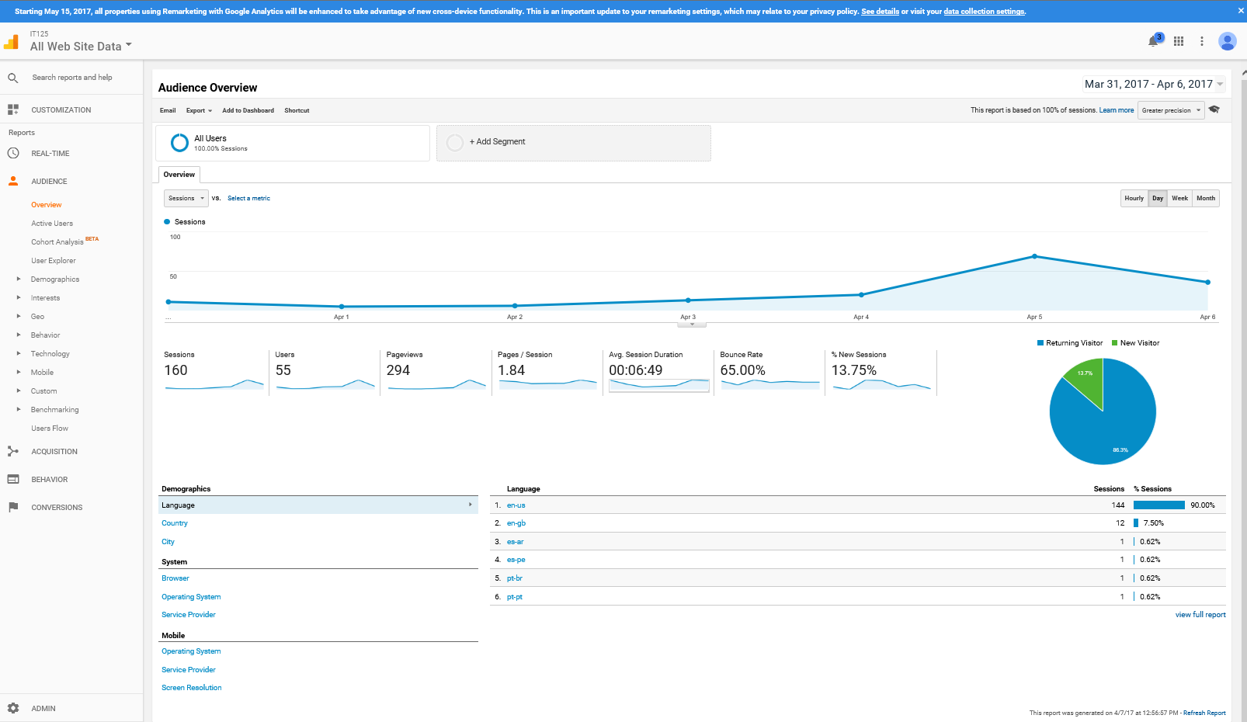
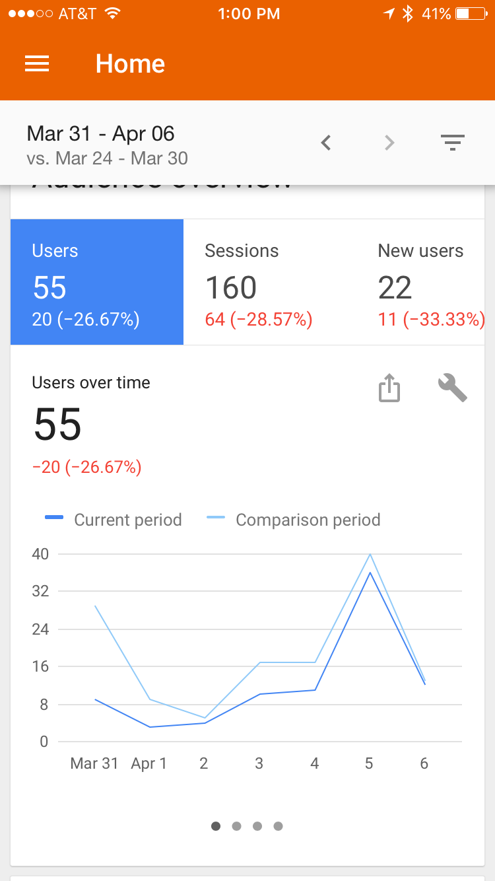
Google Analytics
Laptop browser
iPhone app (Google Analytics)

Slide 22
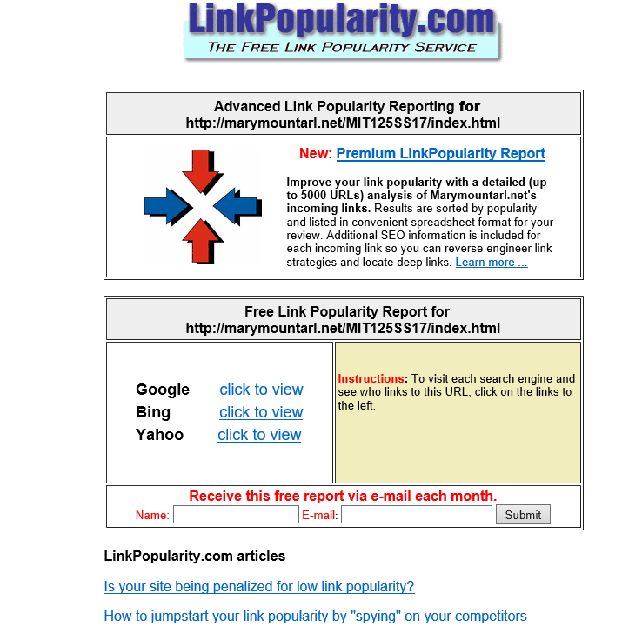
Link Popularity
Rating determined by a search engine based on the number of sites that link to a particular website and the quality
Checking Link Popularity
  Analyze your log file
  Visit a link popularity checking service web site
    http://linkpopularity.com
To receive email reports

Slide 23
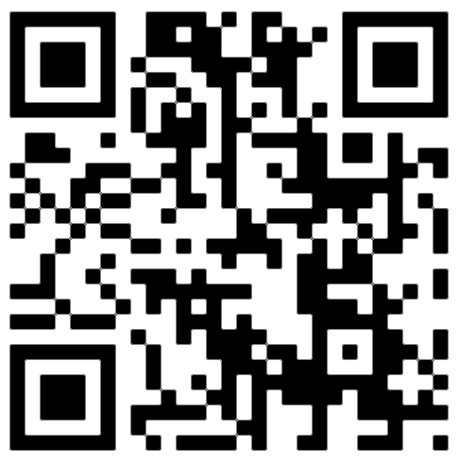
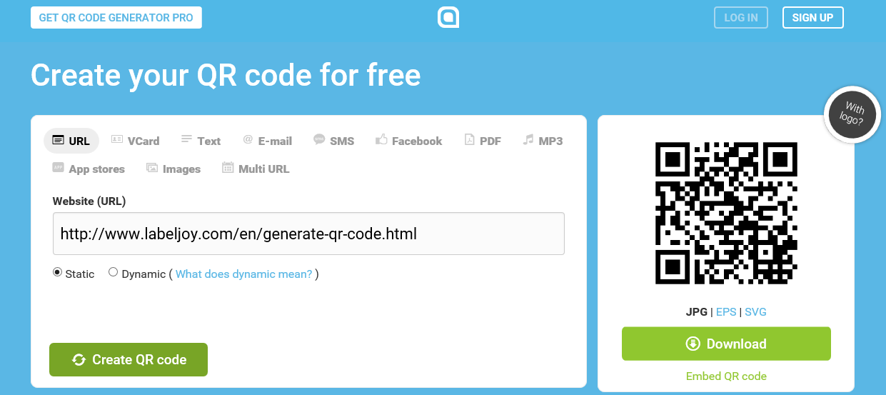
Web Promotion
Social Media Optimization - Creating content of value that is easily sharable
  Benefits:
      Increased brand awareness
      Increased inbound links
  Make sharing easy
      Social Bookmarking.
      http://addthis.com
      Twitter, Facebook, Pinterest, Digg, Reddit, LinkedIn, YouTube, ….
  QR (Quick Response) Code
  A two-dimensional barcode in a square pattern that is readable by a smartphone camera scan application or a QR barcode reader
  Free online QR code generators:
    http://qrcode.kaywa.com (cost)
    http://www.qrstuff.com (cost )
    http://www.labeljoy.com/en/generate-qr-code.html (free)
  Other Site Promotion Activities
  QR (Quick Response) Codes
  Affiliate Programs
  Banner Ads
  Banner Exchange
  Reciprocal Link Agreements
  Newsletters
  “Sticky” Site Features
  Personal Recommendations
  Newsgroup and Listserv Postings
  Traditional Media Ads
  Leverage Existing Marketing Materials

Slide 24
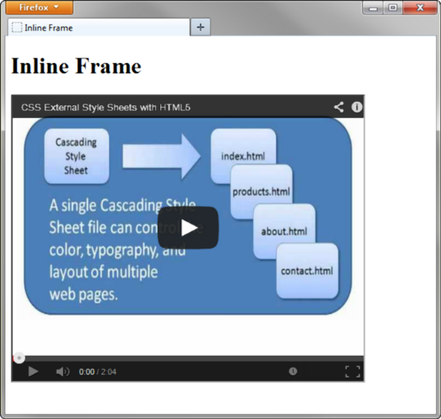
Inline Frame
Also called a floating frame
Embeds one web page within another in a scrolling area
Configure with the iframe element
<iframe src="trillium.html" title="Trillium Wild Flower" height="160" name="flower" width="350">
Description of the lovely Spring wild flower, the
<a href="trillium.html" target="_blank">Trillium</a>
</iframe>
Embed a You Tube example
<iframe src="http://www.youtube.com/embed/VIDEO_ID" width="640" height="385">View the
<a href="http://www.youtube.com/watch?v=VIDEO_ID">YouTube Video</a>
</iframe>
Practice:
Google You Tube javajam
Select the option for: JavaJam Chapter 6 Case Study Overview - YouTube

Slide 25
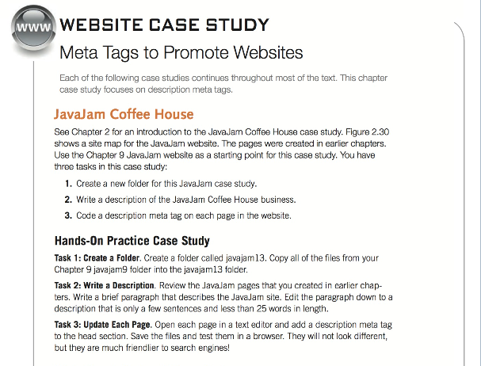
MP5 Chapter 13
Chapter 13 Tasks -- Use javajam12 as your starting point -- copy and paste javajam12 contents into the mp5 "javajam13" folder (done in class).
* Add meta tags with description and comments to all pages (Chapter 13, Task 3) (5%)
<meta name="description" content="Visit JavaJam CoffeeHouse for a relaxing cup of specialty coffee or tea, delicious snacks, and great conversation. Weekly poetry readings and performances by local and regional musicians.">
* Setup a Google Analytics account and create and place code for home page tracking (index.html only) (Chapter 13, new task) (10%)
* Setup Inline frame for video on index.html page only replaceing all the instructions between <div>...</div> tags with You Tube video located during class. (Chapter13, new task) (10%)

Slide 26
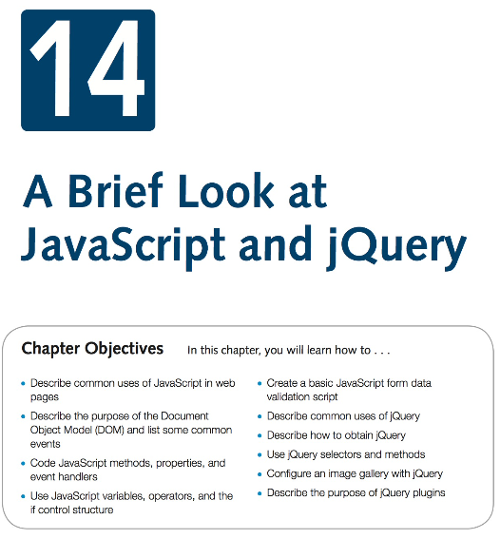
Week 13 Chapter 14
Download Chapter 14 Student Files, save and UnZip to your practice folder

Slide 27
What is JavaScript?
Object-based scripting language
Works with the objects associated with a Web page document
  the window
  the document
  the elements -- such as forms, images, hyperlinks, etc.
Originally developed by Netscape - Named LiveScript
Netscape & Sun Microsystems Collaboration - LiveScript renamed JavaScript
JavaScript is NOT Java
Common Uses
  Display a message box
  Select list navigation
  Edit and validate form information
  Create a new window with a specified size and screen position
  Image Rollovers
  Status Messages
  Display Current Date
  Calculations

Slide 28
Coding JavaScript
JavaScript statements can be coded on a web page using two different techniques:
  Place JavaScript code between <script> tags
  Place JavaScript code as part of an event attached to an HTML element
The script element
  A container tag
  May be placed in either the head or the body section of a web page
  Example:
      <script type="text/javascript">
      <!- -
      alert("Welcome to Our Site");
      // - ->
      </script>

Slide 29
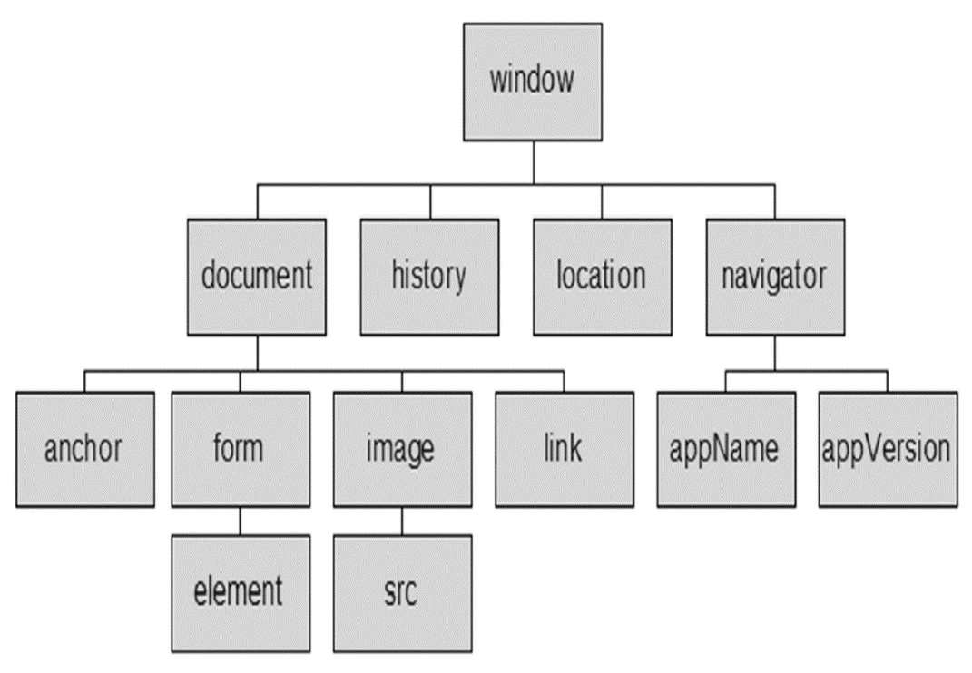
Document Object Model (DOM)
A portion of the DOM is shown at the left.
Defines every object and element on a web page
Hierarchical structure
Accesses page elements and apply styles to page elements
An object is a thing or entity.
  Browser window
  Submit button
  Web page document

Slide 30
JavaScript: Property, Method, & Event
A property is a characteristic or attribute of an object.
  The background color of a web page document
  document.bgcolor
  The date the web page file was last modified
  document.lastmodified
  The src file of an image object
  image1.src
A method is an action (a verb)
  Writing text to a web page document
          document.write()
  Submitting a form
          form1.submit()
An event is an action taken by the web page visitor.
  JavaScript can be configured to perform actions when events occur.
    The event name is coded as an attribute of an HTML tag
    The value of the event attribute contains the JavaScript code
  Example: Display an alert box when the mouse is placed over a hyperlink.
            <a href="home.htm" onmouseover="alert('Click to go home')">Home</a>
Event | Event Handler
click | onclick
load | onload
mouseover | onmouseover
mouseout | onmouseout
submit | onsubmit
unload | onunload

Slide 31
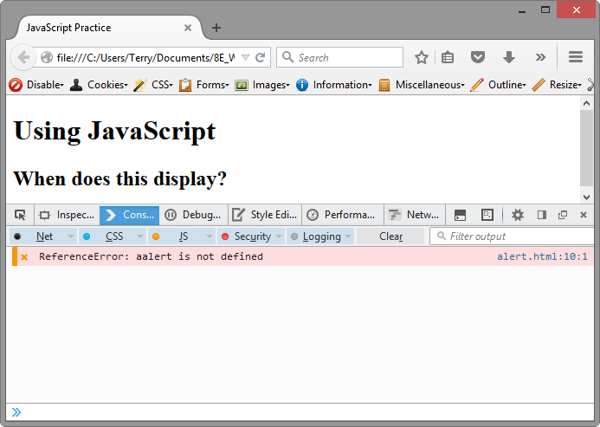
JavaScript Debugging
Check the syntax of the statements -- Pay very close attention to upper and lower case letters, spaces, and quotations
Verify that you have saved the page with your most recent changes
Verify that you are testing the most recent version of the page (refresh or reload the page)
If you get an error message, use the error messages that are displayed by the browser -- In Firefox: Select Tools > Error Console
Using the Firefox browser:
  Select the top right menu icon (“Hamburger” icon)
  Select Developer > Web Console
  The Web Console will indicate an issue and the line number
    This may not be exactly where the problem is
    Sometimes the error is one or two lines above the indicated line number.

Slide 32
JavaScript: Variable, Prompt, & Operators (Arithmetic & Comparison)
A variable is a placeholder for information.
The variable is stored in the computer’s memory (RAM).
    var userName;
    userName = "Karen";
    document.write(userName);
The prompt() method -- Displays a message and accepts a value from the user
    myName = prompt(“prompt message”);
  The value typed by the user is stored in the variable myName
Operators
Comparison
Operator | Description | Example | Sample values of quantity that would result in true
= = | Double equals sign (equivalent) “is exactly equal to” | quantity = = 10 | 10
> | Greater than | quantity > 10 | 11, 12 (but not 10)
> = | Greater than or equal to | quantity > = 10 | 10, 11, 12
< | Less than | quantity < 10 | 8, 9 (but not 10)
< = | Less than or equal to | quantity < = 10 | 8, 9, 10
! = | Not equal to | quantity ! = 10 | 8, 9, 11 (but not 10)
Arithmetic
Operator | Description | Example | Value of Quantity
= | assign | quantity = 10 | 10
+ | addition | quantity = 10 + 6 | 16
- | subtraction | quantity = 10 - 6 | 4
* | multiplication | quantity = 10 * 2 | 20
/ | division | quantity = 10 / 2 | 5

Slide 33
Decision Making
if (condition) {
… commands to execute if condition is true
}
else {
… commands to execute if condition is false
}

Slide 34
JavaScript: Function
A function is a block of one or more JavaScript statements with a specific purpose, which can be run when needed.
Defining:
function showAlert() {
alert("Please click OK to continue.");
}
Calling:
showAlert();

Slide 35
Form Validation
It is common to use JavaScript to validate form information before submitting it to the web server.
  Is the name entered?
  Is the e-mail address of correct format?
  Is the phone number in the correct format?
See Hands-on Practice 14.8
Use the "" or null to check to determine if a form field has information
    if (document.forms[0].userName.value == "" ) {
    alert("Name field cannot be empty.");
    return false;
    } // end if

Slide 36
JavaScript & Accessibility
Don’t expect JavaScript to always function for every visitor
  Some may have JavaScript disabled
  Some may be physically unable to click a mouse
Provide a way for your site to be used if JavaScript is not functioning
  Plain text links
  E-mail contact info

Slide 37
What is jQuery?
jQuery is a free open-source JavaScript Library
Provides interaction and dynamic effects on web pages
Common Uses
  Dynamically manipulate the CSS properties of elements
  Detect and react to events – such as mouse movements
  Animate elements on a web page – such as image slideshows
  And much more...
Resources
  http://jquery.com
  http://jquery.org
Adding a JQuery to a Webpage (2 Options)
  Download jQuery
      http://jquery.com/download
  Access jQuery via a CDN
      <script src=
      "http://ajax.googleapis.com/ajax/libs/jquery/1.11.3/jquery.min.js">
      </script>

Slide 38
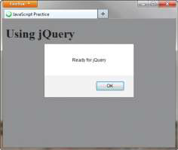
jQuery
The ready event - Triggered when the browser has loaded the Document Object Model(DOM) for the web page
  $(document).ready(function() {
  Your JavaScript statements and other jQuery statements go here
  })
Display an Alert When the page loads
  <script>
  $(document).ready(function() {
  alert("Ready for jQuery");
  })
  </script>

Slide 39
jQuery Selectors
A selector indicates which DOM elements jQuery will affect
http://api.jquery.com/category/selectors
Some commonly used jQuery selectors
Selector | Purpose
$('*') | wildcard – selects all elements
$('li') | HTML element selector – selects all li elements
$('.myclass') | Class selector – selects all elements assigned to the class named myclass
$('#myid') | Id selector – selects the element assigned to the id named myid
$('nav a') | HTML element selector – selects all anchor elements contained within the nav element
$('#resources a') | Id selector and HTML element selector – selects all anchor elements contained within the id named resources
$('li:first') | Positional selector that selects the first element of that type on the page
$('li:odd') | Positional selector- selects every other li element on the page

Slide 40
jQuery Methods
A method acts upon the DOM elements you have selected
http://api.jquery.com
Some commonly used jQuery methods
Method | Purpose
click() | Binds a jQuery event handler to the JavaScript click event
css() | Sets the specified CSS property for the selected element(s
fadeToggle() | Displays or hides the selected element(s) by animating their opacity
hover() | Binds a jQuery event handler to the JavaScript onmouseover event
slideToggle() | Displays or hides the selected element(s) with a sliding motion
toggle() | Displays or hides the selected element(s)
attr() | Gets or sets attributes for the selected element(s)
html() | Gets or sets HTML contents for the selected element(s)

Slide 41
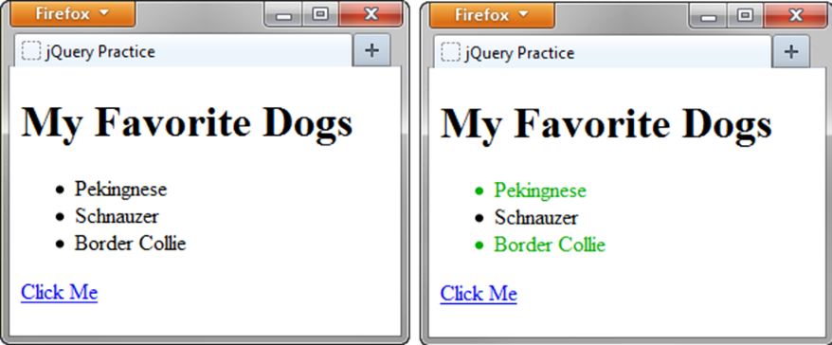
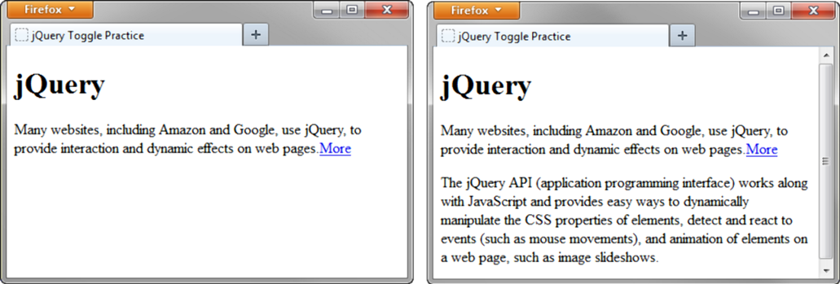
Using Methods
click() and CSS() Methods
  <script>
  $(document).ready(function() {
  $('a').click(function(){
  $('li:even').css('color','#006600');
  });
  });
  </script>
toggle() Method
  <script>
  $(document).ready(function() {
  $('#more').click(function(){
  $('#details').toggle();
  });
  });
  </script>

Slide 42
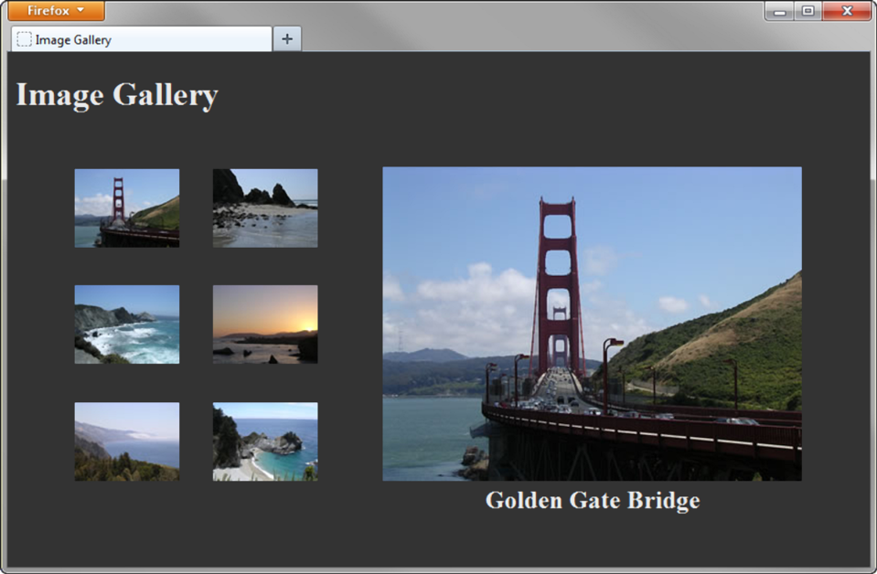
jQuery Image Gallery
<script>
$(document).ready(function(){
$('#gallery a').click(function(){
var galleryHref = $(this).attr('href');
var galleryAlt = $(this).attr('title');
$('figure img').attr({ src: galleryHref, alt: galleryAlt });
$('figcaption').html(galleryAlt);
return false;
});
});
</script>

Slide 43
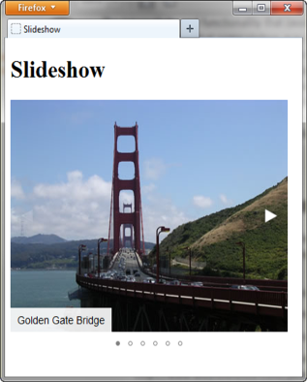
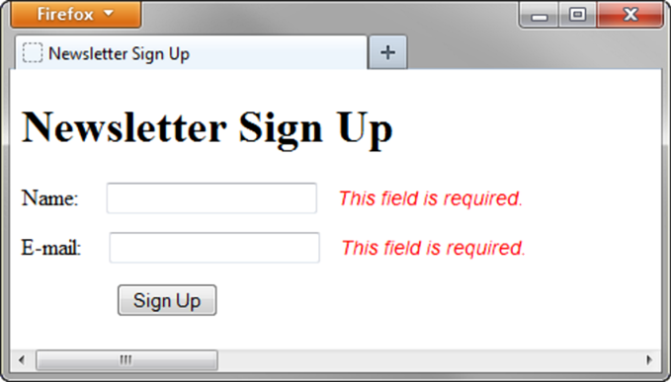
jQuery Plugin
JavaScript that extends the functionality of jQuery
http://plugins.jquery.com
MIT license: http://opensource.org/licenses/MIT
Examples:
  fotorama plugin http://plugins.jquery.com/fotorama
  Validate plugin http://plugins.jquery.com/validation

Slide 44
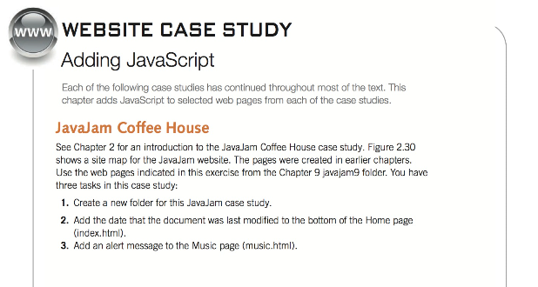
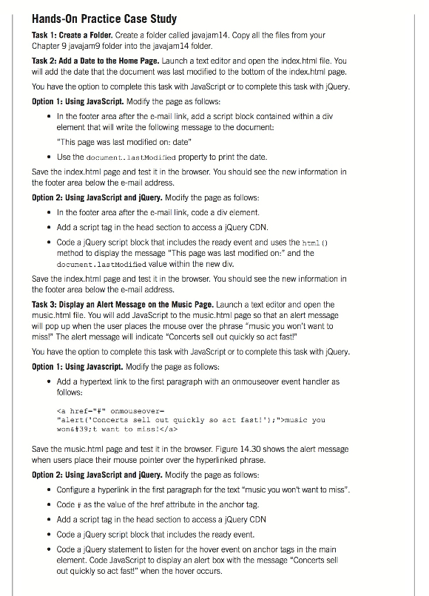
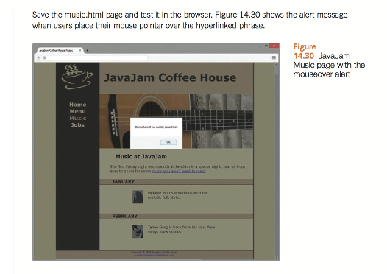
MP5 Chapter 14 (next Class)

