Slide 1

Web Development
IT125
Spring Term 2017
Marymount University
School of Business Administration
Professor Suydam
Week 9
Tables (Chapter 8)
MP3 Preparation

Slide 2
Week 9 Agenda
Review Course Schedule
Chapter 8 Tables
Mini-Project 3

Slide 3
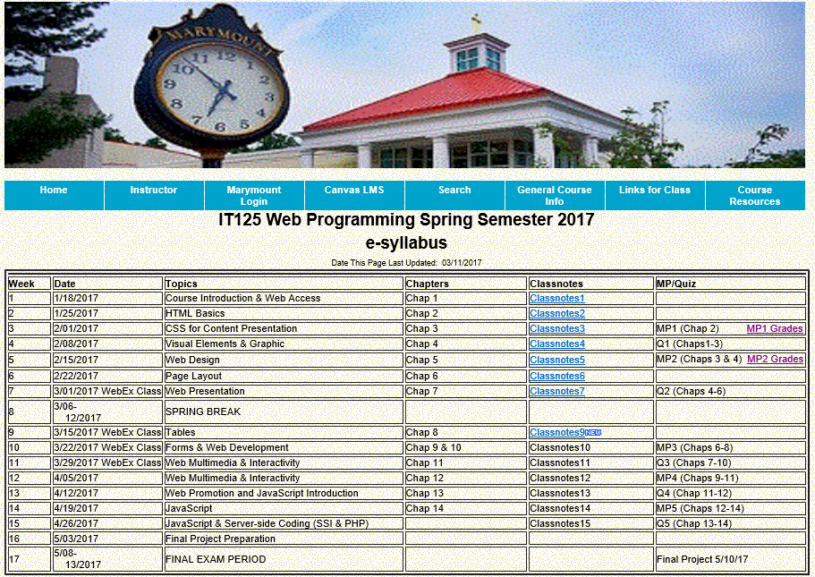
Course Schedule

Slide 4
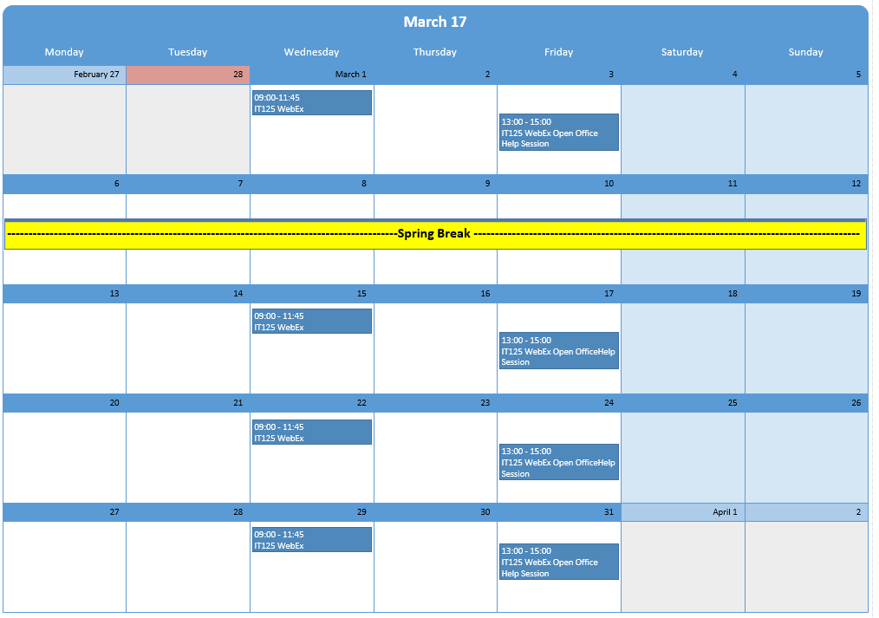
March 2017 Schedule

Slide 5
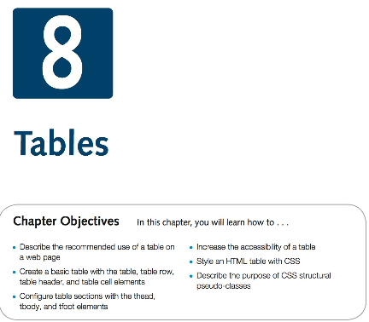
Chapter 8 Objectives

Slide 6
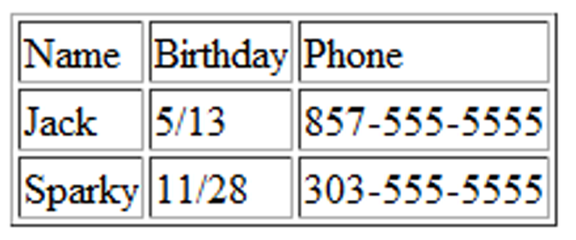
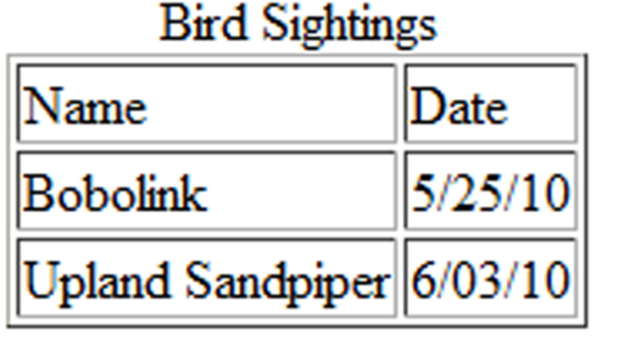
HTML Table
Tables are used on web pages to organize tabular information
Composed of rows and columns – similar to a spreadsheet.
Each individual table cell is at the intersection of a specific row and column.
Configured with table, tr, and td elements
Table Elements
  <table> Contains the table
  <tr>Contains a table row
  <td>Contains a table cell
  <caption> Configures a description of the table
Table Example
    <table border="1">
    <caption>Bird Sightings</caption>
    <tr>
    <td>Name</td>
    <td>Date</td>
    </tr>
    <tr>
    <td>Bobolink</td>
    <td>5/25/10</td>
    </tr>
    <tr>
    <td>Upland Sandpiper</td>
    <td>6/03/10</td>
    </tr>
    </table>

Slide 7
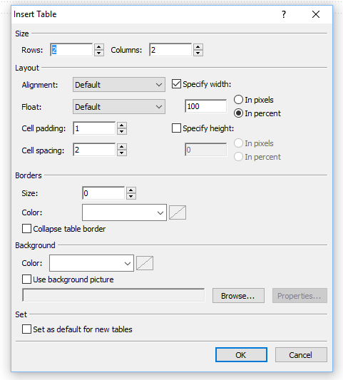
Using Expression Web for Tables
Pulldown menu: Insert>Table

Slide 8
HTML Tables
Table Attributes
  align (obsolete)
  bgcolor (obsolete)
  border
  cellpadding (obsolete)
  cellspacing (obsolete)
  summary (obsolete but may be reinstated)
  width (obsolete)
Use CSS to configure table characteristics instead of HTML attributes
Table Cell Attributes
  align (obsolete)
  bgcolor (obsolete)
  colspan
  rowspan
  valign (obsolete)
  height (deprecated)
  width (deprecated)
Use CSS to configure most table cell characteristics instead of HTML attributes

Slide 9
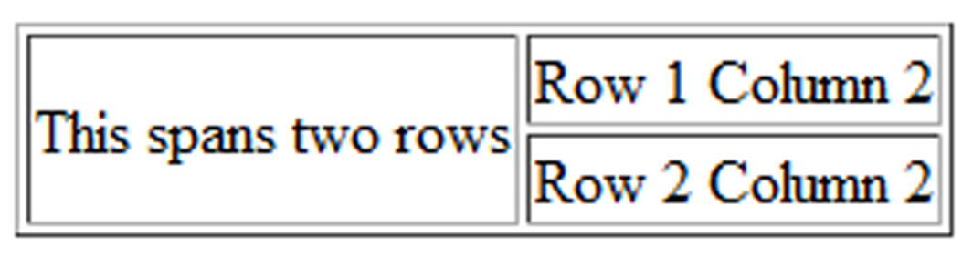

HTML Tables
colspan Attribute
<table border="1">
<tr>
<td colspan=“2”>Birthday List</td>
</tr>
<tr>
<td>James</td>
<td>11/08</td>
</tr>
<tr>
<td>Karen</td>
<td>4/17</td>
</tr>
</table>
Rowspan Attribute
<table border="1">
<tr>
<td rowspan="2">This spans two rows</td>
<td>Row 1 Column 2</td>
</tr>
<tr>
<td>Row 2 Column 2</td>
</tr>
</table>

Slide 10
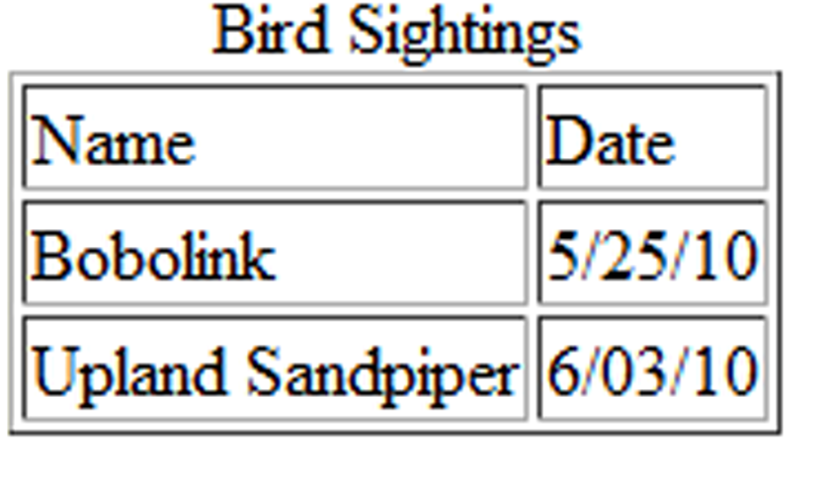
HTML Tables : Accessibility
Use table header elements (<th> tags) to indicate column or row headings.
Use the caption element to provide a text title or caption for the table.
Complex tables:
Associate table cell values with their corresponding headers
  <th> tag id attribute
  <td> tag headers attribute
Example
  <table border="1">
  <caption>Bird Sightings</caption>
  <tr>
  <th id="name">Name</th>
  <th id="date">Date</th>
  </tr>
  <tr>
  <td headers="name">Bobolink</td>
  <td headers="date">5/25/10</td>
  </tr>
  <tr>
  <td headers="name">Upland Sandpiper</td>
  <td headers="date">6/03/10</td>
  </tr>
  </table>

Slide 11
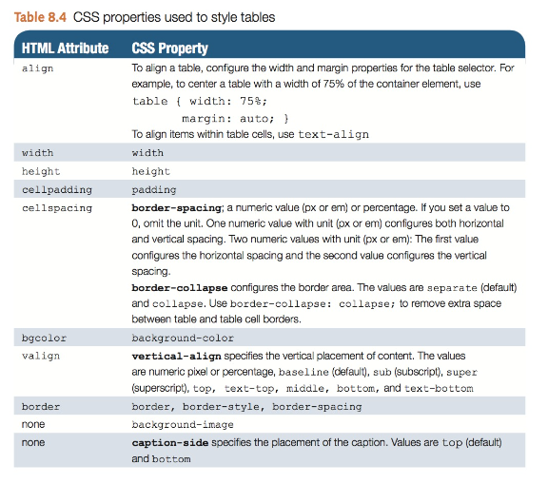
Using CSS to Style a Table

Slide 12
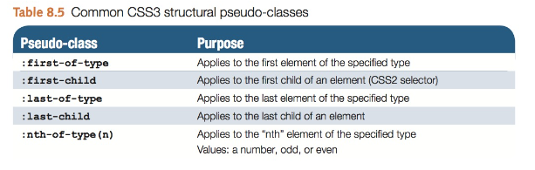
CSS Structural Pseudo-classes
The pseudo-class concept is introduced to permit selection based on information that lies outside of the document tree or that cannot be expressed using the other simple selectors.
A pseudo-class always consists of a "colon" (:) followed by the name of the pseudo-class and optionally by a value between parentheses.
Examples:
Zebra Stripe a Table
tr:nth-of-type(even) { background-color: #eaeaea; }
Configure the first item in an unordered list to display with red text.
li:first-of-type { color: #FF0000; }

Slide 13
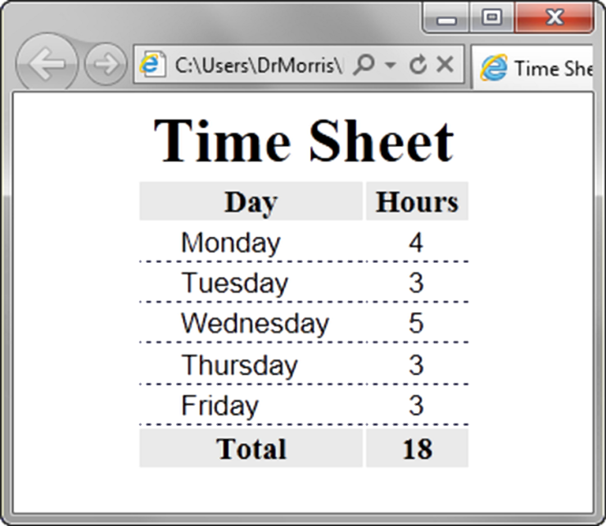
HTML Tables : Row Groups
<table> <caption>Time Sheet</caption>
<thead>
<tr>
<th id="day">Day</th>
<th id="hours">Hours</th>
</tr>
</thead>
<tbody>
<tr>
<td headers="day">Monday</td>
<td headers="hours">4</td>
</tr>
…
<tr>
<td headers="day">Friday</td>
<td headers="hours">3</td>
</tr>
</tbody>
<tfoot>
<tr>
<td headers="day">Total</td>
<td headers="hours">18</td>
</tr>
</tfoot> </table>
<thead> table head rows
<tbody > table body rows
<tfoot> table footer rows

Slide 14
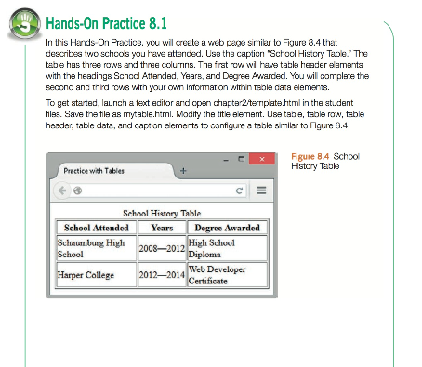
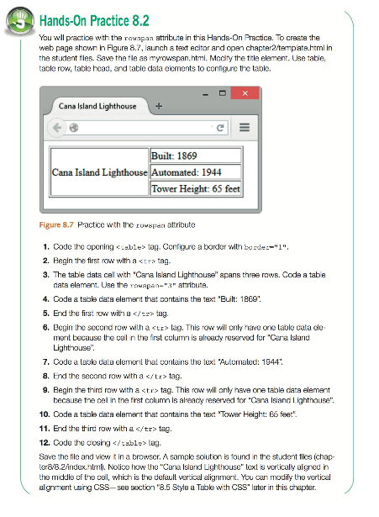
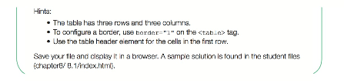
HTML Tables Hands-On Practice 8.1 & 8.2
Download Chapter 8 Student Files and save and UnZip to your practice folder

Slide 15
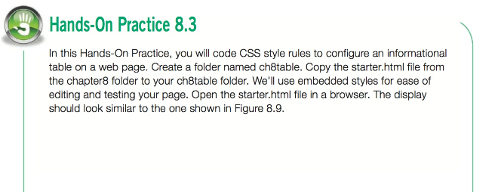
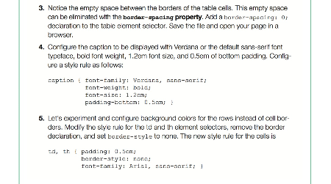
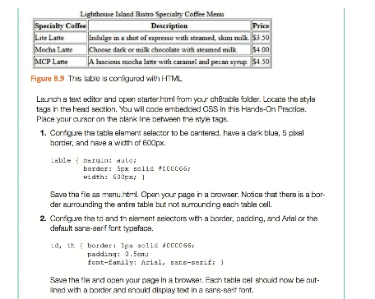
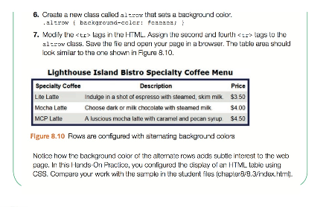
HTML Tables Hands-On Practice 8.3

Slide 16
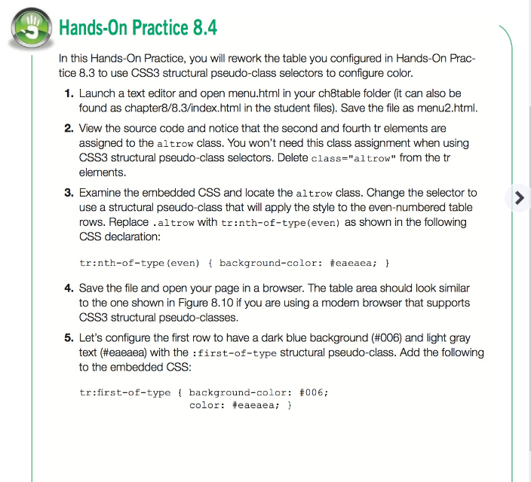
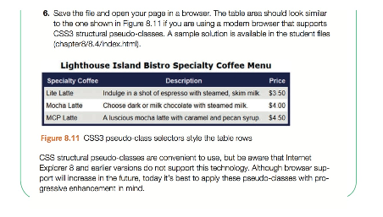
HTML Tables Hands-On Practice 8.4

Slide 17
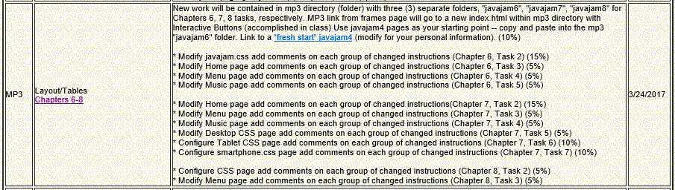
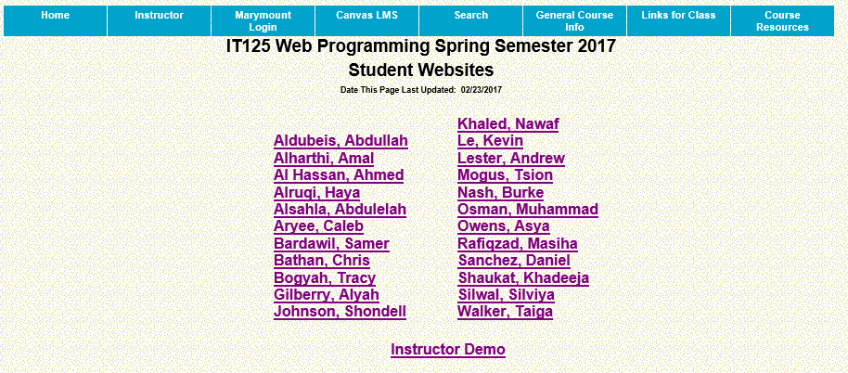
Mini-Project 3

Slide 18
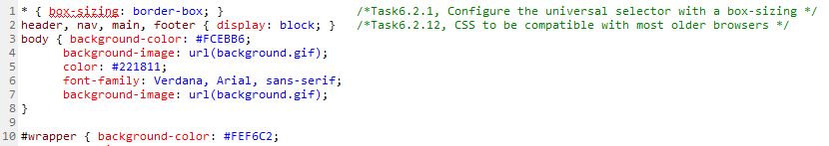
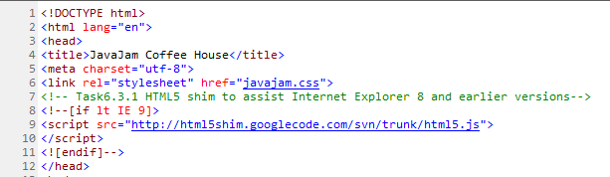
Mini-Project 3 Commenting Code
CSS
HTML Pages

Slide 19
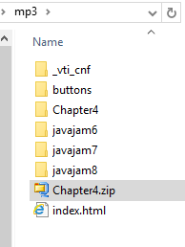
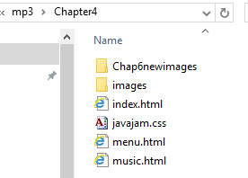
Mini-Project 3 Site Setup

Slide 20
Mini-Project 3 Cross-Walk with Hands-On Practice
MP 3 Requirement (Case Study Chapter/Task Reference) Weight | Hands-On (H-0) Ex & Pg Ref
New work will be contained in mp3 directory (folder) with three (3) separate folders, "javajam6", "javajam7", "javajam8" for Chapters 6, 7, 8 tasks, respectively. MP3 link from frames page will go to a new index.html within mp3 directory with Interactive Buttons (accomplished in class) Use javajam4 pages as your starting point -- copy and paste into the mp3 "javajam6" folder. Link to a “fresh start” javajam4 (modify for your personal information). (10%) | Set up in WebEx class
*Task 2 Modify javajam.css -- add comments on each group of changed instructions, e.g., /*Task 6.2.1 Configure universal selector for CSS box sizing*/ (Chap 6, Task 2) (15%) | In-class exercise with H-O 6.3, Paragraph 6.5, pg 258
*Task 3 Modify Home page -- add comments on changed instructions (Chap 6, Task 3) (5%) | Para 6.15, pg 285, Para 6.7, pg 263
*Task 4 Modify Menu page -- add comments on changed instructions (Chap 6, Task 4) (5%) | Paragraph 6.6, pg 261
* Task 5 Modify Music page -- add comments on changed instructions (Chap 6, Task 5) (5%) | Paragraph 6.6, pg 261
* Task 2 Modify Home page -- add comments on changed instructions (Chap 7, Task 2) (15%) | In-class exercise with H-O 7.5,
* Task 3 Modify Menu page -- add comments on changed instructions (Chap 7, Task 3) (5%) | Paragraph 7.5, pg 330
* Task 4 Modify Music page -- add comments on changed instructions (Chap 7, Task 4) (5%) | Paragraph 7.5, pg 330
* Task 5 Modify Desktop CSS -- add comments on changed instructions (Chap7, Task 5) (5%) | Paragraph 7.5, pg 330
* Task 6 Configure Tablet CSS -- add comments on changed instructions (Chap 7, Task 6) (10%) | H-O 7.7 Pg 334
* Task 7 Configure Smartphone CSS-- add comments on changed instructions (Chap 7, Task 7) (10%) | H-O 7.7 Pg 334
* Task 2 Configure CSS -- add comments on changed instructions (Chap 8, Task 2) (5%) | In-class exercise with H-O 8.3 , Paragraph 8.5 , pg 380
* Task 3 Modify Menu page -- add comments on changed instructions (Chap8, Task 3) (5%) | Paragraph 8.2, pg 374

Slide 21
JavaJam Case Study MP3 Chapter 6 (2-column layout)
In this case study, you will implement a new two- column CSS page layout for JavaJam. Figure 6.49 shows a wireframe for a two-column page layout with wrapper, header, navigation, main content, hero image, and footer areas.
Preparation(in-class):
Download “freshstart”, UnZip, and place in javajam6 folder.
File includes new Chap6 images -- place in images folder.
Task 2 Modify javajam.css : Configure the CSS. Open javajam.css in a text editor. Edit the style rules as follows:
Configure the universal selector with a box-sizing: border-box style declaration.
* { box-sizing: border-box; }
2. Configure id selectors for the hero image on each page.
a. Configure an id selector named heroroad. Set the background image to heroroad.jpg. Configure 100% background-size and height of 250 pixels.
b. Configure an id selector named heromugs. Set the background image to heromugs.jpg. Configure 100% background-size and height of 250 pixels.
c. Configure an id selector named heroguitar. Set the background image to heroguitar.jpg. Configure 100% background-size and height of 250 pixels.
3. Edit the style rules for the main selector so that the hero image will fill the entire area. Change left padding to 0. Change right padding to 0. Also configure a 200px left margin, 0 top padding, and #FEF6C2 background color.
4. Since the main content area no longer has any left or right padding, configure descendant selectors to configure style rules for the following elements within the main element: h2, h3, h4, p, div, ul, dl. Set left padding to 3em and right padding to 2em.
#heroroad { background-image: url(heroroad.jpg);
background-size: 100% 100%;
height: 250px; }
#heromugs { background-image: url(heromugs.jpg);
background-size: 100% 100%;
height: 250px; }
#heroguitar { background-image: url(heroguitar.jpg);
background-size: 100% 100%;
height: 250px; }
main { padding: 0 0 2em 0;
margin-left: 200px;
background-color: #FEF6C2;
}
main h2, main h3, main h4, main p, main div, main ul, main dl { padding-left: 3em; padding-right: 2em; }

Slide 22
JavaJam Case Study MP3 Chapter 6 (2-column layout)
5. Configure the left-column navigation area. Add style declarations to the nav element selector to configure an area that floats to the left and is 200 pixels wide.
6. Configure the :link, :visited, and :hover pseudo-classes for the navigation hyper-links. Use the following text colors: #FEF6C2 (unvisited hyperlinks), #D2B48C (visited hyperlinks), and #CC9933 (hyperlinks with :hover). For example, nav a:link { color: #FEF6C2; }
7. You will organize the navigation hyperlinks within an unordered list in later tasks. The navigation area in Figure 6.50 does not show list markers. Code a nav ul descendant selector to configure unordered lists in the navigation area to display without list mark- ers and with 0 left padding.
8. Modify the wrapper id. Configure a dark background color (#231814) which will display behind the column with the navigation area.
9. Modify the h4 element selector style rules. View the Music page shown in Figure 6.52 and notice that the <h4> tags are styled differently, with all uppercase text (use text-transform), a bottom border, and 0 bottom padding. Also configure a style declaration to clear floats on the left.
10. Refer to the Music page shown in Figure 6.52 and notice how the images float on the left side of the paragraph description. Configure a new class named floatleft that floats to the left with 20 pixels of right and bottom padding.
11. Modify the style rules for the details class and add the overflow: auto; style declaration.
12. Add the following CSS to be compatible with most older browsers: header, nav, main, footer { display: block; }
Save the javajam.css file.
nav { text-align: center;
font-weight: bold;
font-size: 1.5em;
padding-top: 10px;
float: left;
width: 200px;
nav a { text-decoration: none; }
nav a:link { color: #FEF6C2; }
nav a:visited{ color: #D2B48C; }
nav a:hover { color: #CC9933; }
nav ul { list-style-type: none;
padding-left: 0;
}
#wrapper { background-color: #231814;
h4 { background-color: #d2B48C;
font-size: 1.2em;
padding-left: 10px;
padding-bottom: 0;
text-transform: uppercase;
border-bottom: 1px solid #000033;
clear: left;
}
.floatleft { float: left;
padding-right: 20px;
padding-bottom: 20px;
}
.details { padding-left: 20%;
padding-right: 20%;
overflow: auto;
}

Slide 23
JavaJam Case Study MP3 Chapter 6 (2-column layout)
Task 3 Modify Home page : Open index.html in a text editor.
Edit the code as follows:
1. Add the following HTML5 shim code in the head section of the web page after the link element (to assist Internet Explorer 8 and earlier versions):
<!--[if lt IE 9]> <script src="http://html5shim.googlecode.com/svn/trunk/html5.js"> </script> <![endif]-->
2. Configure the left-column navigation area, which is contained within the nav element. Remove any &nbsp; characters that may be present. Code an unordered list to organize the navigation hyperlinks. Each hyperlink should be contained within <li> tags.
<ul>
<li><a href="index.html">Home</a></li>
<li><a href="menu.html">Menu</a></li>
<li><a href="music.html">Music</a></li>
<li><a href="jobs.html">Jobs</a></li>
</ul>
3. Remove the img tag for the windingroad.jpg image. Configure a div element assigned to the heroroad id between the opening main tag and the opening h2 tag. There will be no HTML content in this div, which is a container for a background image you configured with CSS in Task 2.
<div id="heroroad"></div>
Save the index.html file. It should look similar to the web page shown in Figure 6.50. Remember that validating your HTML and CSS can help you find syntax errors. Test and correct this page before you continue.

Slide 24
JavaJam Case Study MP3 Chapter 6 (2-column layout)
Task 4 Modify Menu page : Open menu.html in a text editor. Configure the left-column navigation area, navigation hyperlinks, and HTML5 shim in the same manner as the home page. Remove the img tag for the mugs.jpg image. Configure a div element assigned to the heromugs id between the opening main tag and the opening h2 tag.
Replace: <img src="mugs.jpg" alt="mugs on a wall" align="right" width="400" height="300">
With: <div id="heromugs"></div>
Save your new menu.html page and test it in a browser. It should look similar to the web page shown in Figure 6.51. Use the CSS and HTML validators to help you find syntax errors.
Task 5 Modify Music page : Open music.html in a text editor. Configure the left-column navigation area, navigation hyperlinks, and HTML5 shim in the same manner as the home page. Configure a div element assigned to the heroguitar id between the opening main tag and the opening h2 tag.
Configure the thumbnail images to float to the left. Add class="floatleft" to the image tag for each thumbnail image.
<div id="heroguitar"></div>
Replace: <a href="images/melanie.jpg"><img src="images/melaniethumb.jpg" alt="Melanie Morris" width="80" height="80"></a>
With: <a href=" images/melanie.jpg"><img src=" images/melaniethumb.jpg" class="floatleft" alt="Melanie Morris" width="80" height="80"></a> Also do for “Greg” images.
Save your new music.html page and test it in a browser. It should look similar to the web page shown in Figure 6.52. Use the CSS and HTML validators to help you find syntax errors.

Slide 25
JavaJam Case Study MP3 Chapter 7 (3-column layout)
See Chapter 2 for an introduction to the JavaJam Coffee House case study. Figure 2.30 shows a site map for the JavaJam website. In this case study, you will configure the website to display in mobile devices using the single-column layout shown in Figure 7.17. You will code media queries for mobile styles; modify the current desktop styles; and update the Home, Menu, and Music pages. Use the Chapter 6 JavaJam website as a starting point for this case study. When you are finished, the website will look the same in desktop browsers (see Figure 6.50). The mobile display should be similar to Figure 7.37 or 7.38.
Task 2: Modify the Home Page. Open index.html in a text editor. Edit the code as follows:
1. Configure a viewport meta tag that configures the width to the device-width and sets the initial-scale to 1.0.
<meta name="viewport" content="width=device-width, initial-scale=1.0">
2. The home page displays a phone number in the contact information area. Wouldn’t it be handy if a person using a smartphone could click on the phone number to call the coffee house? You can make that happen by using tel: in a hyperlink. Configure a hyperlink assigned to an id named mobile that contains the phone number as shown below.
A telephone link could confuse those visiting the site with a desktop browser. Code another phone number directly after the hyperlink.
Code a span element assigned to an id named desktop around the phone number as shown below:
<a id="mobile" href="tel:888-555-5555">888-555-5555</a> <span id="desktop">888-555-5555</span><br><br>
Don’t worry about the two phone numbers that are now on the page. You’ll configure CSS in Tasks 5 and 7 to show the appropriate phone number (with or without the telephone link) to your website visitors.
Task 3: Modify the Menu Page. Open menu.html in a text editor. Add the viewport meta tag in a manner consistent with the home page. Save and test your new menu.html page in a browser. Use the HTML validator to help you find syntax errors.
<meta name="viewport" content="width=device-width, initial-scale=1.0">
Task 4: Modify the Music Page. Open music.html in a text editor. Add the viewport meta tag in a manner consistent with the home page. Save and test your new music.html page in a browser. Use the HTML validator to help you find syntax errors.
<meta name="viewport" content="width=device-width, initial-scale=1.0">
Task 5: Modify the Desktop CSS. Open javajam.css in a text editor. Remember the telephone number hyperlink you created in Task 2? Configure the CSS for the phone number display as shown below:
#mobile { display: none; }
#desktop { display: inline; }
Save the javajam.css file. Use the CSS validator to help you find syntax errors.

Slide 26
JavaJam Case Study MP3 Chapter 7 (3-column layout)(Cont’d)
@media only screen and (max-width: 1024px) {
body { background-image: none; }
#wrapper { width: auto;
min-width: 0;
margin: 0;
padding: 0;
box-shadow: none; }
header { border-bottom: 5px solid #FEF6C2; }
h1 { margin-top: 0;
margin-bottom: 1em;
padding-top: 1em;
padding-bottom: 1em;
font-size: 2.5em; }
nav { float: none;
width: auto;
padding-top: 0;
margin: 10px;
font-size: 1.3em; }
nav li { display: inline-block; }
nav a { padding: 1em;
width: 8em;
font-weight: bold;
border-style: none; }
nav ul { padding: 0;
margin: 0; }
#heroroad, #heromugs, #heroguitar { margin: 0; padding: 0; }
main { padding: 0;
margin: 0;
font-size: 90%; }
}
Task 6: Configure the Tablet CSS. Open javajam.css in a text editor. Edit the style rules as follows:
1. Code a media query to select for typical tablet device viewport size, such as @media only screen and (max-width: 1024px) {
}
2. Code the following new styles within the media query:
a. Configure a body element selector with margin set to 0. Set the background-image property to none.
b. Configure a wrapper id selector. Set the width to auto, min-width to 0, margin to 0, padding to 0, and box-shadow to none.
c. Configure the header element selector. Configure a 5px solid #FEF6C2 bottom border.
d. Configure the h1 element selector. Set top margin to 0, bottom margin to 1em, top padding to 1em, bottom padding to 1em, and 2.5em font size.
e. Configure the nav element selector. The mobile layout uses a single column. Set the float to none, auto width, 0 top padding, 10px margin, and 1.3em font size.
f. Configure the nav li selector. Set display to inline-block.
g. Configure the nav a selector. Set padding to 1em, width to 8em, font weight to bold, and border-style to none.
h. Configure the nav ul selector with 0 padding and margin.
i. Configure the #heroroad, #heromugs, and #heroguitar selectors. Configure 0 margin and 0 padding.
j. Configure the main element selector. Set padding to 0, margin to 0, and font size to 90%.
Save the javajam.css file. Use the CSS validator to help you find syntax errors.

Slide 27
JavaJam Case Study MP3 Chapter 7 (3-column layout)(Cont’d)
Task 7: Configure the Smartphone CSS. Open javajam.css in a text editor. Note that any device with a screen max-width of 1024 pixels or less will apply the styles you coded in Task 6. In this task you will code additional styles needed for smaller devices. Edit the style rules as follows:
1. Code a media query to select for typical smartphone device viewport size, such as @media only screen and (max-width: 768px) {
}
2. Code the following new styles within the media query:
a. Configure the header element selector to display an image designed for small mobile devices. Set the background image to javajammini.jpg. Set the height to 128px.
b. Configure the h1 element selector. Set 2em font size, centered text, and 0 left padding.
c. Configure the nav element selector. Set the margin to 0.
d. Configure the anchor tags in the navigation area. Code a style rule for the nav a selector. Set the display to block, padding to 0.2em, and width to auto. Also con- figure a 1 pixel bottom border (use #FEF6C2 for the border color).
e. Configure the nav li selector. Set the display to block.
f. Configure the main element selector. Set top padding to 1px.
g. Configure the h2 element selector. Set 0.5em top padding, 0 right padding, 0 bottom padding, and 0.5em left padding. Set the right margin to 0.5em.
h. Configure the details class selector. Set left and right padding to 0.
i. Configure the #heroroad, #heromugs, and #heroguitar selectors. Set the background image to none. Set the height to auto.
j. Configure the floatleft class selector. Set left and right padding to 0.5em.
k. Remember the telephone number hyperlink you created in Task 2? Configure the CSS for the phone number display as shown below:
#mobile { display: inline; } #desktop { display: none; }
@media only screen and (max-width: 768px) {
header { background-image: url(javajammini.jpg);
height: 128px; }
h1 { font-size: 2em;
text-align: center;
padding-left: 0; }
nav { margin: 0; }
nav a { display: block;
padding: 0.2em;
width: auto;
border-bottom: 1px solid #FEF6C2; }
nav li { display: block; }
main { padding-top: 1px; }
h2 { padding: 0.5em 0 0 0.5em;
margin-right: 0.5em; }
.details { padding-left: 0; padding-right: 0; }
#heroroad, #heromugs, #heroguitar { background-image: none; height: auto; }
.floatleft { padding-left: 0.5em; padding-right: 0.5em; }
#mobile { display: inline; }
#desktop { display: none; }
}

Slide 28
JavaJam Case Study MP3 Chapter 8 (Tables)
See Chapter 2 for an introduction to the JavaJam Coffee House case study. Figure 2.30 shows a site map for JavaJam. Use either the Chapter 7 or Chapter 6 JavaJam website as a starting point for this case study. In this case study, you will modify the Menu page.
Task 2: Configure the CSS. Modify the external style sheet (javajam.css). Open javajam.css in a text editor. Review Figure 8.13 and note the menu descriptions, which are coded in an HTML table. Add style rules to the javajam.css external style sheet to configure a table that is centered, takes up 90% the width of its container, is configured with 0 border-spacing, has a #FFFFCC background color, has td and th selectors with 10 pixels of padding, and displays a background color of #D2B48C in alternate rows (use a class or the :nth-of-type pseudo-class to configure odd table rows).
Save the javajam.css file.
Task 3: Modify the Menu Page. Open menu.html in a text editor. The menu descriptions are configured with a description list. Replace the description list with a table that has three rows and two columns. Use th and td elements where appropriate. Configure line breaks as needed for the pricing information.
Save your page and test it in a browser. If the page does not display as you intended, review your work, validate the CSS, validate the HTML, modify as needed, and test again.
table { width: 90%;
margin: auto;
border-spacing: 0;
background-color: #FFFFCC; }
td, th { padding: 10px; }
tr:nth-of-type(odd) { background-color: #D2B48C; }
<table>
<tr>
<th>Just Java</th>
<td>Regular house blend, decaffeinated coffee, or flavor of the day.<br>Endless Cup $2.00</td>
</tr>
<tr>
<th>Cafe au Lait</th>
<td>House blended coffee infused into a smooth, steamed milk.<br>Single $2.00 Double $3.00</td>
</tr>
<tr>
<th>Iced Cappuccino</th>
<td>Sweetened espresso blended with icy-cold milk and served in a chilled glass.<br>Single $4.75 Double $5.75</td>
</tr>
</table>

