Slide 1

Advanced Web Development
IT125
Spring Term 2017
Marymount University
School of Business Administration
Professor Suydam
Week 4
Mini-Project (MP1), More CSS - Visual Elements & Graphic
& Quiz 1

Slide 2
Outline
Mini-Project (MP1) General Discussion/Comments
Expression Web Introduction and Frames Page Creation
Finish Chapter 3: Configuring Color and Text with CSS
Chapter 4 – More CSS - Visual Elements & Graphic
Quiz 1

Slide 3
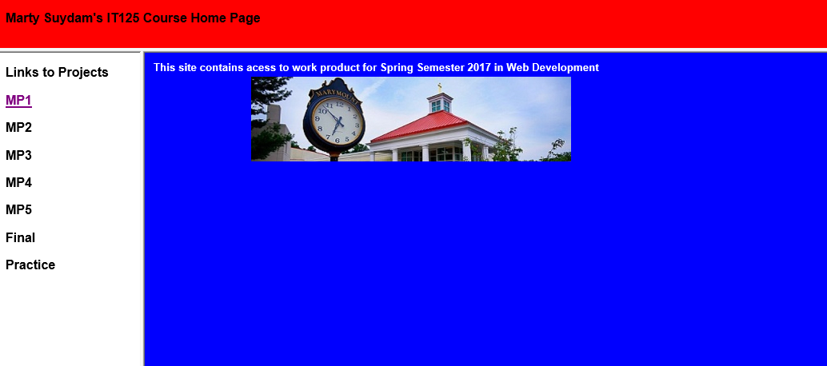
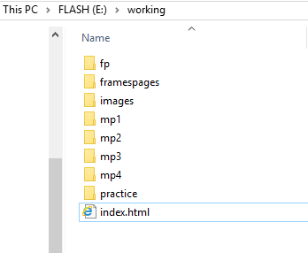
Expression Web – Student Home Page (Frames, Tables, Images, Hypertext Links)
Build a frames home page (colors, font, text – your choice)
Set Page Size 1024x768
File is named “index.html”; Create Table in main page (3 rows, 3 columns, 650px wide; Download MU Image into an images folder and Insert in main page; Resize image to eliminate scroll-right.

Slide 4
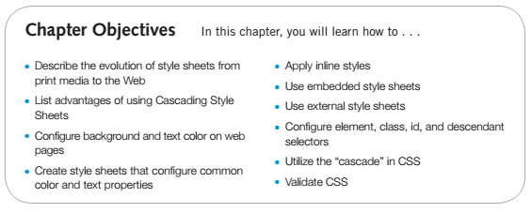
Chapter 3 Learning Outcomes

Slide 5
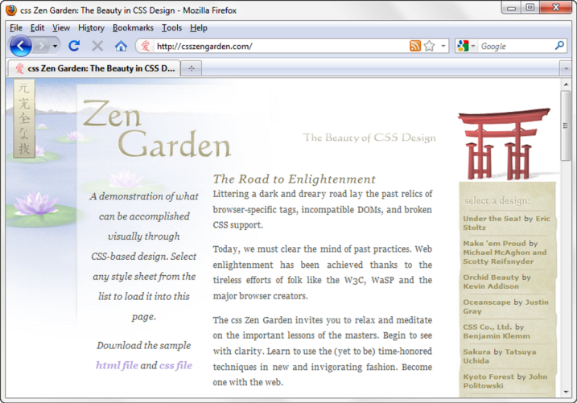
Overview of Cascading Style Sheets (CSS)
See what is possible with CSS:
  Visit http://www.csszengarden.com
Style Sheets
  used for years in Desktop Publishing
  apply typographical styles
  and spacing to printed media
CSS
  provides the functionality of style sheets (and much more) for web developers
  a flexible, cross-platform, standards-based language developed by the W3C.

Slide 6
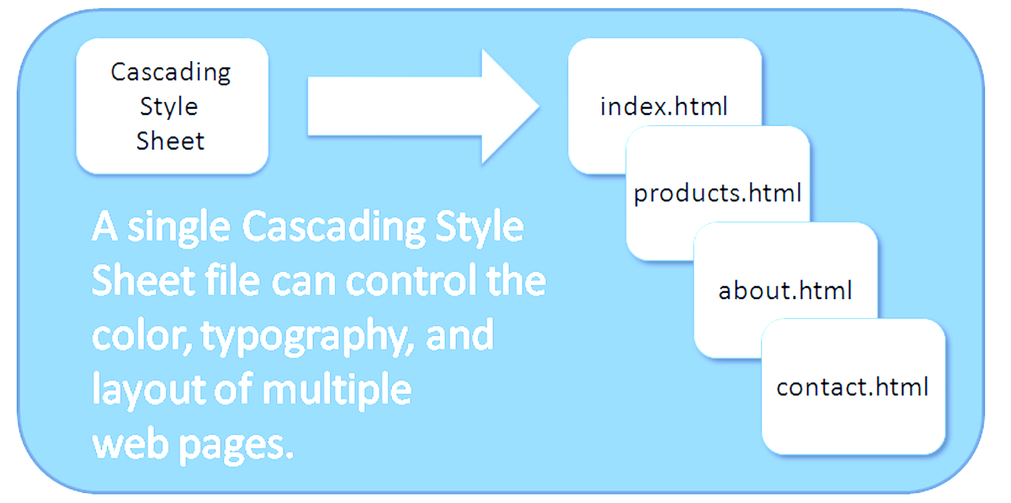
CSS Advantages
Greater typography and page layout control
Style is separate from structure
Styles can be stored in a separate document and associated with the web page
Potentially smaller documents
Easier site maintenance

Slide 7
Cascading Style Sheets
Inline Styles
  body section
  HTML style attribute
  apply only to the specific element
Embedded Styles
  head section
  HTML style element
  apply to the entire web page document
External Styles
  Separate text file with .css file extension
  Associate with a HTML link element in the head section of a web page
Imported Styles
  Similar to External Styles
  We’ll concentrate on the other three types of styles.

Slide 8
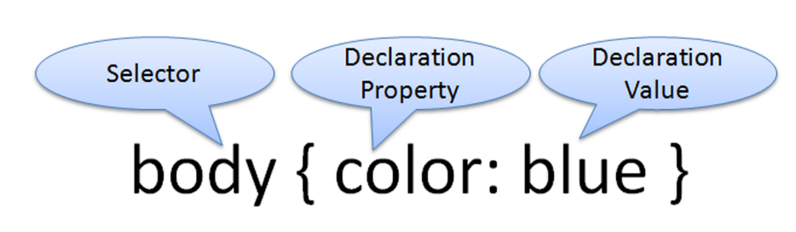


CSS Syntax
Style sheets are composed of "Rules" that describe the styling to be applied.
Each Rule contains a Selector and a Declaration
Example
  Configure a web page to display blue text and yellow background.
  body { color: blue;
  background-color: yellow; }
  This could also be written using hexadecimal color values as shown below.
  body { color: #0000FF;
  background-color: #FFFF00; }

Slide 9
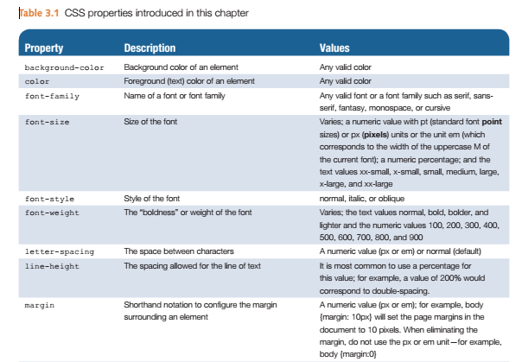
Common Formatting CSS Properties

Slide 10
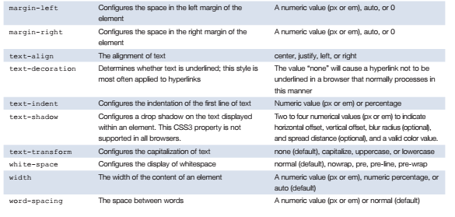
Common Formatting CSS Properties

Slide 11
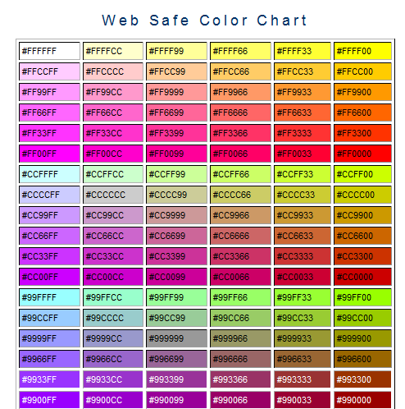
Using Color on Web Pages
Computer displays render color as intensities of red, green, and blue light
RGB Color
The values of red, green, and blue vary from 0 to 255.
Hexadecimal numbers (base 16) represent these color values.
Web Safe Color Palette
  A collection of 216 colors
  Display the most similar on the Mac and PC
  Hex values: 00, 33, 66, 99, CC, FF
  Color Chart http://webdevfoundations.net/color
How to choose a color scheme?
    Monochromatic http://meyerweb.com/eric/tools/color-blend
    Choose from a photograph or other image http://www.colr.org
    Begin with a favorite color http://colorsontheweb.com/colorwizard.asp
# indicates a hexadecimal value
Hex value pairs range from 00 to FF
Three hex value pairs describe an RGB color
  #000000 black #FFFFFF white
  #FF0000 red #00FF00 green
  #0000FF blue #CCCCCC grey

Slide 12
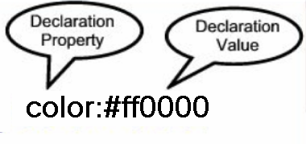

Configuring Color with Inline CSS
Inline CSS
  Configured in the body of the web page
  Use the style attribute of an HTML tag
  Apply only to the specific element
The Style Attribute
  Value: one or more style declaration property and value pairs
Example: configure red color text in an <h1> element:
<h1 style="color:#ff0000">Heading text is red</h1>
Example: configure the red text in the heading
configure a gray background in the heading
Separate style rule declarations with ;
<h1 style="color:#FF0000;background-color:#cccccc">This is displayed as a red heading with gray background</h1>

Slide 13
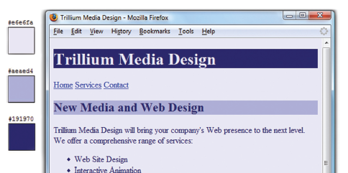
CSS Embedded Styles
Internal Styles
  Configured in the head section of a web page.
  Use the HTML <style> element
  Apply to the entire web page document
  Style declarations are contained between the opening and closing <style> tags
  Example: Configure a web page with white text on a black background
The body selector sets the global style rules for the entire page.
These global rules are overridden for <h1> and <h2> elements by the h1 and h2 style rules.
<style>
body { background-color: #000000;
color: #FFFFFF;
}
</style>
<style>
body { background-color: #E6E6FA;
color: #191970;}
h1 { background-color: #191970;
color: #E6E6FA;}
h2 { background-color: #AEAED4;
color: #191970;}
</style>

Slide 14
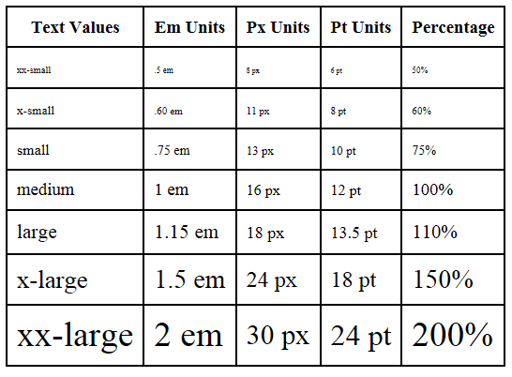
CSS Embedded Styles: Configuring Text
CSS properties for configuring text:
  font-weight - Configures the boldness of text
  font-style- Configures text to an italic style
  font-size - Configures the size of the text
  font-family - Configures the font typeface of the text
Accessibility Accommodation - Use em or percentage font sizes – these can be easily enlarged in all browsers by users

Slide 15
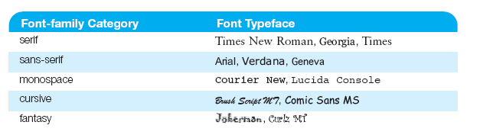
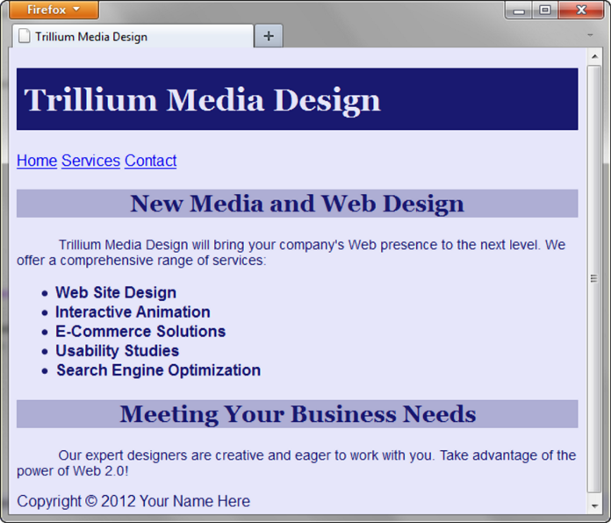
CSS Embedded Styles: The font-family Property
Not everyone has the same fonts installed in their computer
Configure a list of fonts and include a generic family name
p { font-family: Arial, Verdana, sans-serif; }
<style>
body { background-color: #E6E6FA;
color: #191970;
font-family: Arial, Verdana, sans-serif; }
h1 { background-color: #191970;
color: #E6E6FA;
line-height: 200%;
font-family: Georgia, "Times New Roman", serif; }
h2 { background-color: #AEAED4;
color: #191970; text-align: center;
font-family: Georgia, "Times New Roman", serif; }
p {font-size: .90em; text-indent: 3em; }
ul {font-weight: bold; }
</style>

Slide 16
CSS Embedded Styles: More CSS Text Properties
  line-height - Configures the height of the line of text (use the value 200% to appear double-spaced)
  text-align - Configures alignment of text within a block display element
  text-indent - Configures the indentation of the first line of text
  text-decoration - Modifies the appearance of text with an underline, overline, or line-through
  text-transform - Configures the capitalization of text
  letter-spacing - Configures space between text characters
  word-spacing - Configures space between words
  text-shadow - Configures a drop shadow on text

Slide 17

CSS Selectors
CSS style rules can be configured for an:
  HTML element selector
  class selector
    Apply a CSS rule to a certain "class" of elements on a web page
    Does not associate the style to a specific HTML element
    Configure with .classname -- code CSS to create a class called “new” with red italic text.
    Apply the class: <p class=“new”>This is text that is red and in italics</p>
  id selector
    id Selector -- Apply a CSS rule to ONE element on a web page.
    Configure with #idname -- Code CSS to create an id called “new” with red, large, italic text.
    Apply the id: <p id=“new”>This is text is red, large, and in italics</p>
  descendant selector
    Specify an element within the context of its container (parent) element.
    AKA contextual selector
    The example configures a green text color only for p tags located within an element assigned to the id named content
    Advantage of contextual selectors -- Reduces the number of classes and ids you need to apply in the HTML
<style>
.new { color: #FF0000;
font-style: italic;
}
</style>
<style>
#new { color: #FF0000;
font-size:2em;
font-style: italic;
}
</style>
<style>
#content p { color: #00ff00; }
</style>

Slide 18
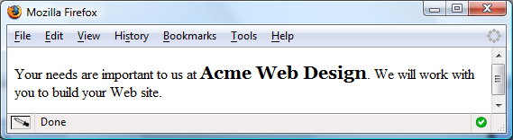
span element
Purpose: configure a specially formatted area displayed in-line with other elements, such as within a paragraph.
There is no additional empty space above or below a span – it is inline display.
HTML: <p>Your needs are important to us at <span class=“companyname">Acme Web Design</span>.
We will work with you to build your Web site.</p>
Embedded CSS Example:
<style>
.companyname { font-weight: bold;
font-family: Georgia, "Times New Roman", serif;
font-size: 1.25em; }
</style>

Slide 19
External Style Sheets
CSS style rules are contained in a text file separate from the HTML documents.
The External Style Sheet text file:
  extension ".css"
  contains only style rules
  does not contain any HTML tags
Multiple web pages can associate with the same external style sheet file.
site.css
index.html
body {background-color:#E6E6FA;
color:#000000;
font-family: Arial, sans-serif;
font-size:90%; }
h2 { color: #003366; }
nav { font-size: 16px;
font-weight: bold; }
clients.html
about.html
etc…

Slide 20
link Element
A self-contained tag
Placed in the head section
Purpose: associates the external style sheet file with the web page.
Example:
External Style Sheet color.css
To associate the external style sheet called color.css, the HTML code placed in the head section is:
<link rel="stylesheet" href="color.css">
body { background-color: #0000FF;
color: #FFFFFF;
}
<link rel="stylesheet" href="color.css">

Slide 21
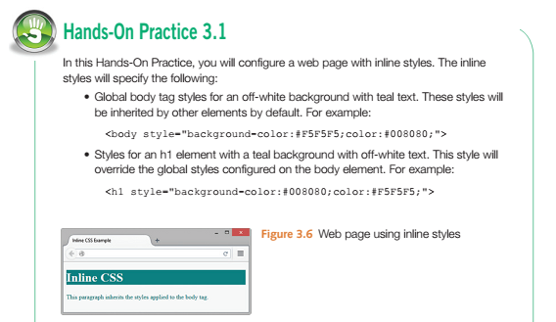
Hands On Practice – 3.1 Inline CSS with Style Attribute
template.html
Copy/paste template.html into a text file
Copy/paste beginning <body> tag
Save as inline.html in same “practice” folder from last class
<!DOCTYPE html>
<html lang="en">
<head>
<title>Page Title Goes Here</title>
<meta charset="utf-8">
</head>
<body>
</body>
</html>
<body style="background-color:#F5F5F5;color:#008080;">
<h1 style="background-color:#008080;color:#F5F5F5;">Inline CSS</h1>
<p>This paragraph inherits the styles applied to the body tag.</p>

Slide 22
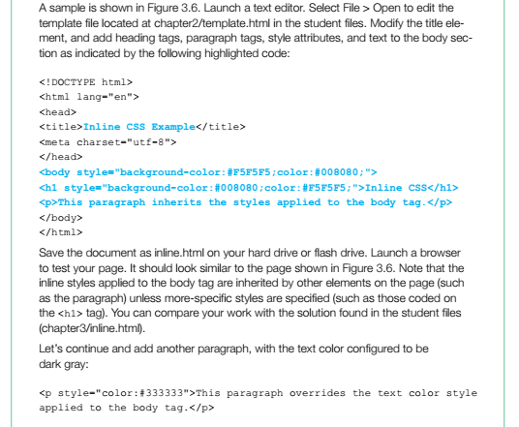
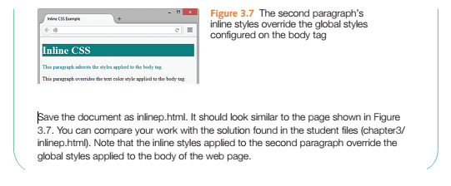
Hands On Practice – 3.1 Inline CSS with Style Attribute
Copy/paste after last <p> tag
Save as inlinep.html in “practice” folder
<p style="color:#333333">This paragraph overrides the text color style applied to the body tag.</p>

Slide 23
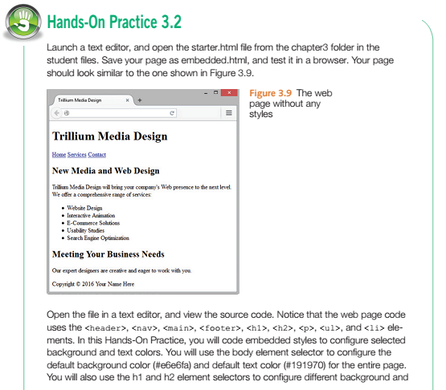
Hands On Practice – 3.2 Embedded CSS with Style Attribute
Create a “trillium” folder inside your practice folder

Slide 24
Hands On Practice – 3.2 Embedded CSS with Style Attribute
This is the starter.html file
Copy/paste in blank text page and save as starter.html in “practice” folder
<!DOCTYPE html>
<html lang="en">
<head>
<title>Trillium Media Design</title>
<meta charset="utf-8">
</head>
<body>
<header>
<h1>Trillium Media Design</h1>
</header>
<nav>
<a href="index.html">Home</a> <a href="services.html">Services</a> <a href="contact.html">Contact</a>
</nav>
<main>
<h2>New Media and Web Design</h2>
<p>Trillium Media Design will bring your company&#39;s Web presence to the next level.
We offer a comprehensive range of services:</p>
<ul>
<li>Website Design</li>
<li>Interactive Animation</li>
<li>E-Commerce Solutions</li>
<li>Usability Studies</li>
<li>Search Engine Optimization</li>
</ul>
<h2>Meeting Your Business Needs</h2>
<p>Our expert designers are creative and eager to work with you.</p>
</main>
<footer>Copyright &copy; 2016 Your Name Here</footer>
</body>
</html>

Slide 25
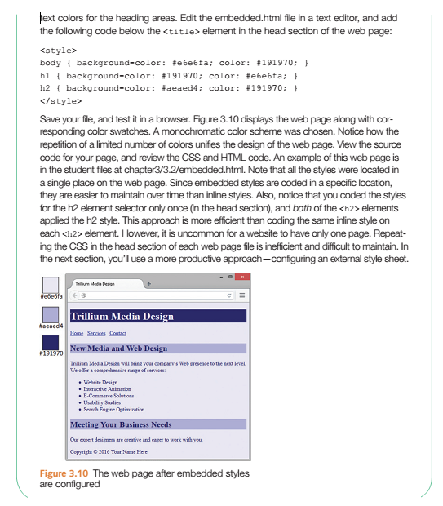
Hands On Practice – 3.2 Embedded CSS with Style Attribute
Copy/paste the following after the </title> tag in the head section and save as starter1.html
<style>
body {background-color: #e6e6fa; color: #191970;}
h1 {background-color: #191970; color: # e6e6fa;}
h2 {background-color: #aeaed4; color: #191970;}
</style>

Slide 26
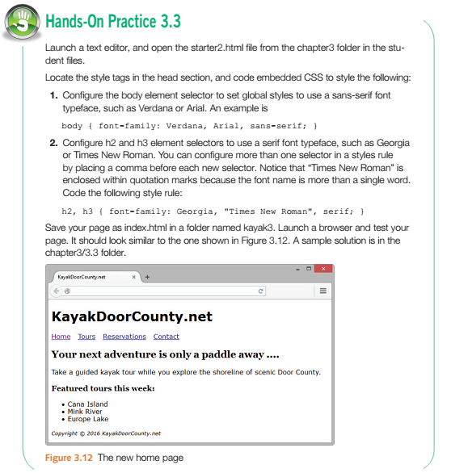
Hands On Practice – 3.3 Configuring Text with CSS

Slide 27
Hands On Practice – 3.3 Configuring Text with CSS
Copy/paste source code below in blank text page and save as index.html in a folder named “kayak”; view page in browser; then copy paste next source code and paste in between style tags; Replace last source code with the third set – each time save and open page to see the changes
Source code #1
Source code #2
<!doctype html>
<html lang="en">
<head>
<meta charset="utf-8">
<title>KayakDoorCounty.net</title>
<style>
</style>
</head>
<body>
<header>
<h1>KayakDoorCounty.net</h1>
</header>
<nav>
<a href="index.html">Home</a> &nbsp;
<a href="tours.html">Tours</a> &nbsp;
<a href="reservations.html">Reservations</a> &nbsp;
<a href="contact.html">Contact</a> &nbsp;
</nav>
<main>
<h2>Your next adventure is only a paddle away ....</h2>
<p>Take a guided kayak tour while you explore the shoreline of scenic Door County. </p>
<h3>Featured tours this week:</h3>
<ul>
<li>Cana Island</li>
<li>Mink River</li>
<li>Europe Lake</li>
</ul>
</main>
<footer>
<small><i>Copyright &copy; 2016 KayakDoorCounty.net</i></small>
</footer>
</body>
</html>
body {font-family: Arial, Verdana, sans-serif }
h1 {font-family: Georgia, "Times New Roman"}
h2 {font-family: Georgia, "Times New Roman", serif}
Source code #3
body { background-color: #e6e6fa;
color: #191970;
font-family: Arial, Verdana, sans-serif; }
h1 { background-color: #191970;
color: #e6e6fa;
line-height: 200%;
font-family: Georgia, "Times New Roman", serif;
text-indent: 1em;
text-shadow: 3px 3px 5px #CCCCCC; }
h2 { background-color: #aeaed4;
color: #191970;
font-family: Georgia, "Times New Roman", serif;
text-align: center; }
nav { font-weight: bold;
word-spacing: 1em;
font-size: 1.25em; }
nav a { text-decoration: none; }
p { font-size: .90em;
text-indent: 3em; }
ul { font-weight: bold; }
footer { color: #333333;
font-size: .75em;
font-style: italic; }
.feature { color: #C70000; }

Slide 28



Hands On Practice – 3.3 Configuring Text with CSS
Resulting pages showing style changes
Source code #1
Source code #2
Source code #3

Slide 29
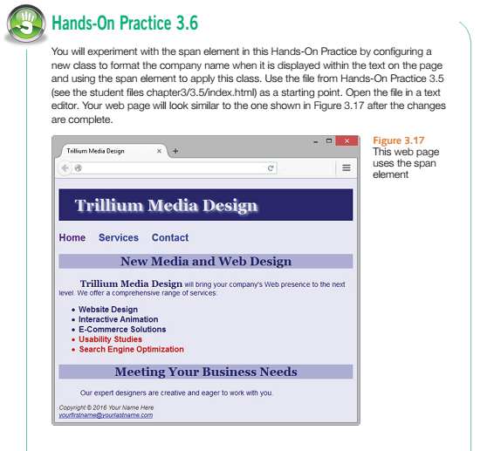
Hands On Practice – 3.6 span element with CSS
<!DOCTYPE html>
<html lang="en">
<head>
<title>Trillium Media Design</title>
<meta charset="utf-8">
<style>
</style>
</head>
<body>
<header>
<h1>Trillium Media Design</h1>
</header>
<nav>
<a href="index.html">Home</a> <a href="services.html">Services</a> <a href="contact.html">Contact</a>
</nav>
<main>
<h2>New Media and Web Design</h2>
<p>Trillium Media Design will bring your company&#39;s Web presence to the next level. We offer a comprehensive range of services:</p>
<ul>
<li>Website Design</li>
<li>Interactive Animation</li>
<li>E-Commerce Solutions</li>
<li class="feature">Usability Studies</li>
<li class="feature">Search Engine Optimization</li>
</ul>
<h2>Meeting Your Business Needs</h2>
<p>Our expert designers are creative and eager to work with you.</p>
</main>
<footer>Copyright &copy; 2016 Your Name Here<br>
<a href="mailto:yourfirstname@yourlastname.com">yourfirstname@yourlastname.com</a>
</footer>
</body>
</html>
Copy/paste and save as index.html in your trillium folder

Slide 30
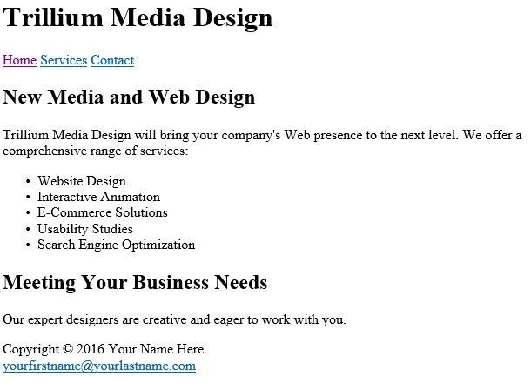
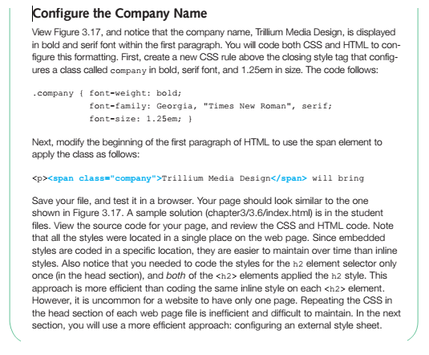


Hands On Practice – 3.6 span element with CSS
Replace Line 21 with the following:
<p><span class="company">Trillium Media Design</span> will bring your company&#39;s Web presence to the next level. We offer a comprehensive range of services:</p>
Then use Source Code #3 from Hands On Practice 3.3, Slide 31

Slide 31
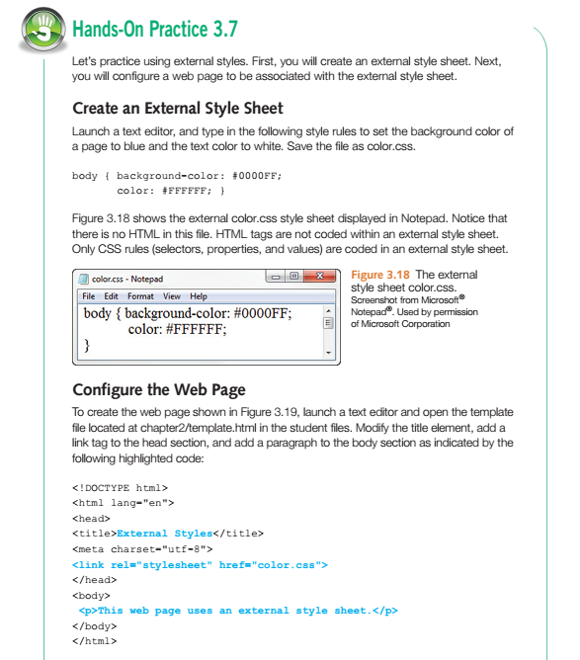
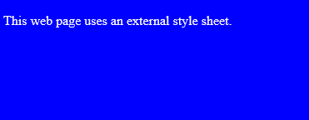
Hands On Practice – 3.7 External CSS
Copy/paste text below into text file and save as color.css in “practice” folder
body {background-color: #0000FF;
color: #FFFFFF;
}
Copy/paste text below into text file and save as external.html in “practice” folder
<!DOCTYPE html>
<html lang="en">
<head>
<title>External Styles</title>
<meta charset="utf-8">
<link rel="stylesheet" href="color.css">
</head>
<body>
<p>This web page uses an external style sheet.</p>
</body>
</html>

Slide 32
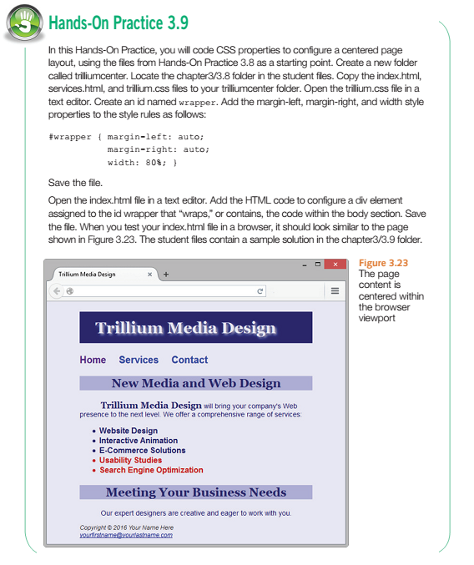
Hands On Practice – 3.9 Centering Page Content with CSS
Create a new folder in your “practice” folder named “trilliumcenter”
Copy/paste text on next page and save to the trilliumcenter folder
Copy/paste #wrapper into trillium.css
#wrapper {
width: 900px;
margin:0px auto; }
Create a div element after the body tag by inserting <div id="wrapper"> and closing the element before the closing body tag.

Slide 33
Hands On Practice – 3.9 Centering Page Content with CSS
index.html
service.html
trillium.css
<!DOCTYPE html>
<html lang="en">
<head>
<title>Trillium Media Design</title>
<meta charset="utf-8">
<link href="trillium.css" rel="stylesheet">
</head>
<body>
<header>
<h1>Trillium Media Design</h1>
</header>
<nav>
<a href="index.html">Home</a> <a href="services.html">Services</a> <a href="contact.html">Contact</a>
</nav>
<main>
<h2>New Media and Web Design</h2>
<p><span class="company">Trillium Media Design</span> will bring your company&#39;s Web presence to the next level. We offer a comprehensive range of services:</p>
<ul>
<li>Website Design</li>
<li>Interactive Animation</li>
<li>E-Commerce Solutions</li>
<li class="feature">Usability Studies</li>
<li class="feature">Search Engine Optimization</li>
</ul>
<h2>Meeting Your Business Needs</h2>
<p>Our expert designers are creative and eager to work with you.</p>
</main>
<footer>Copyright &copy; 2016 Your Name Here<br>
<a href="mailto:yourfirstname@yourlastname.com">yourfirstname@yourlastname.com</a>
</footer>
</body>
</html>
<!DOCTYPE html>
<html lang="en">
<head>
<title>Trillium Media Design Services</title>
<meta charset="utf-8">
<link href="trillium.css" rel="stylesheet">
</head>
<body>
<header>
<h1>Trillium Media Design</h1>
</header>
<nav><a href="index.html">Home</a> <a href="services.html">Services</a> <a href="contact.html">Contact</a></nav>
<main>
<h2>Our Services Meet Your Business Needs</h2>
<dl>
<dt><strong>Website Design</strong></dt>
<dd>Whether your needs are large or small, Trillium can get your company on the Web!</dd>
<dt><strong>Interactive Animation</strong></dt>
<dd>Multimedia training and marketing animations are our specialty.</dd>
<dt><strong>E-Commerce Solutions</strong></dt>
<dd>Trillium offers quick and easy entry into the e-commerce marketplace.</dd>
<dt><strong>Usability Studies</strong></dt>
<dd>Trillium can assess the usability of your current site and suggest improvements.</dd>
<dt><strong>Search Engine Optimization</strong></dt>
<dd>Most people find websites using search engines. Trillium can help you get your site noticed.</dd>
</dl>
</main>
<footer>Copyright &copy; 2016 Your Name Here</footer>
</body>
</html>
body { background-color: #e6e6fa;
color: #191970;
font-family: Arial, Verdana, sans-serif; }
h1 { background-color: #191970;
color: #e6e6fa;
line-height: 200%;
font-family: Georgia, "Times New Roman", serif;
text-indent: 1em;
text-shadow: 3px 3px 5px #CCCCCC; }
h2 { background-color: #aeaed4;
color: #191970;
font-family: Georgia, "Times New Roman", serif;
text-align: center; }
nav { font-weight: bold;
word-spacing: 1em;
font-size: 1.25em; }
nav a { text-decoration: none; }
p { font-size: .90em;
text-indent: 3em; }
ul { font-weight: bold; }
footer { color: #333333;
font-size: .75em;
font-style: italic; }
.feature { color: #C70000; }
.company { font-weight: bold;
font-family: Georgia, "Times New Roman", serif;
font-size: 1.25em; }

Slide 34
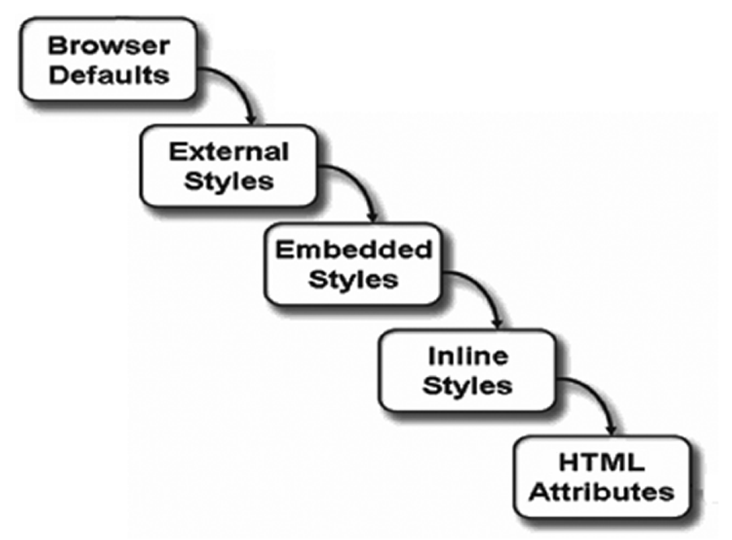
The “Cascade”
Rules of Precedence that applies the styles in order from outermost (external styles) to innermost (HTML attributes coded on the page). This set of rules allows the site-wide styles to be configured, but overridden when needed by more granular page-specific styles (such as embedded or inline styles).

Slide 35
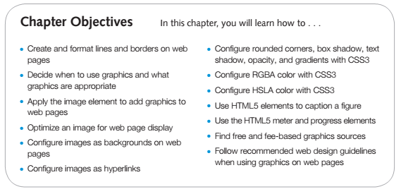
Chapter 4 Learning Outcomes

Slide 36
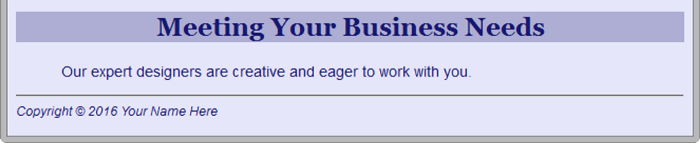
Horizontal Rule Element
Configures a horizontal line
  <hr>

Slide 37


CSS Borders
Border Property
  Configures a border on the top, right, bottom, and left sides of an element
  Consists of
    border-width
    border-style
    border-color
  h2 { border: 2px solid #ff0000 }
Configuring Specific Sides of a Border -- Use CSS to configure a line on one or more sides of an element
    border-bottom
    border-left
    border-right
    border-top
  h2 { border-bottom: 2px solid #ff0000 }
  h2 { border: 2px solid #ff0000; }
  a { border: 2px solid #ff0000; }

Slide 38

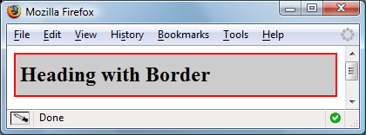
Configure Padding on Specific Sides of an Element
CSS padding Property - Configures empty space between the content of the HTML element and the border
Set to 0px by default
h2 { border: 2px solid #ff0000; padding: 5px; }
No padding property configured:
Use CSS to configure padding on one or more sides of an element
  padding-bottom
  padding-left
  padding-right
  padding-top
h2 { border: 2px solid #ff0000;
background-color: #cccccc;
padding-left: 5px;
padding-bottom: 10px;
padding-top: 10px; }

Slide 39
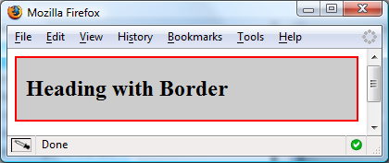
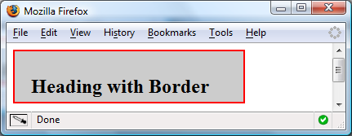
CSS padding Property Shorthand
Two numeric values or percentages
    first value configures top and bottom padding
    the second value configures left and right padding
Four numeric values or percentages
  Configure top, right, bottom, and left padding
    h2 { border: 2px solid #ff0000;
    background-color: #cccccc;
    padding: 20px 10px;
    }
    h2 { border: 2px solid #ff0000;
    width: 250px;
    background-color: #cccccc;
    padding: 30px 10px 5px 20px;
    }

Slide 40
Hands-On Practice

Slide 41


Types of Graphics
Graphic types commonly used on web pages:
  GIF
    Graphics Interchange Format
    Best used for line art and logos
    Maximum of 256 colors
    One color can be configured as transparent
    Can be animated
    Uses lossless compression
    Can be interlaced
  JPG
    Joint Photographic Experts Group
    Best used for photographs
    Up to 16.7 million colors
    Use lossy compression
    Cannot be animated
    Cannot be made
    transparent
    Progressive JPEG – similar to interlaced display
  PNG
    Portable Network Graphic
    Support millions of colors
    Support multiple levels of transparency
    (but most browsers do not -- so limit to one transparent color for Web display)
    Support interlacing
    Use lossless compression
    Combines the best of GIF & JPEG
    Browser support is growing

Slide 42

HTML Image Element
Configures graphics on a web page
src Attribute -- File name of the graphic
alt Attribute -- Configures alternate text description
height Attribute -- Height of the graphic in pixels
width Attribute --Width of the graphic in pixels
Accessibility
  Required: Configure the alt attribute
      Alternate text content to convey the meaning/intent of the image
      NOT the file name of the image
      Use alt="" for purely decorative images
  Recommended: If your site navigation uses image links for the main navigation, provide simple text links at the bottom of the page.
Image link
  To create an image hyperlink use an anchor element to contain an image element
  Some browsers automatically add a border to image links.
  Configure CSS to eliminate the border. img { border-style: none; }
<img src=“dog.jpg” alt=“Dog at computer” height=“100” width=“100”>
<a href="index.html"><img src="home.gif" height="19" width="85" alt="Home"></a>

Slide 43
Guidelines for Using Images
Reuse images
Consider image file size with image quality
Consider image load time
Use appropriate resolution
Specify dimensions
Be aware of brightness and contrast

Slide 44
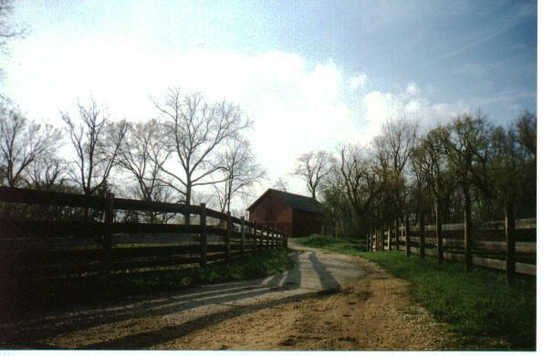

Images for the Web
Image Optimization
    Photographs taken with digital cameras are not usually optimized for the Web
    Reduce the file size of the image
    Reduce the dimensions of the image to the actual width and height of the image on the web page.
Image Editing Tools:
    MS Paint
    GIMP (free!)
    Adobe Fireworks
    Adobe Photoshop
    http://pixlr.com/editor (free!)
Choosing Names
  Use all lowercase letters
  Do not use punctuation symbols and spaces
  Do not change the file extensions
  (should be .gif, .jpg, .jpeg, or .png)
  Keep your file names short but descriptive
    i1.gif is probably too short
    myimagewithmydogonmybirthday.gif is too long
    dogbday.gif may be just about right
A small image configured to link to a larger version of that image.
<a href=“big.jpg”><img src=“small.jpg” alt=“country road” width=“200” height=“100”></a>

Slide 45
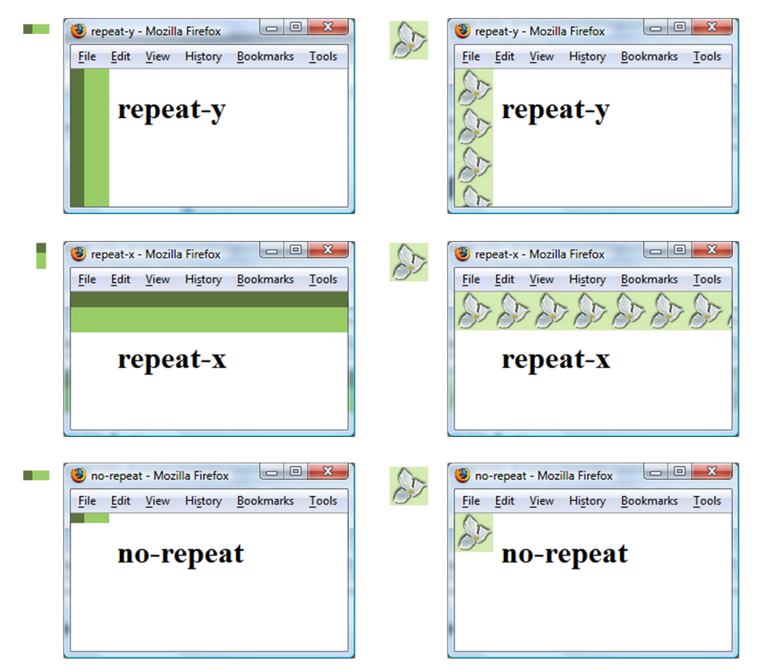

CSS background-image Property
Configures a background-image
By default, background images tile (repeat)
body { background-image: url(background1.gif); }
To have no-repeat use: background-repeat: no-repeat;
Example:
h2 { background-color: #d5edb3;
color: #5c743d;
font-family: Georgia, "Times New Roman", serif;
padding-left: 30px;
background-image: url(trilliumbullet.gif);
background-repeat: no-repeat;
}

Slide 46
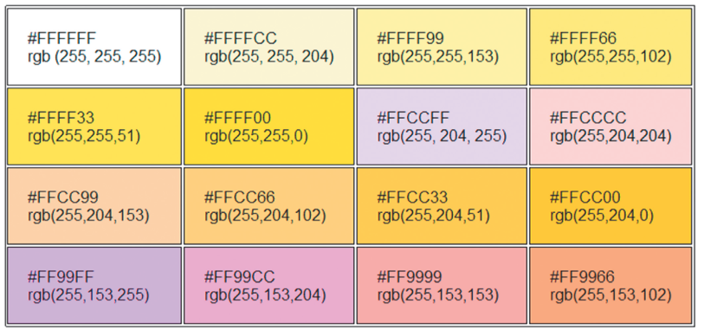
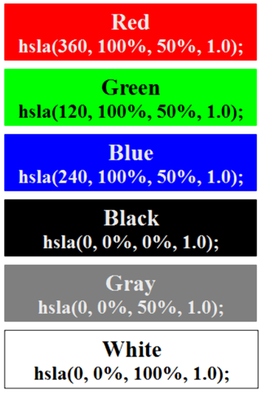
Color
RGBA - Four values are required:
  red color, green color, blue color, and alpha(transparency) decimal values from 0 to 255.
  The alpha value must be a number between 0 (transparent) and 1 (opaque).
    Example:
    h1 { color: #ffffff;
    color: rgba(255, 255, 255, 0.7);
    font-size: 5em; padding-right: 10px;
    text-align: right;
    font-family: Verdana, Helvetica, sans-serif;
    }
HSLA
  hue, saturation, light, alpha
  Hue is a value between 0 and 360
  Saturation: percent
  Lightness: percent
  Optional alpha: from 0 to 1

