Slide 1

Web Development
IT125
Spring Term 2017
Marymount University
School of Business Administration
Professor Suydam
Week 12
Web Multimedia & Interactivity
e-Commerce
(Chapter 12)

Slide 2
Week 12 Agenda
Chapter 12 – e-Commerce Overview
Mini-Project 4 Review – javajam9, javajam10, javajam11

Slide 3
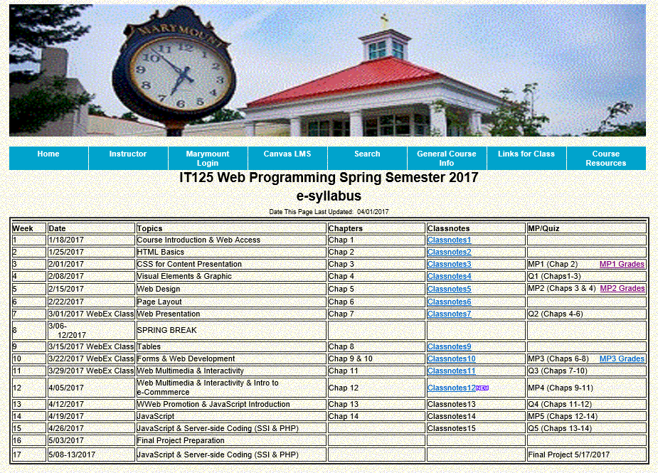
Course Schedule

Slide 4
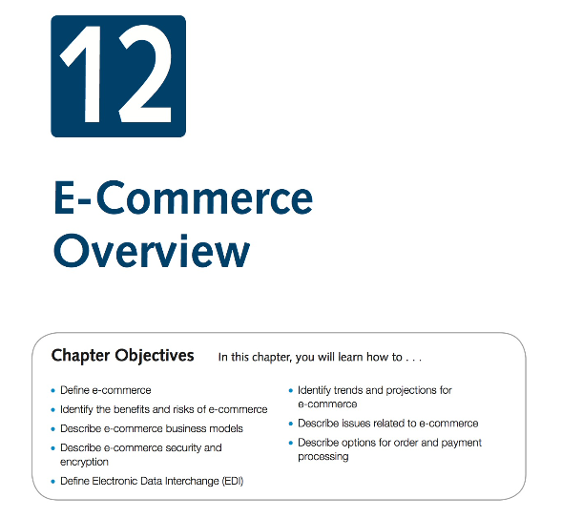
Week 12 Agenda
Download Chapter 12 Student Files, save and UnZip to your practice folder

Slide 5
Introduction to e-Commerce
What is e-commerce? The integration of communications, data management, and security technologies to allow individuals and organizations to exchange information related to the sale of goods and services.
Major functions of e-Commerce include:
  the buying of goods,
  the selling of goods, and
  performance of financial transactions on the Internet.
Advantages for Business
  Reduced Costs
  Increased Customer Satisfaction
  More Effective Data Management
  Potentially Higher Sales
Risks for Business
  Need for a robust, reliable web site
  Fraudulent transactions
  Customer reluctance to purchase online
  Increased competition
Advantages for Consumers
  Convenience
  Easier Comparison Shopping
  Wider Selection of Goods
Risks for Consumers
  Possible Security Issues
  Possible Privacy Issues
  Purchasing from photos & descriptions
  Possible difficulty with returns

Slide 6
Introduction to e-Commerce (Cont’d)
Business Models
  B2C – Business-to-Consumer
  B2B – Business-to-Business
  C2C – Consumer-to-Consumer
  B2G – Business-to-Government
Electronic Data Interchange (EDI)
  The transfer of data between different companies using networks. Facilitates the exchange of standard business documents including purchase orders and invoices
  EDI is not new -- In existence since the 1960s
  Trading Partners - Organizations that exchange EDI transmissions
  Newer technologies
    XML and Web Services are replacing traditional EDI
    Provide opportunities to customize secure information exchange over the Internet

Slide 7
Introduction to e-Commerce (Cont’d)
e-Commerce U.S. Retail Sales -- What do people buy online?
Merchandise Line | 2015 ($M)
 | Total | E-commerce
Total Electronic Shopping and Mail-Order Houses (NAICS 45411) | 433,692 | 294,809
Books and magazines | 12,583 | 11,648
Clothing and clothing accessories (includes footwear) | 58,188 | 52,128
Computer hardware | S | 17,459
Computer software | S | S
Drugs, health aids, and beauty aids | S | 21,469
Electronics and appliances | 30,016 | 26,050
Food, beer, and wine | 9,841 | 7,579
Furniture and home furnishings | 32,369 | 28,883
Music and videos | S | S
Office equipment and supplies | 10,613 | 9,236
Sporting Goods | 13,104 | 11,681
Toys, hobby goods, and games | 12,110 | 10,682
Other merchandis | 68,378 | 52,893
Nonmerchandise receipts³ | 29,153 | 26,374
Source: http://www2.census.gov/retail/releases/current/arts/ecommerce4541.xls
Note: S - Estimate does not meet publication standards because of high sampling variability (coefficient of variation is greater than 30%), poor response quality (total quantity response rate is less than 50%), or other concerns about the estimate's quality. Unpublished estimates derived from this table by subtraction are subject to these same limitations and should not be attributed to the U.S. Census Bureau. For a description of publication standards and the total quantity response rate, see http://www.census.gov/about/policies/quality/standards/standardf1.html.

Slide 8
Introduction to e-Commerce (Cont’d)
Who’s On the Internet?
Category | Percentage That Use the Internet
Men | 87%
Women | 86%
Age: 18-29 | 97%
Age: 30-49 | 93%
Age: 50-64 | 88%
Age: Over 65 | 57%
Household Income: Less than $30,000 | 77%
Household Income: $30,000 to $49,999 | 85%
Household Income: $50,000 to $74,999 | 93%
Household Income: $75,000 or higher | 99%
Education: High school graduate | 77%
Education: Some college | 91%
Education: College graduate | 97%
Source: http://www.pewinternet.org/data-trend/internet-use/latest-stats/
Other Demographics:
  http://www.pewinternet.org/
  http://www.clickz.com
  http://www.census.gov/eos/www/ebusiness614.htm

Slide 9
Introduction to e-Commerce (Cont’d)
E-Commerce Issues
  Intellectual Property
  Security
  Fraud
  Taxation
  International Commerce
Security
  Encryption
    Ensures privacy within an organization and on the Internet.
    The conversion of data into an unreadable form, called a ciphertext.
  Decryption
    The process of converting the ciphertext back into its original form, called plaintext or cleartext, so it can be understood.
    The encryption/decryption process requires an algorithm and a key.

Slide 10
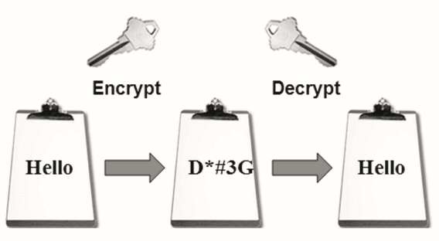
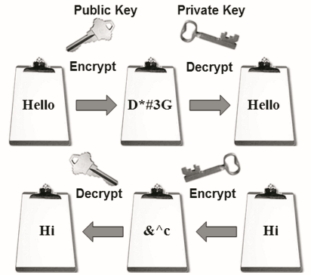


Introduction to e-Commerce (Cont’d)
Symmetric-Key Encryption
Also called single-key encryption
Both encryption and decryption
use the same key
Both the sender and receiver must know the key before
communicating using encryption.
Advantage: speed
Encryption Types
Secure E-Commerce transactions use the encryption technologies below:
    Symmetric-key Encryption
    Asymmetric-key Encryption
    Hash Encryption
Hash Encryption
    A hash algorithm transforms a string of characters into a “digest”
    A shorter fixed-length value or key that represents the original string
    One-way encryption
    Used for information that will not be read or decrypted
    Purpose: verify the integrity of information
SSL (Secure Sockets Layer)
    Utilizes these encryption technologies
    Provides for secure transmission of data on the Internet.
Asymmetric-Key Encryption
Also called public-key encryption
There is no shared secret
Two keys are
created at the same time:
  Public key
  Private key
Asymmetric-key encryption
is much slower than
symmetric-key encryption.

Slide 11
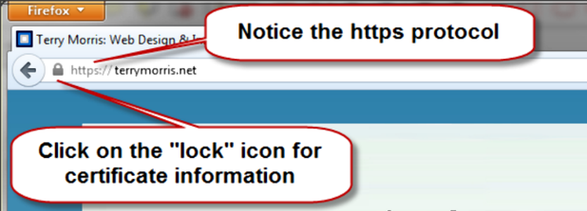
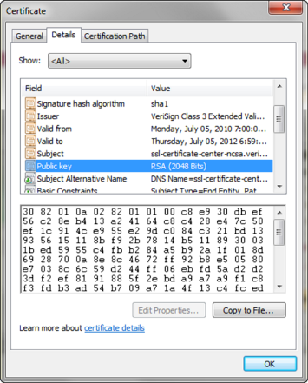
Secure Sockets Layer (SSL)
A protocol that allows data to be privately exchanged over public networks
Developed by Netscape
Encrypts data sent between a client (usually a Web browser) and a Web server.
Utilizes both symmetric and asymmetric keys.
“https” protocol
Browsers display a “lock” icon
SSL provides secure communication between a client and server by using:
  Server and (optionally) client digital certificates for authentication
  Symmetric-key cryptography using a "session key" for bulk encryption
  Public-key cryptography for transfer of the session key
  Message Digests (hash encryption) to verify the integrity of the transmission
SSL & Digital Certificate - A form of an asymmetric key -- Also contains information about the certificate, the holder of the certificate, and the issuer of the certificate. Used by SSL to authenticate the identity of the web server

Slide 12
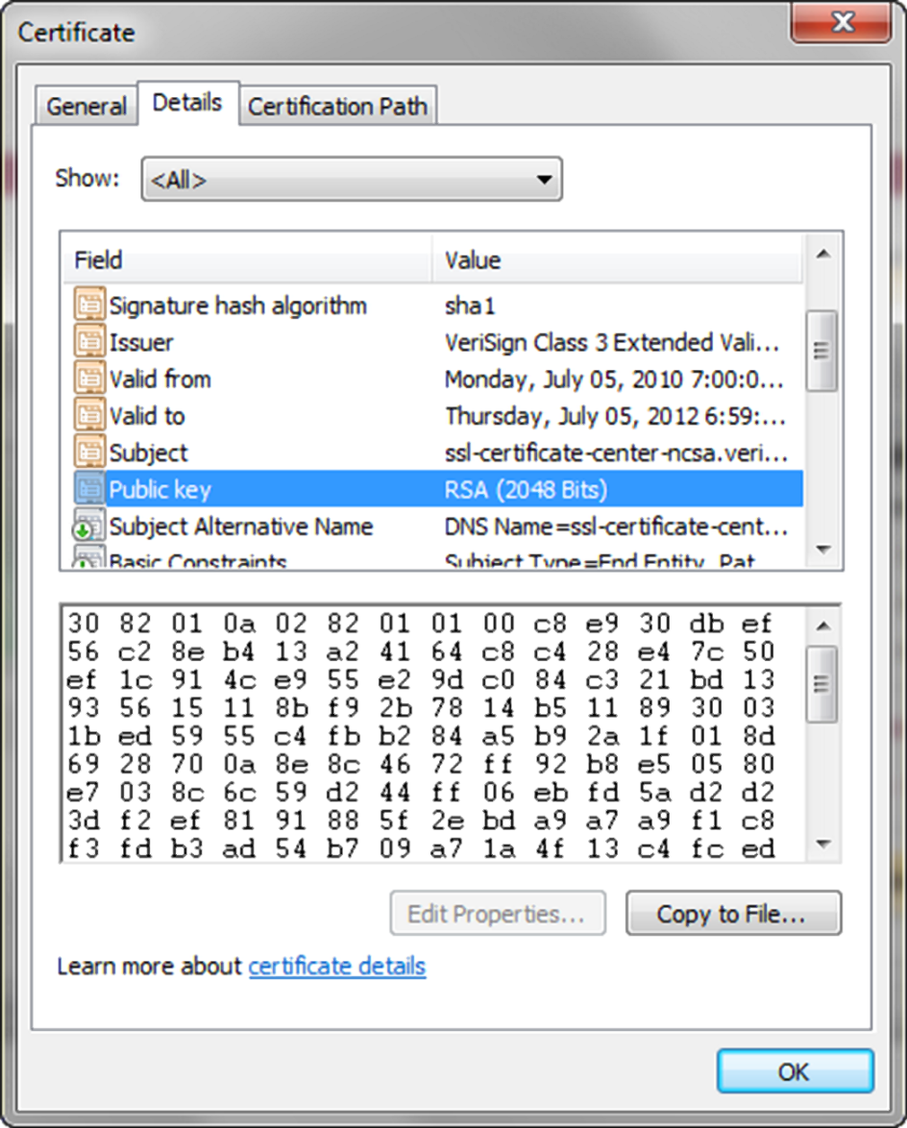
Digital Certificate
The contents of a digital certificate include:
  The public key
  Effective date of the certificate
  Expiration date of the certificate
  Details about the Certificate Authority -- the issuer of the certificate
  Details about the certificate holder
  A digest of the certificate content
Certificate Authority
  A trusted third-party organization or company that issued digital certificates.
  Well-known Certificate Authorities:
  Verisign http://www.verisign.com
  Thawte http://www.thawte.com

Slide 13
Order & Payment Processing
E-Commerce Payment Methods:
  Credit Card
  Stored-value Card
  Smart Card
  Digital Cash
Storefront Solutions
  Instant Online Storefront - Shopify, BigCommerce
  Off-The-Shelf Shopping Cart Software - Agoracart, osCommerce, ZenCart
  Custom Built Solution
      IBM's WebSphere Commerce Suite, Microsoft's Commerce Server
      Microsoft Visual Studio, Adobe Dreamweaver
  Semi-Custom Built Solutions on a Budget
      Paypal order processing
      Free shopping cart scripts

Slide 14
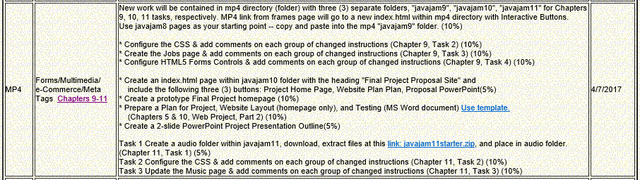
MP4
“Fresh Start” javajam8 files

Slide 15
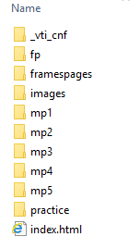
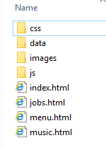
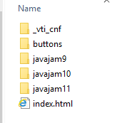
Mini-Project 4 Site Setup
Create a blank notepad document named “log.txt” and save in data folder

Slide 16
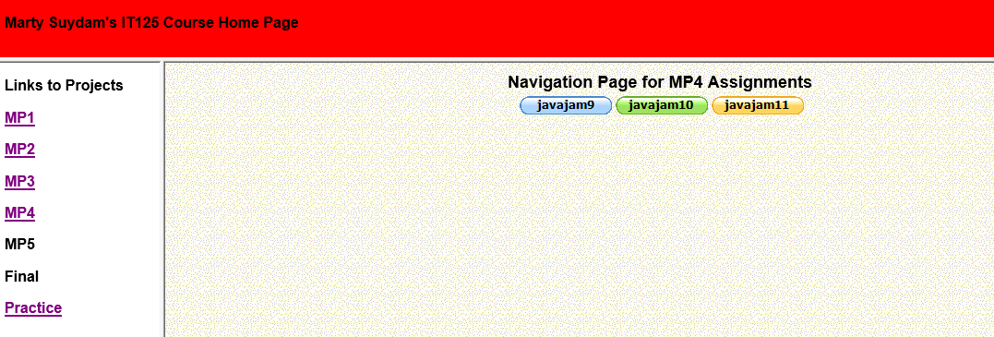
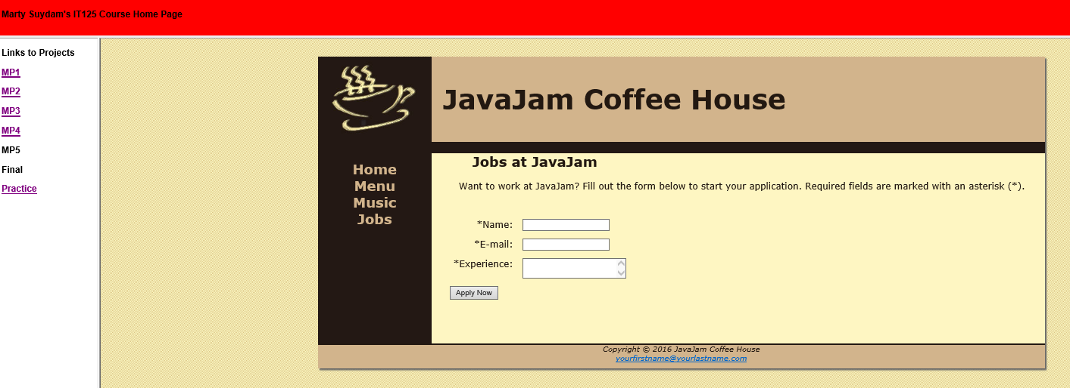
Mini-Project 4 Instructor Example
New Jobs Page

Slide 17
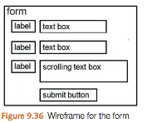
JavaJam Case Study MP4 Chapter 9
You have four tasks in this case study:
1. Create a new folder for this JavaJam case study.
2. Modify the style sheet (javajam.css) to configure style rules for the new form.
3. Create the new Jobs page shown in Figure 9.35.
4. Configure HTML5 form controls.
Preparation(in-class):
Create a folder called javajam9. Copy all of the files from your Chapter 8 javajam8 folder into the javajam9 folder.
Task 2 Configure the CSS. Modify the external style sheet (javajam.css). Open javajam.css in a text editor. Review Figure 9.35 and the wireframe in Figure 9.36. Notice how the text labels for the form controls are on the left side of the content area but contain right-aligned text. Notice the empty vertical space between each form control. Configure CSS as indicated below:
Create a form element selector with a style declaration that sets 2em of padding.
Configure a label element selector to float to the left with block display. Set the text alignment to right, assign a width of 8em, and set 1em of right padding
Configure the input element and textarea element selectors with block display and 1em of bottom margin.
Configure a selector for an id named mySubmit that sets the left margin to 9.5em.
Save the javajam.css file.
Place after CSS table element
form { padding: 2em; }
label { float: left;
display: block;
text-align: right;
width: 8em;
padding-right: 1em; }
input, textarea { display: block; margin-bottom: 1em; }
#mySubmit { margin-left: 9.5em; }

Slide 18
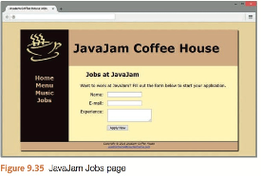
JavaJam Case Study MP4 Chapter 9
Task 3: Create the Jobs Page. Use the Menu page as the starting point for the Jobs page. Launch a text editor and open menu.html. Save the file as jobs.html. Modify your jobs.html file to look similar to the Jobs page (shown in Figure 9.35) as follows: Figure 9.36 Wireframe for the form 2.
The Jobs page will contain an h2, a paragraph, and a form in the main element.
1. Change the page title to an appropriate phrase.
2. The Jobs page will contain an h2, a paragraph, and a form in the main element. Delete the div within the main element. Delete the table in the main element.
3. Edit the text within the h2 element to say "Jobs at JavaJam".
Replace the text in the paragraph with the following: “Want to work at JavaJam? Fill out the form below to start your application.”
4. Prepare to code the HTML for the form area. Begin with a form element that uses the post method and the action attribute to invoke server-side processing. Unless directed otherwise by your instructor, configure the action attribute to send the form data to http://webdevbasics.net/scripts/javajam8.php.
5. Configure the form control for the Name information. Create a label element that contains the text “Name:”. Create a text box named myName. Use the for attribute to associate the label element with the form control.
6. Configure the form control for the E-mail information. Create a label element that contains the text “E-mail:”. Create a text box named myEmail. Use the for attribute to associate the label element with the form control.
7. Configure the Experience area on the form.
Create a label element that contains the text “Experience:”.
Create a textarea element named myExperience with rows set to 2 and cols set to 20. Use the for attribute to associate the label element with the form control.
8. Configure the submit button. Code an input element with type="submit" and value="Apply Now". Assign the input element to an id named mySubmit.
9. Code an ending tag on a blank line after the submit button.
Save your file and test your web page in a browser. It should look similar to the page shown in Figure 9.35. If you are connected to the Internet, submit the form. This will send your form information to the server-side script configured in the form tag. A confirmation page that lists the form information and their corresponding names will be displayed.
<form method="post" action="http://webdevbasics.net/scripts/javajam8.php">
<label for="myName">Name: </label>
<input type="text" id="myName" name="myName" required="required">
<label for="myEmail">E-mail: </label>
<input type="email" id="myEmail" name="myEmail" required="required">
<label for="myExperience">Experience: </label>
<textarea name="myExperience" id="myExperience" rows="2" cols="20" required="required"></textarea>
<input type="submit" id="mySubmit" name="mySubmit" value="Apply Now">
</form>

Slide 19
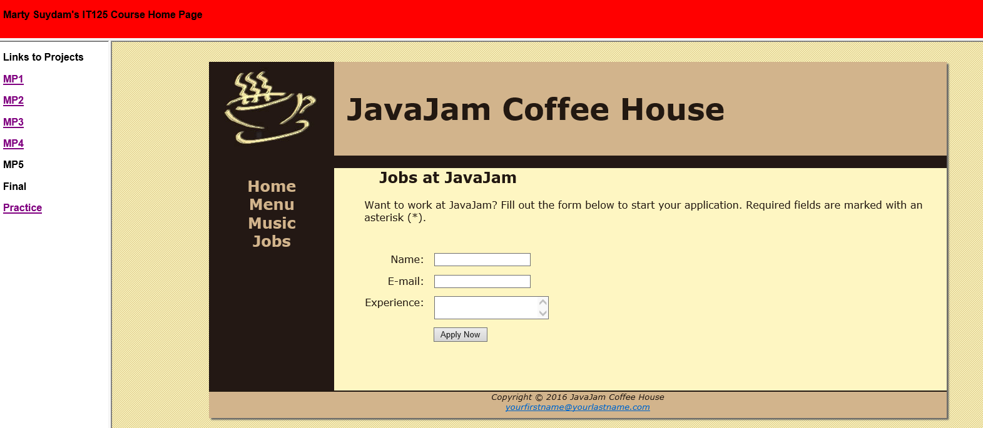
JavaJam Case Study MP4 Chapter 9
Task 4: Configure HTML5 Form Controls. Get more practice with the new HTML5 elements by modifying the form on the Jobs page to use HTML5 attributes and values. Modify the jobs.html file in a text editor.
1. Add the following sentence to the paragraph above the form: “Required fields are marked with an asterisk (*).”
2. Use the required attribute to require the name, e-mail, and experience form controls to be entered. Add an asterisk at the beginning of each label text.
3. Configure the input element for the e-mail address with type="email".
Save your file and display your web page in a browser. Submit the form with missing information or only a partial e-mail address. Depending on the browser’s level of HTML5 support,
<p>Want to work at JavaJam? Fill out the form below to start your application. Required fields are
marked with an asterisk (*).</p>
*Name, *Email, *Experience
<input type="email" id="myEmail" name="myEmail" required="required">

Slide 20
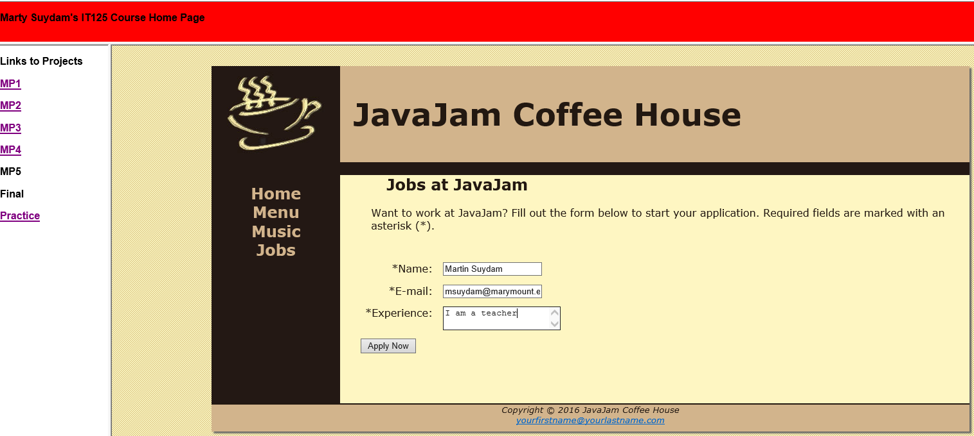
The Revised form Tag in jobs.html
Invokes a Server-Side PHP Script for Processing When the Input Data is Valid
Replace this <form>
With this <form>
<form method="post" action="http://webdevbasics.net/scripts/javajam8.php">
<form id="contactForm" onsubmit="return validateContactForm()"
action="js/processFeedback.php" method="post">

Slide 21
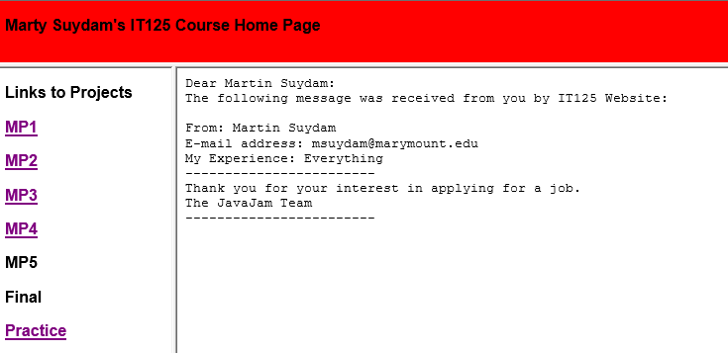
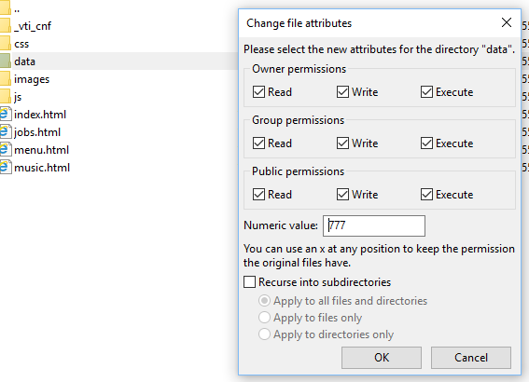
The Feedback Message and Log File from processFeedback.php
Create a log.txt blank page and save in data subdirectory
Using File Zilla, right-click on data folder, select “File permissions” and change as shown in image lower-right below.
Test the feedback form to verify it works.
A browser display of processing from processFeedback.php and emails showing confirmation to the user indicates that the Jobs Form Input has in fact been received.
Needs permissions set
Confirmation Web Page

Slide 22
PHP Code to Process Feedback in processFeedback.php
<?php
//processFeedback.php
//Construct the message to be sent to the business
$messageToBusiness =
"From: ".$_POST['myName']."\r\n" .
"E-mail address: ".$_POST['myEmail']."\r\n".
"My Experience: ".$_POST['myExperience']."\r\n";
//Send the e-mail feedback message to the business
//replace email address with your email address
$headerToBusiness = "From: $_POST[myEmail]\r\n";
mail('youremail@marymount.edu', $messageToBusiness, $headerToBusiness);
//Construct the confirmation message to be e-mailed to the client
$messageToClient =
"Dear ".$_POST['myName'].":\r\n".
"The following message was received from you by IT125 Website:\r\n\r\n".
$messageToBusiness.
"------------------------\r\nThank you for your interest in applying for a job.\r\n" .
"The JavaJam Team\r\n------------------------\r\n";
//Send the confirmation message to the client
//replace email address with your email address
$headerToClient = "From: youremail@marymount.edu\r\n";
mail($_POST['myEmail'], $messageToClient, $headerToClient);
//Transform the confirmation message to the client into XHTML format and display it
$display = str_replace("\r\n", "<br />\r\n", $messageToClient);
$display =
"<html><head><title>Your Message</title></head><body><tt>".
$display.
"</tt></body></html>";
echo $display;
//Log the message in a file called log.txt on the web server
$fileVar = fopen("../data/log.txt", "a")
or die("Error: Could not open the log file.");
fwrite($fileVar, "\n-------------------------------------------------------\n")
or die("Error: Could not write to the log file.");
fwrite($fileVar, "Date received: ".date("jS \of F, Y \a\\t H:i:s\n"))
or die("Error: Could not write to the log file.");
fwrite($fileVar, $messageToBusiness)
or die("Error: Could not write to the log file.");
?>
Replace information noted by <your email>
Create as a .php page and save in js folder
Change email address
Change email address

Slide 23
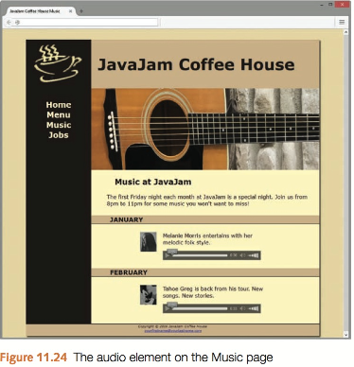
JavaJam Case Study MP4 (javajam11) Chapter 11
You have three tasks in this case study:
Create a new folder for this JavaJam case study.
Modify the style sheet (javajam.css) to configure style rules for an audio element.
Configure the Music page (music.html) to play audio files.
Figure 11.24 shows the Music page with the audio players.
Task 1: Create a audio folder within javajam11, download, extract files at this link: javajam11starter.zip, and place in audio folder.

Slide 24
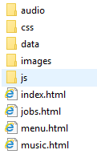
Mini-Project 4 (javajam11) Site Setup

Slide 25
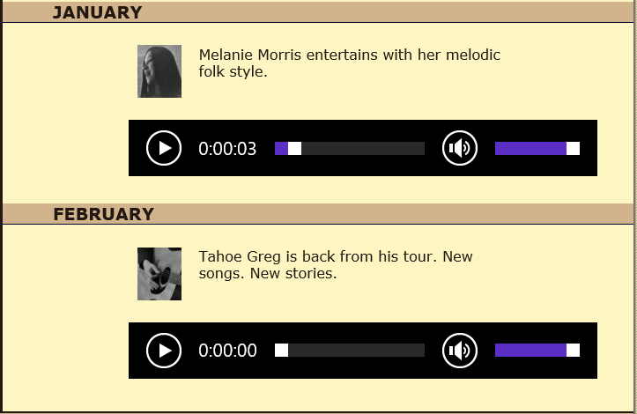
JavaJam Case Study MP4 (javajam11) Chapter 11
Task 2: Configure the CSS. Modify the external style sheet (javajam.css). Open javajam.css in a text editor. Create an audio element selector with block display and 1em of top margin. Add comment for added instruction
(place before @media only screen and (max-width: 1024px))
Save the javajam.css file.
Task 3: Update the Music Page. Open music.html in a text editor. Modify music.html so that two HTML5 audio controls display (see Figure 11.24).
Refer to Hands-On Practice 11.3 when you create the audio control. Configure an audio control within the div about Melanie to play the melanie.mp3 or melanie.ogg file and provide a hyperlink to the melanie.mp3 file as a fallback if the audio element is not supported.
Configure an audio control within the div about Greg to play the greg.mp3 or greg.ogg file and provide a hyperlink to the greg.mp3 file as a fallback if the audio element is not supported.
Save the web page.
Check your HTML syntax using the W3C validator (http://validator.w3.org).
Correct and retest if necessary. Display the page in different browsers and play the audio files.
audio { display: block; margin-top: 1em; }
<audio controls="controls">
<source src="audio/melanie.mp3" type="audio/mpeg">
<source src="audio/melanie.ogg" type="audio/ogg">
<a href="audio/melanie.mp3">Download</a> (MP3)
</audio>

