Slide 1
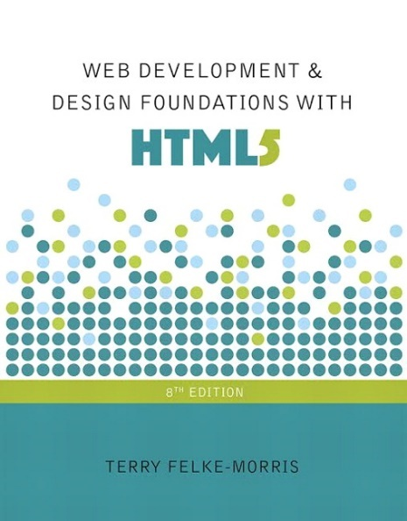
Web Development
IT125
Spring Term 2017
Marymount University
School of Business Administration
Professor Suydam
Week 11
Web Multimedia & Interactivity
(Chapters 11)

Slide 2
Week 11 Agenda
Review Course Schedule
Mini-Project 3 Grading Comments
Mini-Project 4 Introduction
Chapter 11

Slide 3
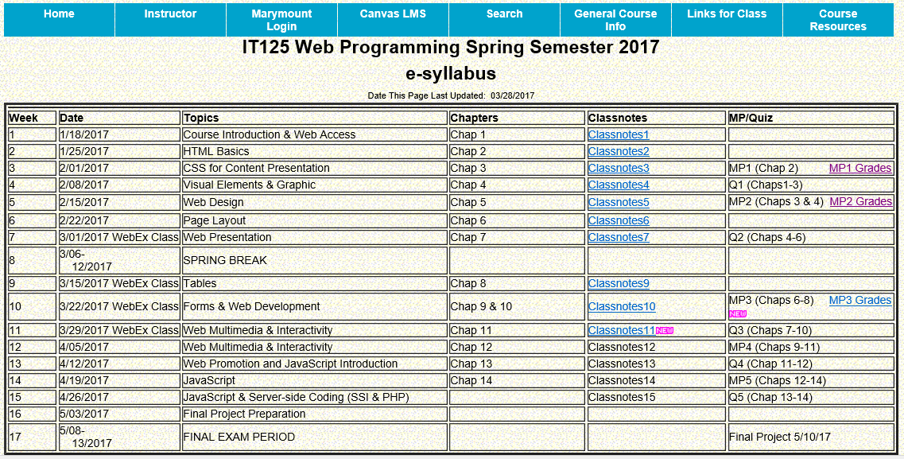
Course Schedule

Slide 4
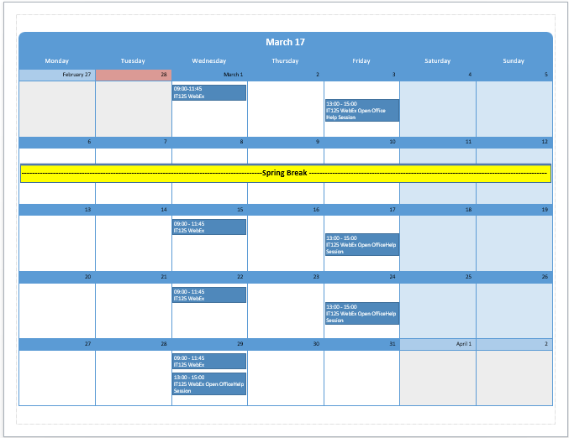
March 2017 Schedule

Slide 5
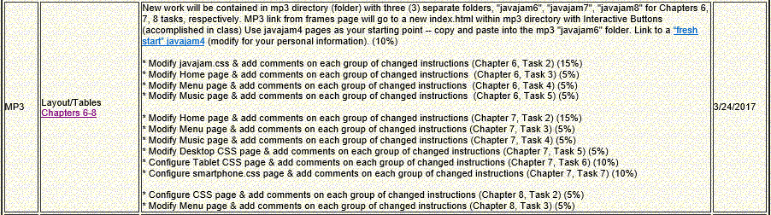
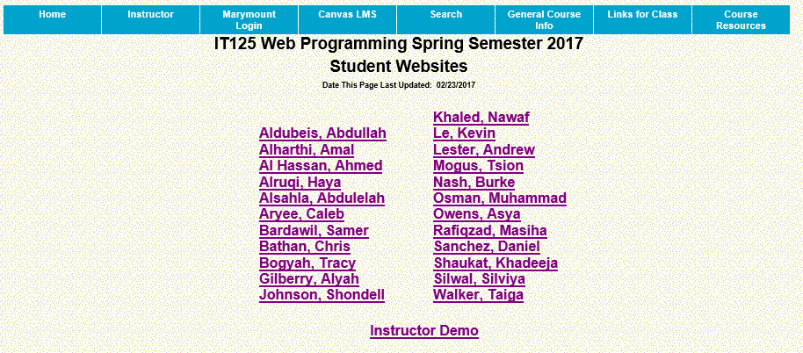
Mini-Project 3 Comments

Slide 6
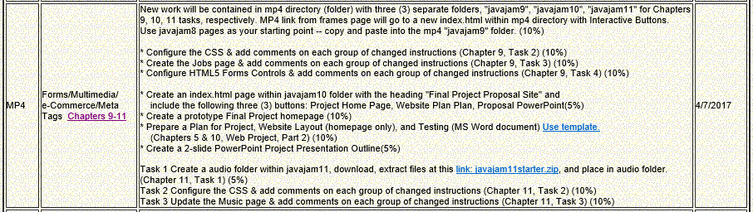
Mini-Project 4

Slide 7
Mini-Project 4 Cross-Walk with Hands-On Practice
MP 4 Requirement (Case Study Chapter/Task Reference) Weight | Hands-On (H-0) Ex, Pg, Classnotes Ref
New work will be contained in mp4 directory (folder) with three (3) separate folders, "javajam9", "javajam10", "javajam11" for Chapters 9, 10, 11 tasks, respectively. MP4 link from frames page will go to a new index.html within mp4 directory with Interactive Buttons. Use javajam8 pages as your starting point -- copy and paste into the mp4 "javajam9" folder. (10%) | Classnotes 10, slides 36-37
* Configure the CSS & add comments on each group of changed instructions (Chapter 9, Task 2) (10%) | Classnotes 10, slide 38
* Create the Jobs page & add comments on each group of changed instructions (Chapter 9, Task 3) (10%) | Classnotes 10, slide 39
* Configure HTML5 Forms Controls & add comments on each group of changed instructions (Chapter 9, Task 4) (10%) | Classnotes 10, slide 40
* Create an index.html page within javajam10 folder with the heading "Final Project Proposal Site" and include the following three (3) buttons: Project Home Page, Website Plan, Proposal PowerPoint(10%) | Classnotes 10, slides 57-58
* Create a prototype Final Project homepage (10%)
* Prepare a Plan for Project, Website Layout (homepage only), and Testing (MS Word document) Use template. (Chapters 5 & 10, Web Project, Part 2) (10%) | Classnotes 10, slides 57-58
* Create a 2-slide PowerPoint Project Presentation Outline(5%)
* Create a audio folder within javajam11, download, extract files at this link: javajam11starter.zip, and place in audio folder. (Chapter 11, Task 1) (5%) | Classnotes 11, slides ?
* Configure the CSS & add comments on each group of changed instructions (Chapter 11, Task 2) (10%)
* Update the Music page & add comments on each group of changed instructions (Chapter 11, Task 3) (10%) | H-O 11.3

Slide 8
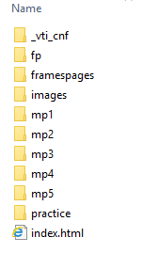
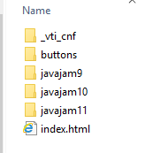
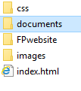
Mini-Project 4 Site Setup

Slide 9
Week 11 Agenda
Download Chapter 11 Student Files, save and UnZip to your practice folder

Slide 10
Multimedia Terms
Helper Application
  A program that can be designated to handle a particular file type (such as .wav or .mpg) to allow the user to view or otherwise utilize the special file.
  The helper application runs in a separate window from the browser.
Plug-In
  A newer and more common method
  Plug-ins run right in the browser window so that media objects can be integrated directly into the web page.
  Commonly Used - Adobe Flash Player, Adobe Reader, Windows Media Player, Apple Quicktime
Container - Designated by the file extension – contains the media and metadata
Codec - The algorithm used to compress the media
HTML5 audio & video
  Native to the browser
  ISSUE: Browsers do not all support the same codecs
    http://www.longtailvideo.com/html5/

Slide 11
Multimedia File Types
Common Audio File Types
  .wav Wave File
  .aiff Audio Interchange File Format
  .mid Musical Instrument Digital Interface (MIDI)
  .au Sun UNIX sound file
  .mp3 MPEG-1 Audio Layer-3
  .ogg Ogg Vorbis (open-source)
  . m4a MPEG 4 Audio.
  This audio-only MPEG-4 format is
  supported by Quicktime, iTunes, and iPods.
Common Video File Types
  .mov Quicktime
  .avi Microsoft Audio Video Interleaved
  .wmv Windows Media File
  .flv Flash Video File
  .mpg MPEG (Motion Picture Experts Group)
  .m4v .mp4 (MPEG-4)
  .ogv Ogg Theora (open-source)
  .webm VP8 codec (open video format, free)

Slide 12
Copyright Issues
Only publish web pages, images, and other media that you have personally created or have obtained the rights or license to use.
Ask permission to use media created by another person instead of simply “grabbing” it.
All work (including web pages) are automatically copyrighted even if there is not copyright mark or date.
Fair Use Clause of the Copyright Act
Creative Commons – A new approach to copyright

Slide 13
Hands-On Practice 11.1 Podcast (mp3)
  <h1>Web Design Podcast</h1>
  <div><a href="podcast.mp3" title="Web Design Podcast &amp; Episode 1">Podcast Episode 1</a> (MP3)</div>
  <div><a href="podcast.txt">Podcast Transcript</a></div>

Slide 14
Multimedia & Accessibility
Provide alternate content:
  Transcript (for audio)
  Captions (for video)
  Text format
Provide links to plug-ins
Provide text descriptions and captions
Verify keyboard access
Check for screen flickering
Verify functionality if JavaScript is disabled
If media is used for main navigation, provide plain text links

Slide 15
What is Adobe Flash?
A popular multimedia application
Create multimedia which adds visual interest and interactivity to web pages
Flash movies are saved in “.swf” files
Perception of speedy display
.swf files play as they download
Flash Player
    Free browser plug-in
    Widely installed on desktop browsers, but not well-supported by mobile devices

Slide 16
Hands-On Practice 11.2 HTML5 Embed Element
<embed type="application/x-shockwave-flash" src="lighthouse.swf" quality="high" width="320" height="240" title="Door County Lighthouse Cruise">

Slide 17
Hands-On Practice 11.3
HTML5 Audio & Source Elements
<audio controls="controls"> <source src="podcast.mp3" type="audio/mpeg"> <source src="podcast.ogg" type="audio/ogg"> <a href="podcast.mp3">Download the Podcast</a> (MP3)
</audio>

Slide 18
Hands-On Practice 11.4 HTML5 Video on a Web Page
<video controls="controls" poster="lighthouse.jpg" width="320" height="240">
<source src="lighthouse.m4v" type="video/mp4"> <source src="lighthouse.ogv" type="video/ogg"> <embed type="application/x-shockwave-flash"
src="lighthouse.swf" quality="high" width="320" height="240"
title="Door County Lighthouse Cruise"> </video>

Slide 19
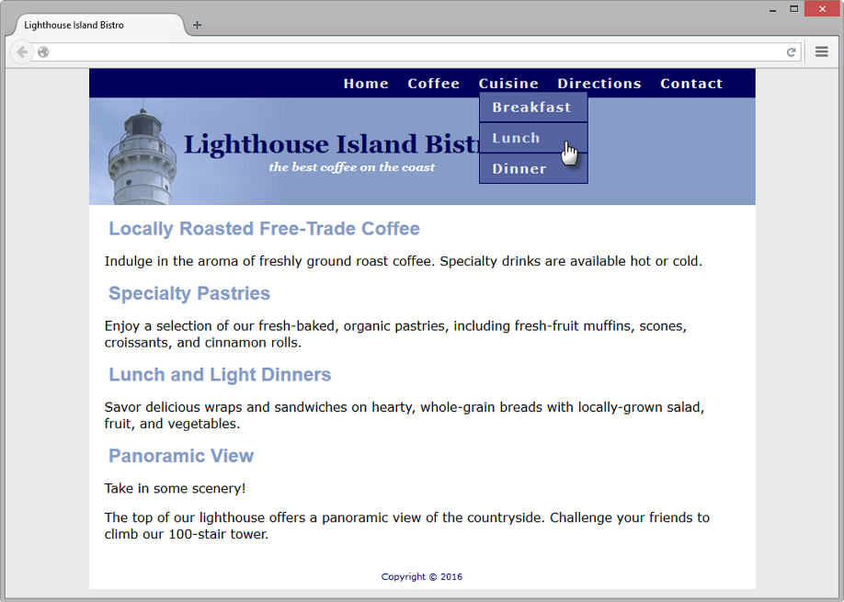
CSS Drop Down Menu
Configure nav container with position relative
Code submenu (drop down menu) ul element with the parent li element
Configure submenu ul element to initially not display
Configure submenu ul element with absolute positioning

Slide 20
Hands-On Practice 11.5 Dropdown Menu
<nav> <ul>
<li><a href="index.html">Home</a></li> <li><a href="coffee.html">Coffee</a></li> <li><a href="cuisine.html">Cuisine</a>
<ul> <li><a href="breakfast.html">Breakfast</a></li> <li><a href="lunch.html">Lunch</a></li> <li><a href="dinner.html">Dinner</a></li>
</ul>
</li> <li><a href="directions.html">Directions</a></li> <li><a href="contact.html">Contact</a></li>
</ul> </nav>

Slide 21
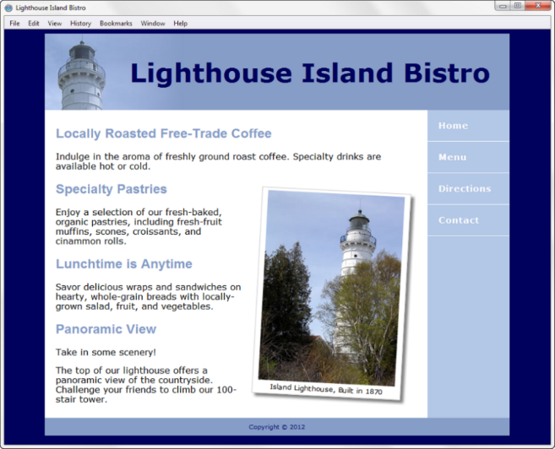
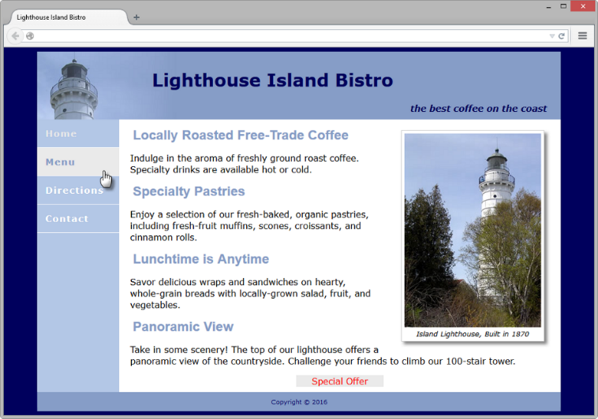
CSS3 Transform & Transition Properties
Transform Property
  Allows you to rotate, scale, skew, or move an element
  Example:
    transform: rotate(3deg);
Transition Property
  Provides for changes in property values to display in a smoother manner over a specified time.
  Example:
    nav a:hover { color: #869dc7; background-color: #eaeaea;
    transition: background-color 2s linear; }

Slide 22
Hands-On Practice 11.6 Transform Property
figure { float: right; margin: 10px; background-color: #FFF; padding: 5px; border: 1px solid #CCC; box-shadow: 5px 5px 5px #828282; transform: rotate(3deg); }
#offer { background-color: #eaeaea; width: 10em;
margin: auto; text-align: center; transform: scale(2);

Slide 23
Hands-On Practice 11.7 Transition Property
nav a { text-decoration: none; display: block; padding: 15px;
transition: background-color 2s linear;

Slide 24
Hands-On Practice 11.8 Practice with Transitions

Slide 25
Hands-On Practice 11.8 Practice with Transitions (Cont’d)
<li><a href="photo1.jpg"><img src="photo1thumb.jpg" width="100" height="75" alt="Golden Gate Bridge"> <span><img src="photo1.jpg" width="400" height="300" alt="Golden Gate Bridge"><br>Golden Gate Bridge</span></a>
</li>
#gallery span { position: absolute; left: -1000px; opacity: 0; transition: opacity 3s ease-in-out; }
#gallery a:hover span { position: absolute; top: 16px; left: 320px; text-align: center; opacity: 1; }

Slide 26
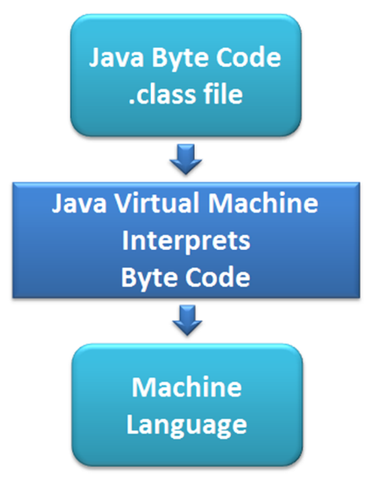
Java
What is Java?
  Object Oriented Programming (OOP)
  Developed by Sun Microsystems
  Java is not the same language as JavaScript.
  Java is more powerful and much more flexible than JavaScript.
  Java can be used to:
    develop stand-alone executable applications
    applets that are invoked by Web pages
Java Applets
  Compiled -- translated from the
  English-like Java statements to an encoded form called Byte Code.
  Use the “.class” file extension
  Java Virtual Machine (JVM)
    interprets the byte code into the proper machine language for the operating system
    After translation, the applet is executed and appears on the Web page.

Slide 27
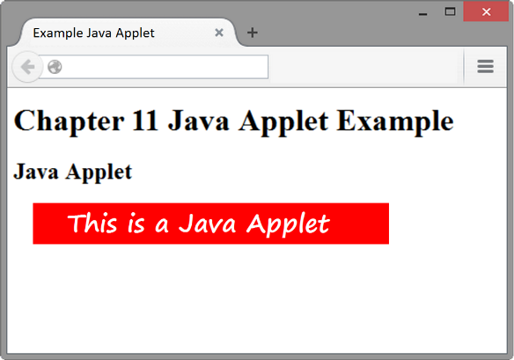
Adding a Java Applet to a Web Page
OBSOLETE: the applet element
HTML5: the object element
<object type="application/x-java-applet" width="610" height="30"
title="This Java Applet displays a message">
<param name="code" value="example.class">
<param name="textColor" value="#FF0000">
<param name="message" value="This is a Java Applet">
<param name="backColor" value="#FFFFFF">
Java Applets can be used to display text, manipulate graphics, play
games, and more.
Visit <a href="http://download.oracle.com/javase/tutorial/">Oracle</a>
for more information.
</object>
Enabling Java in browsers

Slide 28
JavaScript
What is Javascript?
  Object-based client-side scripting language
  Originally developed by Brendan Eich at Netscape
  JavaScript is NOT Java
  Manipulates the objects associated with a web page document:
      the window
      the document
      the elements such as forms, images, hyperlinks, and so on
Common Uses of JavaScript
  Display a message box
  Select list navigation
  Edit and validate form information
  Create a new window with a specified size and screen position
  Image Rollovers
  Status Messages
  Display Current Date
  Calculations

Slide 29
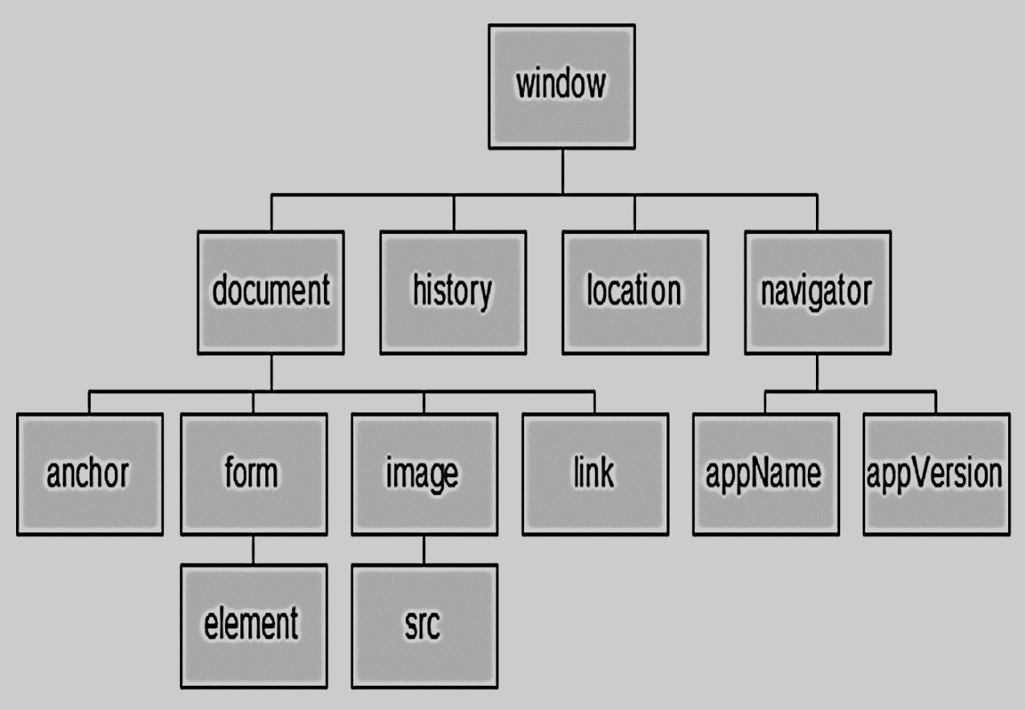
Document Object Model (DOM)
A portion of the DOM is shown below.
Defines every object and element on a Web page
Hierarchical structure
Accesses page elements and apply styles to page elements

Slide 30
What is Ajax?
Asynchronous JavaScript and XML
“Ajax” – Jesse James Garrett at Adaptive Path
Existing technologies used in a new way
    Standards-based XHTML and CSS
    Document Object Model
    XML (and the related XSLT technology)
    Asynchronous data retrieval using XMLHttpRequest
    JavaScript
Very Basic Example: http://webdevfoundations.net/css

Slide 31
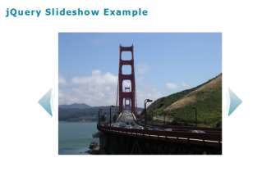
Exploring JQuery
A JavaScript library intended
to simplify client-side scripting
  Example: http://webdevfoundations.net/jquery
API – Application Programming Interface
    A protocol that allows software components to communicate – interacting and sharing data.
The jQuery API can be used to configure many interactive features, including:
  image slideshows
  animation (moving, hiding, fading)
  event handling (mouse movements and mouse clicking)
  document manipulation
  Ajax

Slide 32
HTML5 APIs
APIs
  A protocol that allows software components to communicate – interacting and sharing data
  A variety of APIs that are intended to work with HTML5, CSS, and JavaScript are currently under development and in the W3C approval process, including:
    geolocation
    web storage
    offline web applications
    Canvas
HTML5 Geolocation
  Allows your web page visitors to share their geographic location
  Their location may be determined by the IP address, wireless network connection, local cell tower, or GPS hardware depending on the type of device and browser.
  JavaScript is used to work with the latitude and longitude coordinates provided by the browser.
  Examples:
  http://webdevfoundations.net/geo and http://html5demos.com/geo

Slide 33
HTML5 APIs (Cont’d)
Web Storage
Traditionally, the JavaScript cookie object has been used to store information in key-value pairs on the client (the website visitor’s computer).
NEW FOR HTML5: Web Storage API
  provides two new ways to store information on the client side:
  local storage and session storage.
  Advantage: increase in the amount of data that can be stored (5MB per domain).
  The localStorage object stores data without an expiration date.
  The sessionStorage object stores data only for the duration of the current browser
  JavaScript is used to work with the values stored in the localStorage and sessionStorage objects.
Examples:
  http://webdevfoundations.net/storage and http://html5demos.com/storage

Slide 34
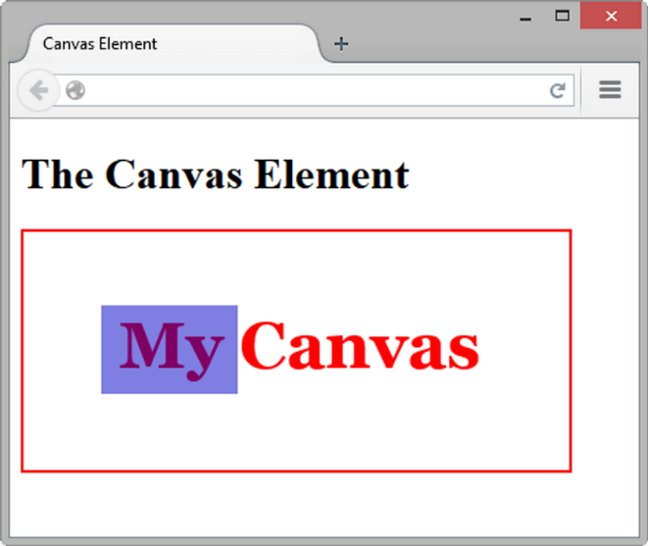
HTML5 APIs (Cont’d)
Offline Web Applications
An offline web application enables website visitors to view documents and access web applications even when they are not connected to the Internet.
A web application (app) can be written with HTML, CSS and JavaScript and can run in any browser – as long as you are online.
An offline web application takes this one step further and stores the HTML, CSS, and JavaScript files on the visitor’s device for use offline, even when the device is not connected to the Internet.
Examples:
  http://html5demos.com/offlineapp
  http://www.w3schools.com/html/html5_app_cache.asp
HTML5 Canvas Element
Configures dynamic graphics
  Draw lines, shapes, text, image
  Interact with actions taken by the user
Canvas API (application programming interface)
JavaScript – client-side scripting language
<script type="text/javascript">
function drawMe() {
var canvas = document.getElementById("myCanvas");
if (canvas.getContext) {
var ctx = canvas.getContext("2d");
ctx.fillStyle = "rgb(255, 0, 0)";
ctx.font = "bold 3em Georgia";
ctx.fillText("My Canvas", 70, 100);
ctx.fillStyle = "rgba(0, 0, 200, 0.50)";
ctx.fillRect (57, 54, 100, 65);
}
}
</script>

Slide 35
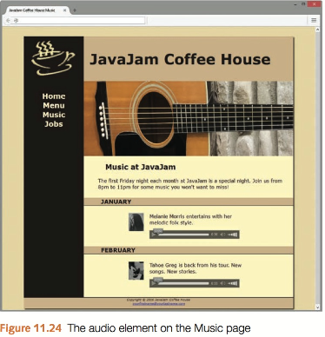
JavaJam Case Study MP4 (javajam11) Chapter 11
You have three tasks in this case study:
Create a new folder for this JavaJam case study.
Modify the style sheet (javajam.css) to configure style rules for an audio element.
Configure the Music page (music.html) to play audio files.
Figure 11.24 shows the Music page with the audio players.
Task 1: Create a audio folder within javajam11, download, extract files at this link: javajam11starter.zip, and place in audio folder.

Slide 36
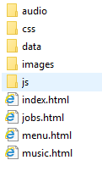
Mini-Project 4 (javajam11) Site Setup

Slide 37
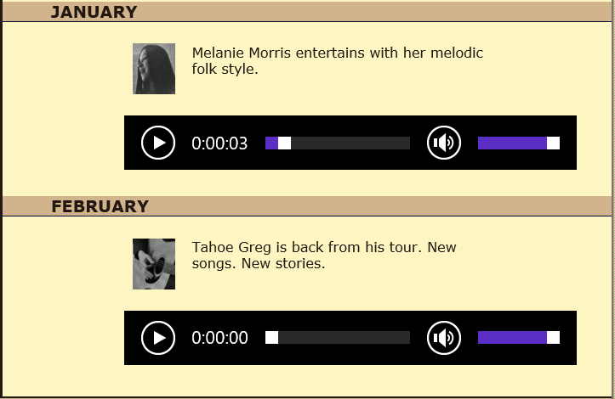
JavaJam Case Study MP4 (javajam11) Chapter 11
Task 2: Configure the CSS. Modify the external style sheet (javajam.css). Open javajam.css in a text editor. Create an audio element selector with block display and 1em of top margin. Add comment for added instruction
(place before @media only screen and (max-width: 1024px))
Save the javajam.css file.
Task 3: Update the Music Page. Open music.html in a text editor. Modify music.html so that two HTML5 audio controls display (see Figure 11.24).
Refer to Hands-On Practice 11.3 when you create the audio control. Configure an audio control within the div about Melanie to play the melanie.mp3 or melanie.ogg file and provide a hyperlink to the melanie.mp3 file as a fallback if the audio element is not supported.
Configure an audio control within the div about Greg to play the greg.mp3 or greg.ogg file and provide a hyperlink to the greg.mp3 file as a fallback if the audio element is not supported.
Save the web page.
Check your HTML syntax using the W3C validator (http://validator.w3.org).
Correct and retest if necessary. Display the page in different browsers and play the audio files.
audio { display: block; margin-top: 1em; }
<audio controls="controls">
<source src="audio/melanie.mp3" type="audio/mpeg">
<source src="audio/melanie.ogg" type="audio/ogg">
<a href="audio/melanie.mp3">Download</a> (MP3)
</audio>

