Slide 1

Web Development
IT125
Spring Term 2017
Marymount University
School of Business Administration
Professor Suydam
Week 10
Forms (Chapter 9)
Web Development (Chapter 10)

Slide 2
Week 10 Agenda
Review Course Schedule
Mini-Project 3
Chapter 9 Forms
Chapter 10 Web Development

Slide 3
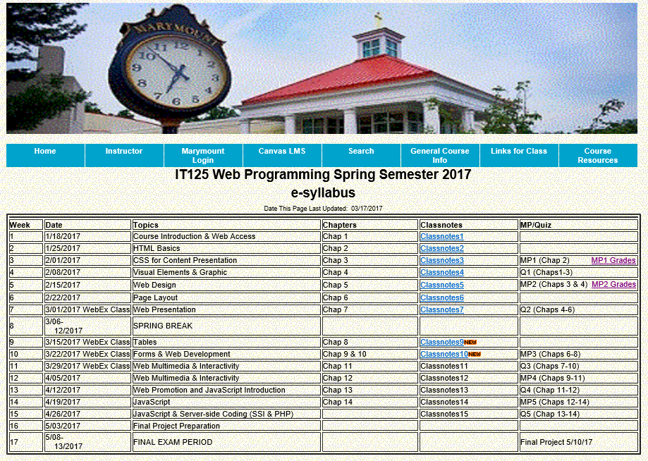
Course Schedule

Slide 4
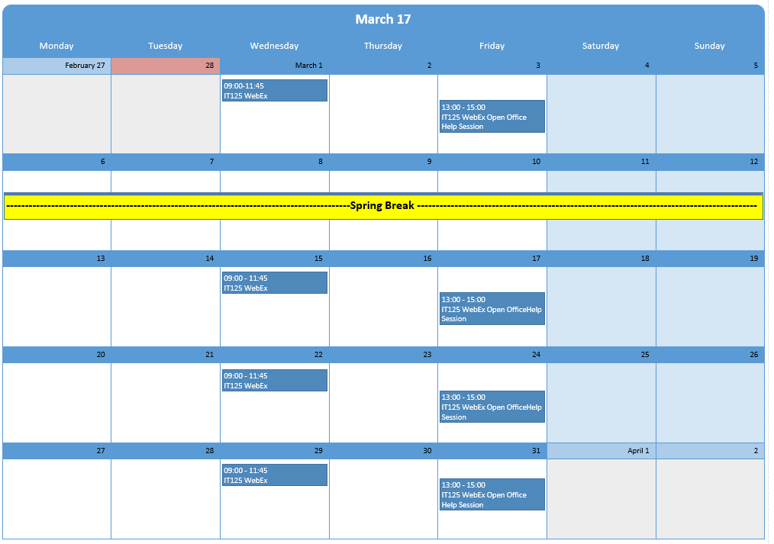
March 2017 Schedule

Slide 5
Mini-Project 3 Cross-Walk with Hands-On Practice
MP 3 Requirement (Case Study Chapter/Task Reference) Weight | Hands-On (H-0) Ex & Pg Ref
New work will be contained in mp3 directory (folder) with three (3) separate folders, "javajam6", "javajam7", "javajam8" for Chapters 6, 7, 8 tasks, respectively. MP3 link from frames page will go to a new index.html within mp3 directory with Interactive Buttons (accomplished in class) Use javajam4 pages as your starting point -- copy and paste into the mp3 "javajam6" folder. Link to a “fresh start” javajam4 (modify for your personal information). (10%) | Set up in WebEx class
*Task 2 Modify javajam.css -- add comments on each group of changed instructions, e.g., /*Task 6.2.1 Configure universal selector for CSS box sizing*/ (Chap 6, Task 2) (15%) | In-class exercise with H-O 6.3, Paragraph 6.5, pg 258
*Task 3 Modify Home page -- add comments on changed instructions (Chap 6, Task 3) (5%) | Para 6.15, pg 285, Para 6.7, pg 263
*Task 4 Modify Menu page -- add comments on changed instructions (Chap 6, Task 4) (5%) | Paragraph 6.6, pg 261
* Task 5 Modify Music page -- add comments on changed instructions (Chap 6, Task 5) (5%) | Paragraph 6.6, pg 261
* Task 2 Modify Home page -- add comments on changed instructions (Chap 7, Task 2) (15%) | In-class exercise with H-O 7.5,
* Task 3 Modify Menu page -- add comments on changed instructions (Chap 7, Task 3) (5%) | Paragraph 7.5, pg 330
* Task 4 Modify Music page -- add comments on changed instructions (Chap 7, Task 4) (5%) | Paragraph 7.5, pg 330
* Task 5 Modify Desktop CSS -- add comments on changed instructions (Chap7, Task 5) (5%) | Paragraph 7.5, pg 330
* Task 6 Configure Tablet CSS -- add comments on changed instructions (Chap 7, Task 6) (10%) | H-O 7.7 pg 334
* Task 7 Configure Smartphone CSS-- add comments on changed instructions (Chap 7, Task 7) (10%) | H-O 7.7 pg 334
* Task 2 Configure CSS -- add comments on changed instructions (Chap 8, Task 2) (5%) | In-class exercise with H-O 8.3 , Paragraph 8.5 , pg 380
* Task 3 Modify Menu page -- add comments on changed instructions (Chap8, Task 3) (5%) | Paragraph 8.2, pg 374

Slide 6
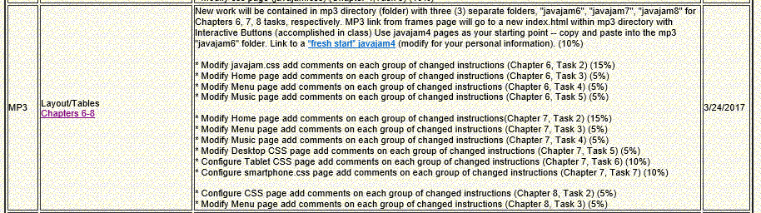
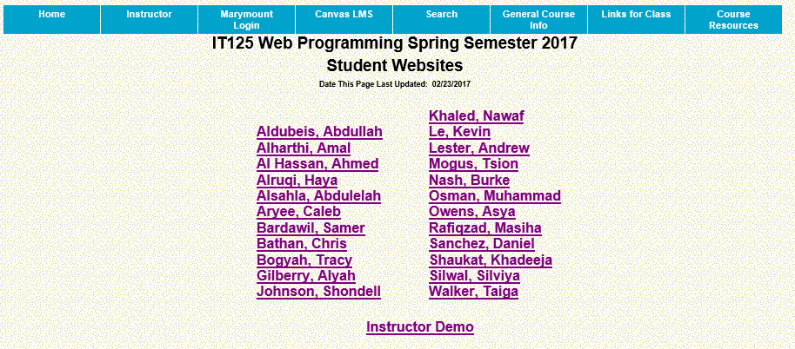
Mini-Project 3

Slide 7
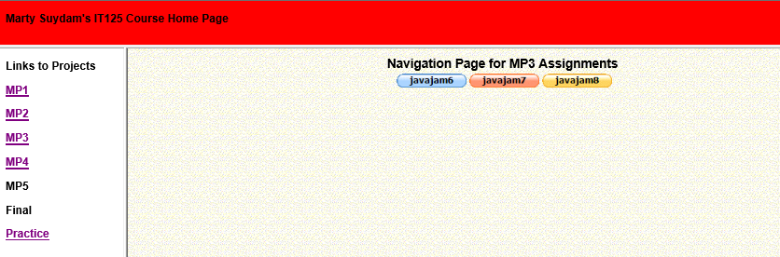
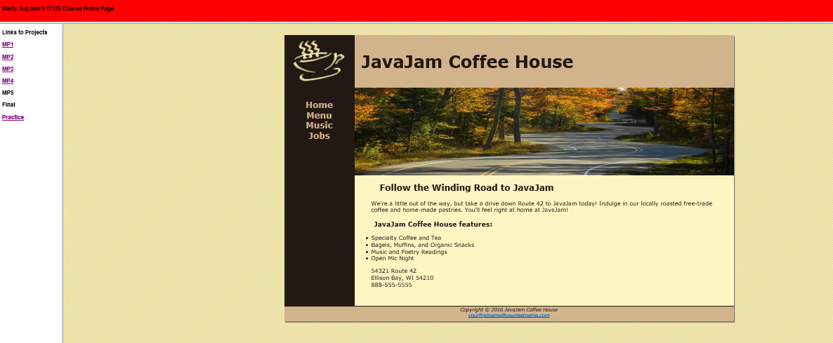
Mini-Project 3 Instructor Example

Slide 8
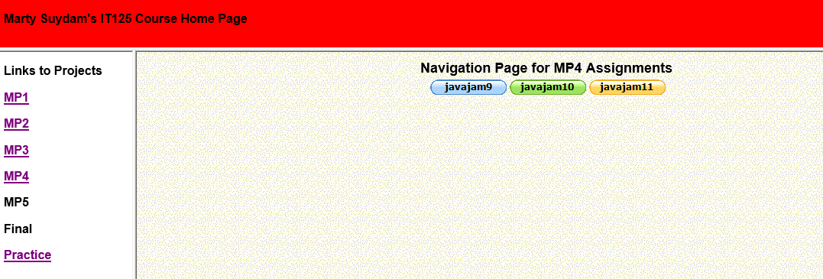
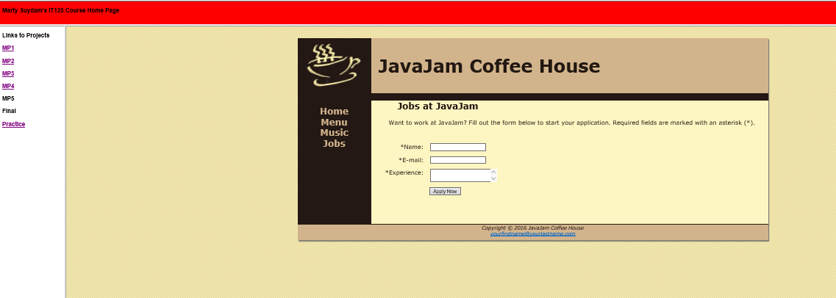
Mini-Project 4 Instructor Example

Slide 9
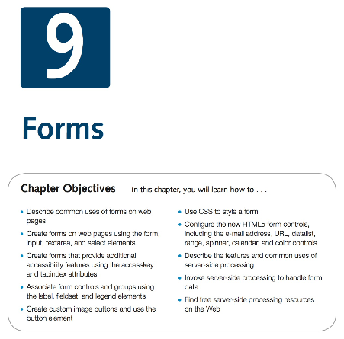
Chapter 9 Objectives
Download Chapter 9 Student Files, save and UnZip to your practice folder

Slide 10

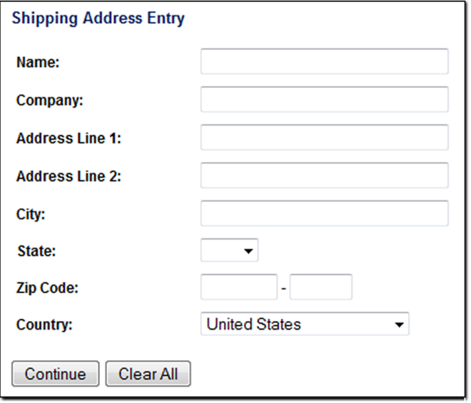


Overview of Forms
Forms are used all over the Web to:
  Accept information
  Provide interactivity
Types of forms: Search form, Order form, Newsletter sign-up form, Survey form, Add to Cart form, and so on…
Form - An HTML element that contains and organizes form controls such as: text boxes, check boxes, and buttons that can accept information from website visitors.

Slide 11
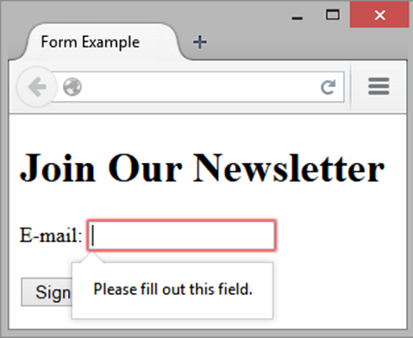
Two Components of Using Forms
The HTML form -- the web page user interface
The server-side processing --- Server-side processing works with the form data and sends e-mail, writes to a text file, updates a database, or performs some other type of processing on the server.
Tags
  <form> Contains the form elements on a web page (Container tag )
  <input> Configures a variety of form elements including text boxes, radio buttons, check boxes, and buttons (Stand alone tag)
  <textarea> Configures a scrolling text box (Container tag)
  <select> Configures a select box (drop down list) (Container tag)
  <option> Configures an option in the select box (Container tag)
Sample
  <form>
  E-mail: <input type="text" name ="email" id="email"><br>
  <input type="submit">
  <input type="reset">
  </form>

Slide 12
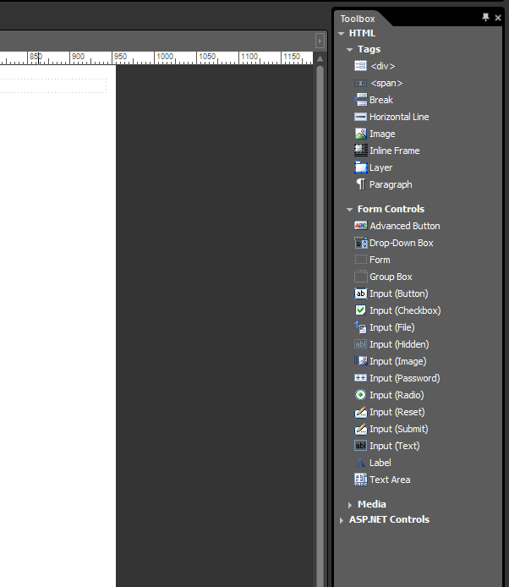
Using Expression Web for Forms
Pulldown menu: Panels>Toolbox

Slide 13
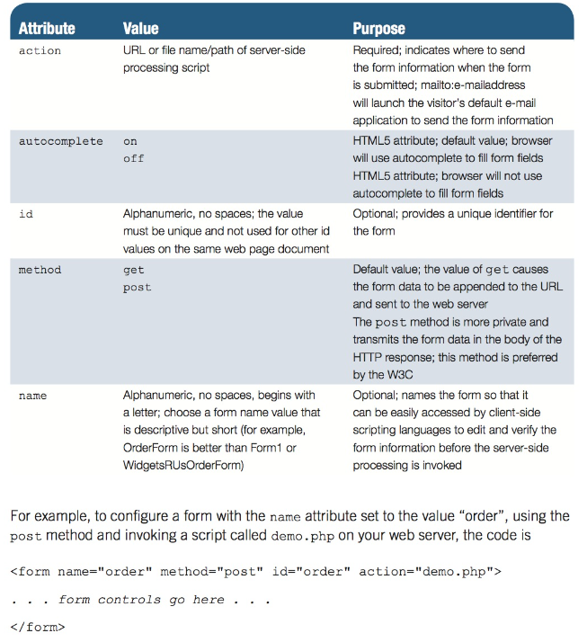

HTML form element
The form element attributes:
  action - Specifies the server-side program or script that will process your form data
  method
      get – default value,
      form data passed in URL
      post – more secure,
      form data passed in HTTP Entity Body
  name - Identifies the form
  id - Identifies the form

Slide 14

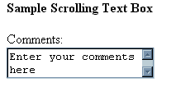

Form Controls: Input Boxes
Text Box
<input> Accepts text information
Attributes:
    type="text“
    name
    id
    size
    maxlength
    Value
textarea scrolling text box
    <textarea> </textarea>
    Attributes:
    name
    id
    cols
    rows

Slide 15
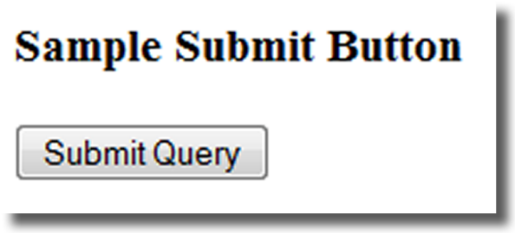
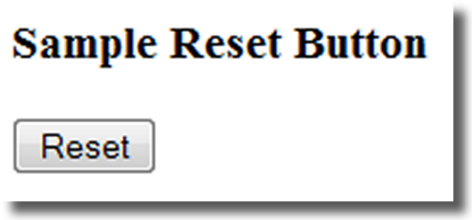
Form Controls: Buttons
Input submit button - Submits the form information
<input name="Button1" type="button" value="button" />
When clicked:
  Triggers the action method on the <form> tag
  Sends the form data (the name=value pair for each form element) to the web server.
  Attributes:
    type=“submit”
    name
    id
    value
Reset button - Resets the form fields to their initial values
<input name="Reset1" type="reset" value="reset" />
  Attributes:
  type=“reset”
  name
  id
  value

Slide 16
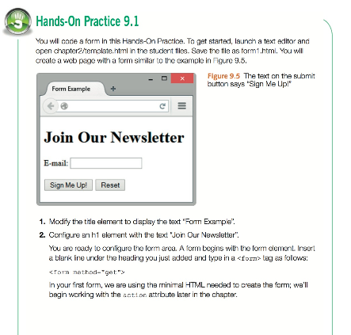
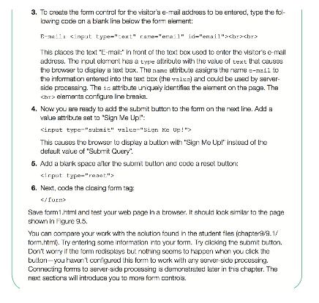
Hands-On Practice 9.1
Start with template.html contained in Chapter9 student files
or open a new html page in Expression Web
<h1>Join Our Newsletter</h1>
E-mail: <input type="text" name="email" id="email">
<br>
<br>
<input type="submit" value="Sign Me Up!"> <input type="reset">
</form>
<form method="get”>

Slide 17

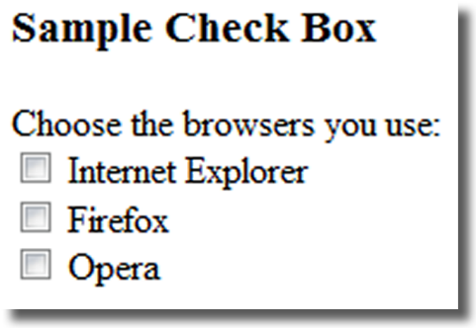
Form Controls: Inputs
Password box - Accepts text information that needs to be hidden as it is entered
<input name="Password1" type="password" />
Attributes:
  type=“password”
  name
  id
  size
  maxlength
  value
Check Box - Allows the user to select one or more of a group of predetermined items
<input name="Checkbox1" type="checkbox" />
Attributes:
  type="checkbox“
  name
  id
  checked
  value

Slide 18
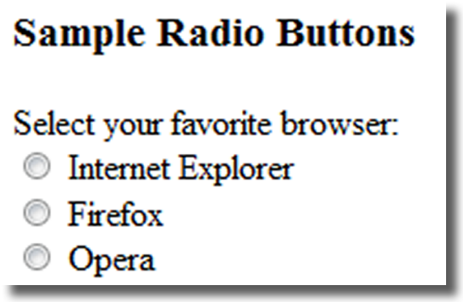
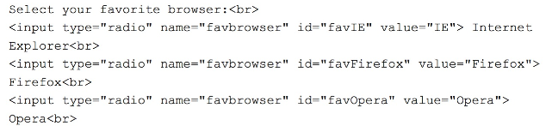
Form Controls: Inputs
Radio Button -Allows the user to select exactly one from a group of predetermined items
<input checked="checked" name="Radio1" type="radio" />
Each radio button in a group is given the same name and a unique value
Attributes:
  type="radio“
  name
  id
  checked
  value
Hidden form data
<input name="Hidden1" type="hidden" />
This form control is not displayed on the web page.
Hidden form fields
  Can be accessed by both client-side and server-side scripting
  Sometimes used to contain information needed as the visitor moves from page to page.
Attributes:
  type="hidden“
  name
  id
  value

Slide 19

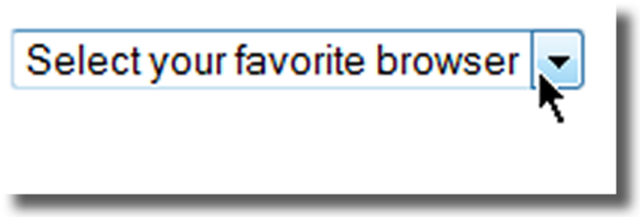
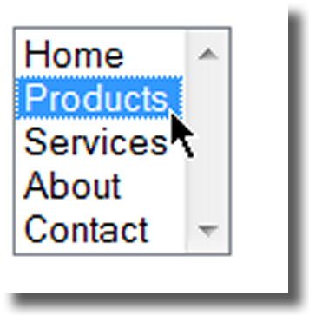
Form Controls: Input
Select list - Configures a select list (along with option elements)
Also known as: Select Box, Drop-Down List, Drop-Down Box, and Option Box.
Allows the user to select one or more items from a list of predetermined choices.
Attributes:
  name
  id
  size
  multiple
Options - Configures the options in a Select List
<select name="Select1">
<option></option>
</select>
Attributes:
  value
  selected

Slide 20
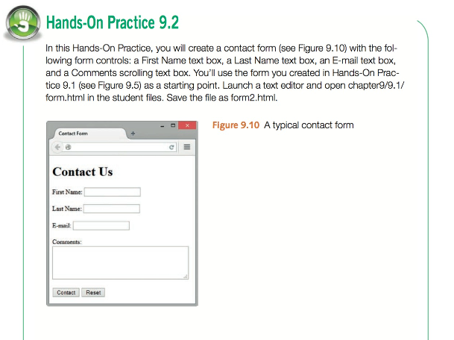
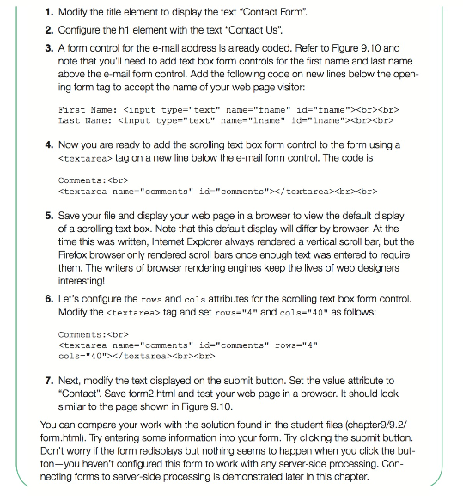
Hands-On Practice 9.2
<!DOCTYPE html>
<html lang="en">
<head>
<title>Form Example</title>
<meta charset="utf-8">
</head>
<body>
<h1>Join Our Newsletter</h1>
<form method="get">
E-mail: <input type="text" name="email" id="email">
<br>
<br>
<input type="submit" value="Sign Me Up!"> <input type="reset">
</form>
</body>
</html>
First Name: <input type="text" name="fmail" id="fmail"><br><br>
Last Name: <input type="text" name="lmail" id="lmail"><br><br>
Comments:<br>
<textarea name="comments" id="comments" rows="4" cols="40"></textarea><br><br>

Slide 21
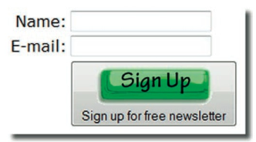

Form Controls: Button
Input Image Button - Submits the form
<input name="Image1" type="image" />
When clicked:
  Triggers the action method on the form tag
  Sends the form data (the name=value pair for each form element) to the web server.
Attributes:
  type=“image”
  name
  id
  src

Slide 22
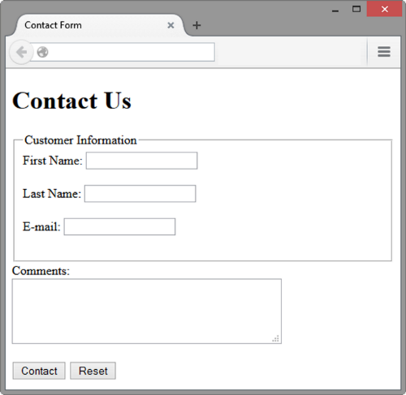
Accessibility & Forms
Label Element
Associates a text label with a form control
Two Different Formats:
<label>Email: <input type="text" name=“email" id ="email"></label>
  OR
  <label for="email">Email: </label>
  <input type="text" name="CustEmail" id= "email">
Fieldset Element
  Container tag
  Creates a visual group of form elements on a web page
  <fieldset><legend>Customer Information</legend>
  <label>Name:
  <input type="text" name="Name" id="Name“></label>
  <br><br>
  <label>Email:
  <input type="text" name="Email" id="Email"></label>
  </fieldset>
Legend Element
  Container tag
  Creates a text label within the fieldset

Slide 23
Accessibility & Forms
tabindex Attribute - Attribute that can be used on form controls and anchor tags
Modifies the default tab order
Assign a numeric value
<input type="text" name="CustEmail" id="CustEmail" tabindex="1">
Accesskey Attribute - Attribute that can be used on form controls and anchor tags
Create a “hot-key” combination to place the focus on the component
Assign a value of a keyboard letter
On Windows use the CTRL and the “hot-key” to move the cursor
<input type="text" name="CustEmail" id="CustEmail" accesskey="E">

Slide 24
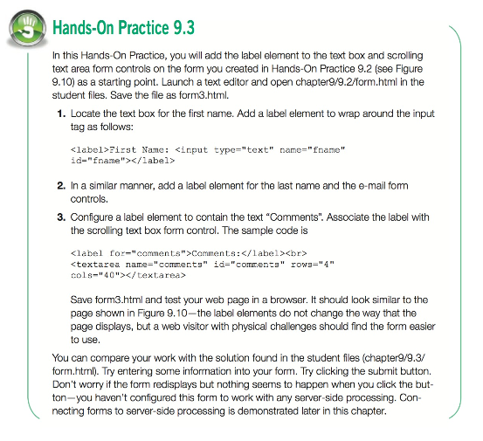
Hands-On Practice 9.3
<!DOCTYPE html>
<html lang="en">
<head>
<title>Contact Form</title>
<meta charset="utf-8">
</head>
<body>
<h1>Contact Us</h1>
<form method="get">
First Name: <input type="text" name="fmail" id="fmail"><br><br>
Last Name: <input type="text" name="lmail" id="lmail"><br><br>
E-mail: <input type="text" name="email" id="email"><br><br>
Comments:<br>
<textarea name="comments" id="comments" rows="4" cols="40"></textarea><br><br>
<input type="submit" value="Contact"> <input type="reset">
</form>
</body>
</html>
<label>First Name: <input type="text" name="fname" id="fname"></label><br><br>
<label>Last Name: <input type="text" name="lname" id="lname"></label><br><br>
<label>E-mail: <input type="text" name="email" id="email"></label><br><br>
<label for="comments">Comments:</label><br>

Slide 25
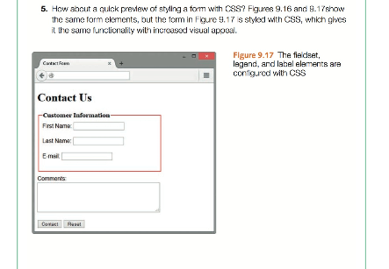
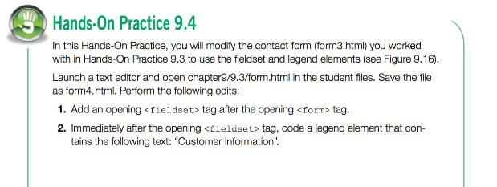
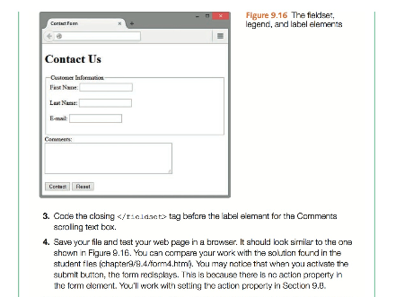
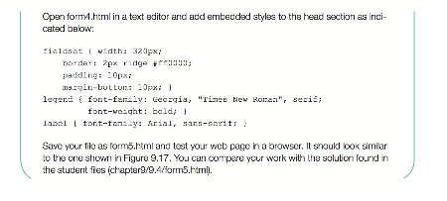
Hands-On Practice 9.4
Start with Hands-On Practice 9.3
<style>
fieldset { width: 320px;
border: 2px ridge #ff0000;
padding: 10px;
margin-bottom: 10px; }
legend { font-family: Georgia, "Times New Roman", serif;
font-weight: bold; }
label { font-family: Arial, sans-serif; }
</style>
<fieldset><legend>Customer Information</legend>
<label>First Name: <input type="text" name="fname" id="fname"></label><br><br>
<label>Last Name: <input type="text" name="lname" id="lname"></label><br><br>
<label>E-mail: <input type="text" name="email" id="email"></label><br><br>
</fieldset>

Slide 26
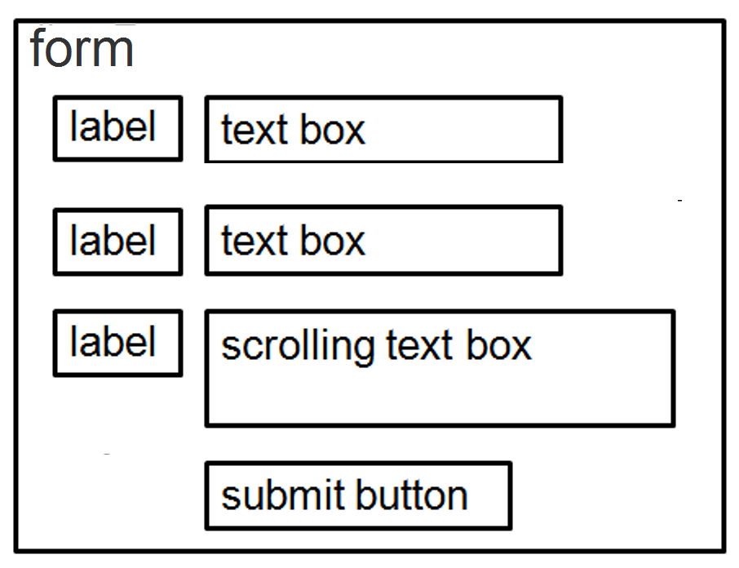
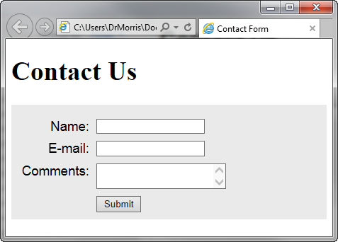
Using CSS to Style a Form
Chapter9 Student Files: formcss.html
form { background-color: #eaeaea;
font-family: Arial, sans-serif; padding: 10px; }
label { float: left; width: 100px; clear: left; text-align: right;
padding-right: 10px; margin-top: 10px; }
input, textarea { margin-top: 10px; display: block; }
#mySubmit { margin-left: 110px; }

Slide 27
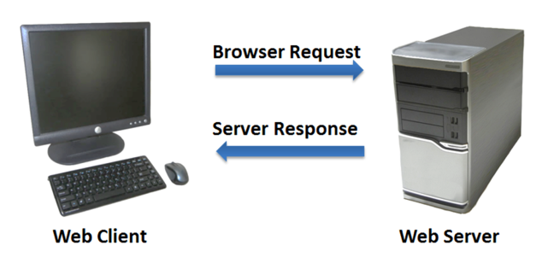
Server-Side Processing
General - Your web browser requests web pages and their related files from a web server.
The web server locates the files and sends them to your web browser.
The web browser then renders the returned files and displays the requested web pages for you to use.
Common Gateway Interface (CGI) - A protocol for a web server to pass a web page user's request to an application program and accept information to send to the user.
Server-side Scripting - One of many technologies in which a server-side script is embedded within a Web page document saved with a file extension such as:
  .php (PHP)
  .asp (Active Server Pages)
  .cfm (Adobe ColdFusion)
  .jsp (Sun JavaServer Pages)
  .aspx (ASP.Net).
Uses direct execution — the script is run either by the web server itself or by an extension module to the web server.

Slide 28
Server-Side Processing (Cont’d)
Steps in Utilizing Server-Side Processing
  Web page invokes server-side processing by a form or hyperlink.
  Web server executes a server-side script.
  Server-side script accesses requested database, file, or process.
  Web server returns web page with requested information or confirmation of action.
Common Uses of Server-Side Scripting
  Search a database
  Place an order at an online store
  Send a web page to a friend
  Subscribe to a newsletter

Slide 29
Server-Side Processing (Cont’d)
Sources of Free Server-Side Processing - Many web host providers offer free scripts for their clients. Contact their support area or FAQ to learn more about their services. Some web sites that offer FREE remotely hosted scripts (in return for displaying an ad).
  http://formbuddy.com
  http://response-o-matic.com
  http://master.com
  http://www.formmail.com
  http://wufoo.com
  http://formassembly.com
Server-Side Scripting Technologies
JavaServer Pages- http://www.oracle.com/technetwork/java/javaee/jsp
ColdFusion - http://www.adobe.com/products/coldfusion
PHP - http://www.php.net
Ruby on Rails - http://www.rubyonrails.org
Microsoft’s .NET Framework - http://www.microsoft.com/net
Microsoft Active Server Pages - http://msdn.microsoft.com/en-us/library/ms972337.aspx

Slide 30
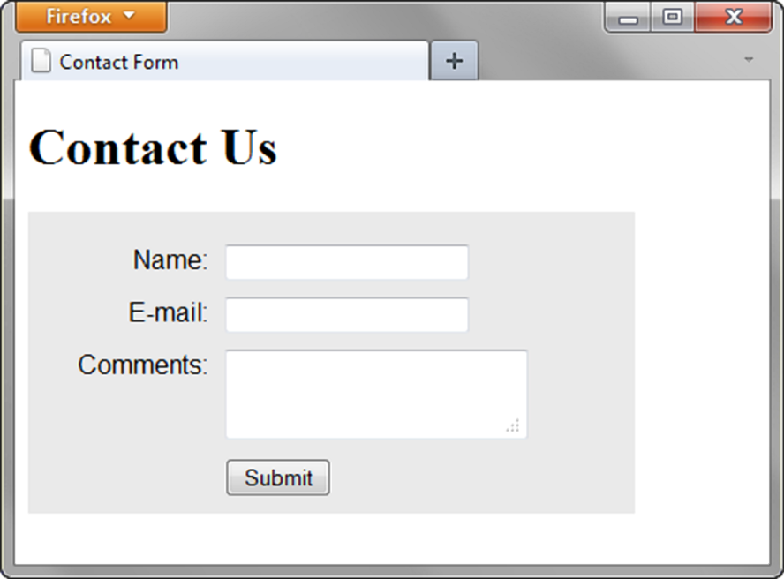
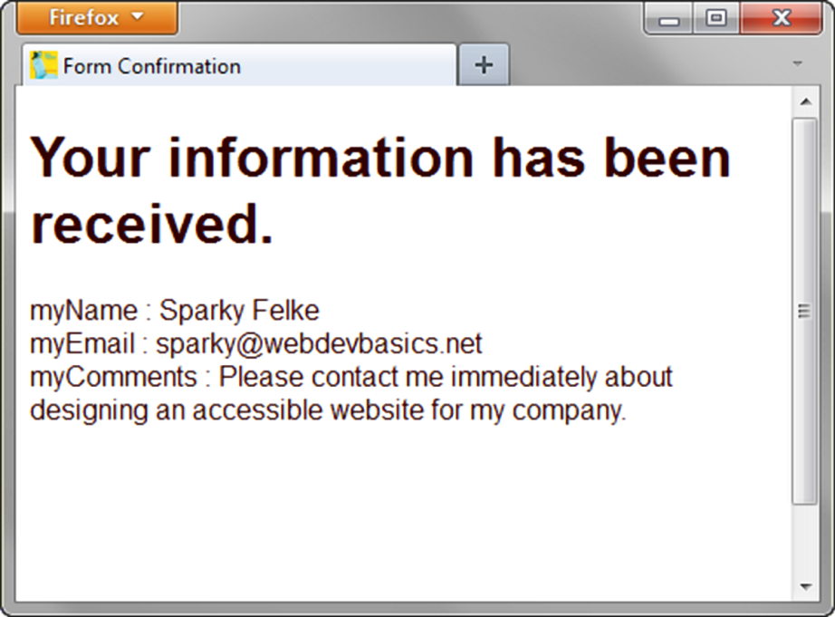
Sending information to a Server-side Script
<form method="post" action="http://webdevbasics.net/scripts/demo.php ">

Slide 31
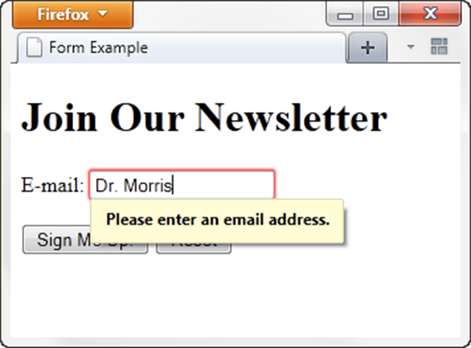
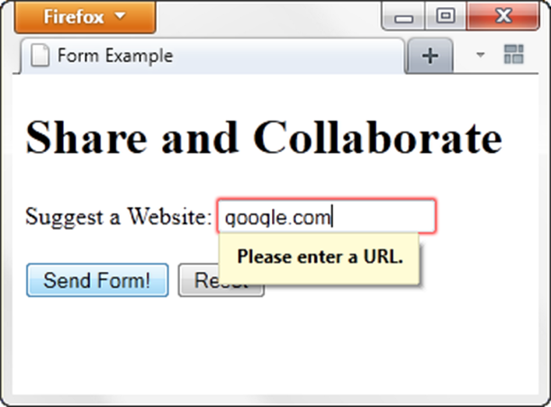
HTML5: Other Input Tools
Email Text Box - Accepts text information in e-mail address format
Common Attributes:
  type="email“
  name
  id
  size
  maxlength
  value
  placeholder
  required
URL Text Box - Accepts text information in URL format
Common Attributes:
  type="url"
  name
  id
  size
  maxlength
  value
  placeholder
  required

Slide 32
HTML5: Other Input Tools
Telephone Number Text Box - Accepts text information in telephone number format
  Common Attributes:
  type="tel“
  name
  id
  size
  maxlength
  value
  placeholder
  required
Search Text Box - Accepts search terms
  Common Attributes:
  type="search"
  name
  id
  size
  maxlength
  value
  placeholder
  required

Slide 33
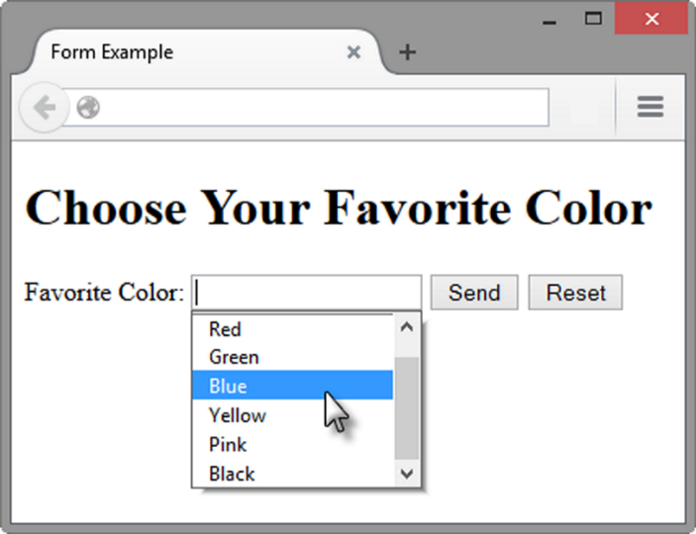
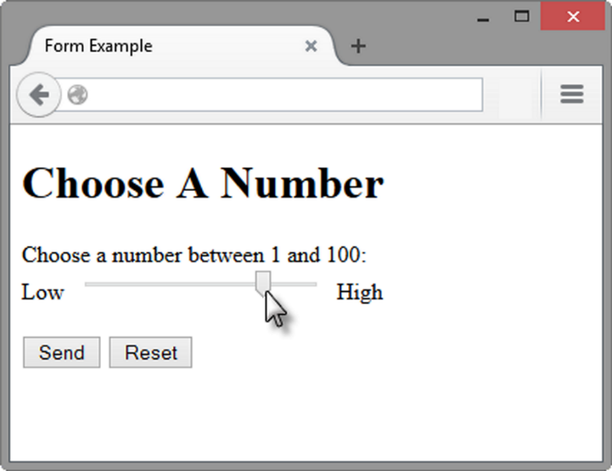
HTML5: Other Input Tools
Datalist Control
<label for="color">Favorite Color:</label>
<input type="text" name="color" id="color" list="colors" >
<datalist id="colors">
<option value="red" label="Red">
<option value="green" label="Green">
<option value="blue" label="Blue">
<option value="yellow" label=“Yellow">
<option value="pink" label="Pink">
<option value="black" label="Black">
</datalist>
Slider Control
<label for="myChoice">
Choose a number between 1 and 100:</label><br>
Low <input type="range"
name="myChoice"
id="myChoice"
min="1"
max="100"> High

Slide 34
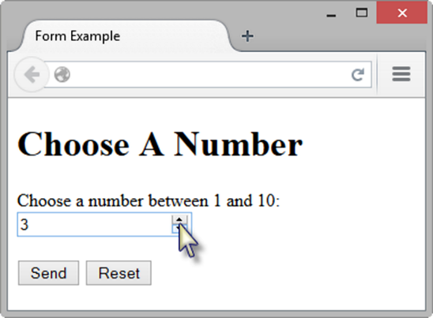
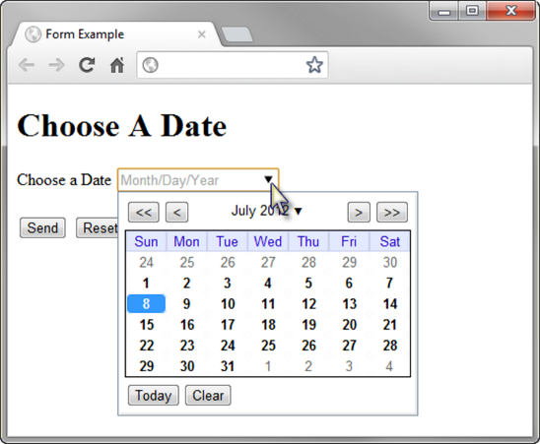
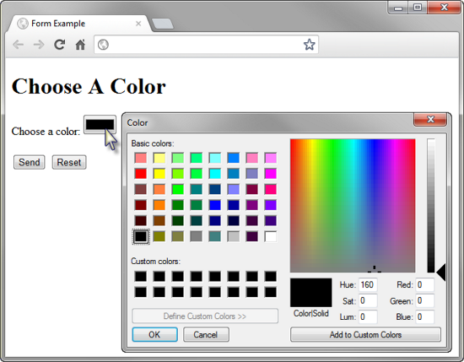
HTML5: Other Input Tools
Spinner Control
<label for="myChoice">
Choose a number between 1 and 10:</label>
<input type="number"
name="myChoice"
id="myChoice“
min="1" max="10">
Calendar Control
<label for="myDate">Choose a Date</label>
<input type="date" name="myDate" id="myDate">
Color Well Control
<label for="myColor">Choose a color:</label>
<input type="color" name="myColor" id="myColor">

Slide 35
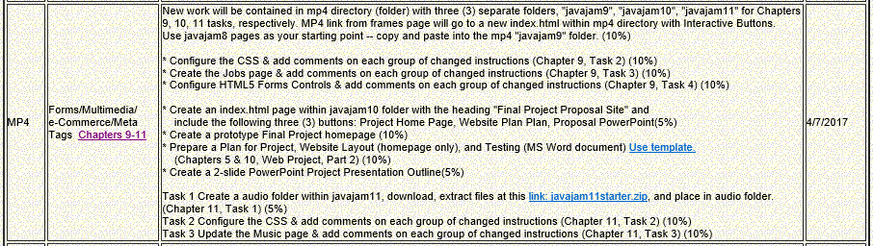
MP4
Hands-On Practice 9.5 & 9.6 demonstrated as part of Chapter 9 tasks.

Slide 36
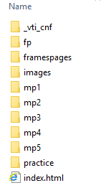
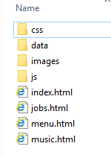
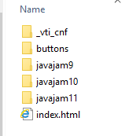
Mini-Project 4 Site Setup
Create a blank notepad document named “log.txt” and save in data folder

Slide 37
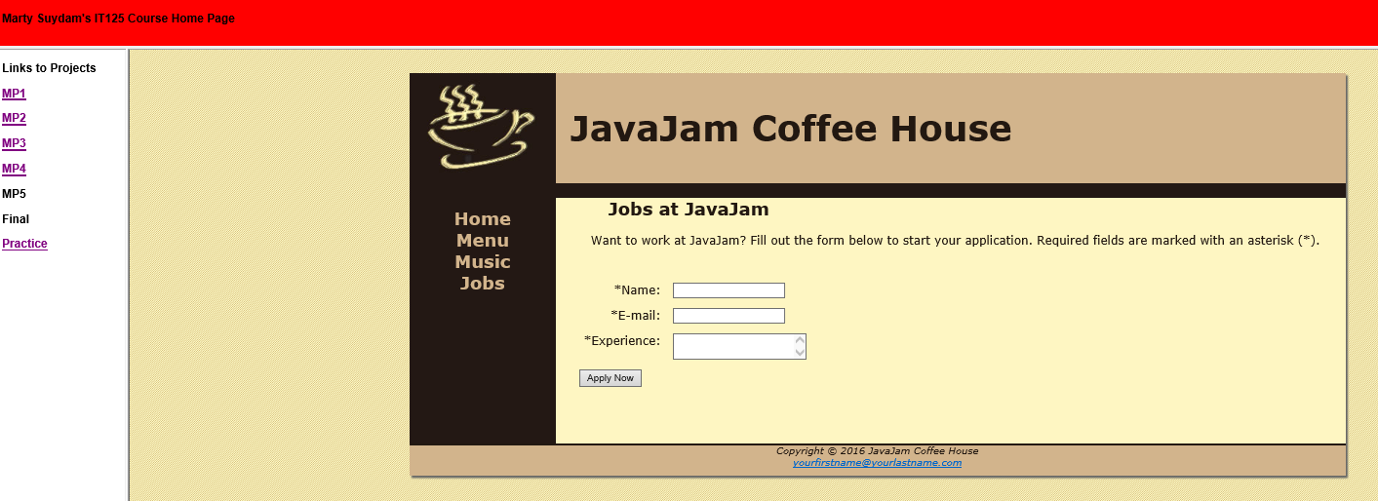
Mini-Project 4 Instructor Example
New Jobs Page

Slide 38
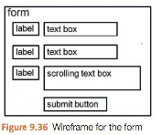
JavaJam Case Study MP4 Chapter 9
You have four tasks in this case study:
1. Create a new folder for this JavaJam case study.
2. Modify the style sheet (javajam.css) to configure style rules for the new form.
3. Create the new Jobs page shown in Figure 9.35.
4. Configure HTML5 form controls.
Preparation(in-class):
Create a folder called javajam9. Copy all of the files from your Chapter 8 javajam8 folder into the javajam9 folder.
Task 2 Configure the CSS. Modify the external style sheet (javajam.css). Open javajam.css in a text editor. Review Figure 9.35 and the wireframe in Figure 9.36. Notice how the text labels for the form controls are on the left side of the content area but contain right-aligned text. Notice the empty vertical space between each form control. Configure CSS as indicated below:
Create a form element selector with a style declaration that sets 2em of padding.
Configure a label element selector to float to the left with block display. Set the text alignment to right, assign a width of 8em, and set 1em of right padding
Configure the input element and textarea element selectors with block display and 1em of bottom margin.
Configure a selector for an id named mySubmit that sets the left margin to 9.5em.
Save the javajam.css file.
Place after CSS table element
form { padding: 2em; }
input, textarea { display: block; margin-bottom: 1em; }
#mySubmit { margin-left: 9.5em; }
label { float: left;
display: block;
text-align: right;
width: 8em;
padding-right: 1em; }
input, textarea { display: block; margin-bottom: 1em; }
#mySubmit { margin-left: 9.5em; }

Slide 39

JavaJam Case Study MP4 Chapter 9
Task 3: Create the Jobs Page. Use the Menu page as the starting point for the Jobs page. Launch a text editor and open menu.html. Save the file as jobs.html. Modify your jobs.html file to look similar to the Jobs page (shown in Figure 9.35) as follows: Figure 9.36 Wireframe for the form 2.
The Jobs page will contain an h2, a paragraph, and a form in the main element.
1. Change the page title to an appropriate phrase. Delete the div within the main element. Delete the table in the main element.
3. Edit the text within the h2 element to say "Jobs at JavaJam".
Replace the text in the paragraph with the following: “Want to work at JavaJam? Fill out the form below to start your application.”
4. Prepare to code the HTML for the form area. Begin with a form element that uses the post method and the action attribute to invoke server-side processing. Unless directed otherwise by your instructor, configure the action attribute to send the form data to http://webdevbasics.net/scripts/javajam8.php.
5. Configure the form control for the Name information. Create a label element that contains the text “Name:”. Create a text box named myName. Use the for attribute to associate the label element with the form control.
6. Configure the form control for the E-mail information. Create a label element that contains the text “E-mail:”. Create a text box named myEmail. Use the for attribute to associate the label element with the form control.
7. Configure the Experience area on the form.
Create a label element that contains the text “Experience:”.
Create a textarea element named myExperience with rows set to 2 and cols set to 20. Use the for attribute to associate the label element with the form control.
8. Configure the submit button. Code an input element with type="submit" and value="Apply Now". Assign the input element to an id named mySubmit.
9. Code an ending tag on a blank line after the submit button.
Save your file and test your web page in a browser. It should look similar to the page shown in Figure 9.35. If you are connected to the Internet, submit the form. This will send your form information to the server-side script configured in the form tag. A confirmation page that lists the form information and their corresponding names will be displayed.
<form method="post" action="http://webdevbasics.net/scripts/javajam8.php">
<label for="myName">Name: </label>
<input type="text" id="myName" name="myName" required="required">
<label for="myEmail">E-mail: </label>
<input type="email" id="myEmail" name="myEmail" required="required">
<label for="myExperience">Experience: </label>
<textarea name="myExperience" id="myExperience" rows="2" cols="20" required="required"></textarea>
<input type="submit" id="mySubmit" name="mySubmit" value="Apply Now">
</form>

Slide 40

JavaJam Case Study MP4 Chapter 9
Task 4: Configure HTML5 Form Controls. Get more practice with the new HTML5 elements by modifying the form on the Jobs page to use HTML5 attributes and values. Modify the jobs.html file in a text editor.
1. Add the following sentence to the paragraph above the form: “Required fields are marked with an asterisk (*).”
2. Use the required attribute to require the name, e-mail, and experience form controls to be entered. Add an asterisk at the beginning of each label text.
3. Configure the input element for the e-mail address with type="email".
Save your file and display your web page in a browser. Submit the form with missing information or only a partial e-mail address. Depending on the browser’s level of HTML5 support,
<p>Want to work at JavaJam? Fill out the form below to start your application. Required fields are
marked with an asterisk (*).</p>
*Name, *Email, *Experience
<input type="email" id="myEmail" name="myEmail" required="required">

Slide 41

The Revised form Tag in jobs.html
Invokes a Server-Side PHP Script for Processing When the Input Data is Valid
Replace this <form>
With this <form>
<form method="post" action="http://webdevbasics.net/scripts/javajam8.php">
<form id="contactForm" onsubmit="return validateContactForm()"
action="js/processFeedback.php" method="post">

Slide 42


The Feedback Message and Log File from processFeedback.php
Create a log.txt blank page and save in data subdirectory
Using File Zilla, right-click on data folder, select “File permissions” and change as shown in image below.
Test the feedback form to verify it works.
A browser display of processing from processFeedback.php and emails showing confirmation to the user indicates that the Jobs Form Input has in fact been received.
Needs permissions set
Confirmation Web Page

Slide 43
PHP Code to Process Feedback in processFeedback.php
<?php
//processFeedback.php
//Construct the message to be sent to the business
$messageToBusiness =
"From: ".$_POST['myName']."\r\n" .
"E-mail address: ".$_POST['myEmail']."\r\n".
"My Experience: ".$_POST['myExperience']."\r\n";
//Send the e-mail feedback message to the business
//replace email address with your email address
$headerToBusiness = "From: $_POST[myEmail]\r\n";
mail('youremail@marymount.edu', $messageToBusiness, $headerToBusiness);
//Construct the confirmation message to be e-mailed to the client
$messageToClient =
"Dear ".$_POST['myName'].":\r\n".
"The following message was received from you by IT125 Website:\r\n\r\n".
$messageToBusiness.
"------------------------\r\nThank you for your interest in applying for a job.\r\n" .
"The JavaJam Team\r\n------------------------\r\n";
//Send the confirmation message to the client
//replace email address with your email address
$headerToClient = "From: youremail@marymount.edu\r\n";
mail($_POST['myEmail'], $messageToClient, $headerToClient);
//Transform the confirmation message to the client into XHTML format and display it
$display = str_replace("\r\n", "<br />\r\n", $messageToClient);
$display =
"<html><head><title>Your Message</title></head><body><tt>".
$display.
"</tt></body></html>";
echo $display;
//Log the message in a file called log.txt on the web server
$fileVar = fopen("../data/log.txt", "a")
or die("Error: Could not open the log file.");
fwrite($fileVar, "\n-------------------------------------------------------\n")
or die("Error: Could not write to the log file.");
fwrite($fileVar, "Date received: ".date("jS \of F, Y \a\\t H:i:s\n"))
or die("Error: Could not write to the log file.");
fwrite($fileVar, $messageToBusiness)
or die("Error: Could not write to the log file.");
?>
Replace information noted by <your email>
Create as a .php page and save in js folder
Change email address
Change email address

Slide 44

Chapter 10
Download Chapter 10 Student Files and save and UnZip to your practice folder

Slide 45
Skills and Functions Needed for a Successful Projects
Large-Scale
  Project Manager
  Information Architect
  User Experience Designer
  Marketing Representative
  Copy Writer & Editor
  Content Manager
  Graphic Designer
  Database Administrator
  Network Administrator
  Web Developer / Web Designer
Small-Scale
  The skills and functions are essentially the same as on a large project
  Each person may wear many “hats” and juggle their job roles
    Example: The web designer may also be the graphic designer.
  Some job roles may be outsourced
    Most Common:
    An external web site provider is used so there is less (if any) need for a Network Administrator.

Slide 46
Project Staffing Criteria
Finding the right people to work on a project is crucial
  Consider:
    work experience
    portfolio
    formal education
    industry certifications
Alternative:
Outsource all or portions of the project to a web design/development firm

Slide 47

Web Development
Cycle
Conceptualization
  Determine the intended audience
  Determine the goals or mission of the web site
    Short-term goals
    Long-term goals
    Develop measurable objectives such as:
        Number of visitors
        Percent of product sales
    Analysis
  Determine the following:
    information topics
    functionality requirements (high-level) - Determine “what” a site will do – not “how” it will do it
    environmental requirements
    content requirements
  If a redesign, compare the old approach with the new approach
  Review competitor’s sites
  Estimate costs - Cost/Benefit analysis

Slide 48
Web Development
Design
  Determine the site organization
  Prototype the design
  Determine a page layout design
  Document each page
Production
  Choose a web authoring tool
  Organize your site files
  Develop and individually test components
  Add content
Testing
  Test on different web browsers and browser versions
  Test with different screen resolutions
  Test using different bandwidths
  Test from another location
  Test, Test, Test

Slide 49
Web Development: Types of Testing
Automated Testing Tools and Validation
  Automated Testing (Link checkers, etc.)
  W3C HTML and CSS validation tests
Usability Testing
  Testing how actual web page visitors use a web site
  Can be done at almost any stage of development
  Early – use paper and sketches of pages
  Design – use prototype
  Production & Testing – use actual pages

Slide 50
Web Development: Test Plan
Test on Different Browsers and Browser Versions. It is very important to test your pages on commonly used browsers and versions of those browsers.
Test with Different Screen Resolutions. Although, as a web developer, you may use a very high screen resolution, not everyone uses 2560×1440 screen resolution. The most commonly used screen resolutions at the time of this writing are 1366×768, 1920×1080, and 1024×768. Be sure to test your web pages on various resolutions—you might be surprised at the results.
Test Using Different Bandwidths. If you live and work in a metropolitan area, every- one you know may have broadband access to the Internet. However, many people still use dial-up connections to access the Web. It is important to test your site on both slow and fast connections. Images that look great over your school’s T3 line may load very slowly over a mobile hotspot.
Test from Another Location. Be sure to test your website using a computer other than the one the website was developed on, in order to simulate the web page visitor’s experience more closely.

Slide 51
Web Development
Approval & Launch
  User or Client Testing - Client will test site before giving official approval for site launch
  Approval & Launch
    Obtain sign-off form or email from client
    Upload files to web server
    Create backup copies of files
    TEST THE WEB SITE AGAIN AFTER UPLOAD!
Maintenance – the never-ending task…
  Enhancements to site
  Fixes to site
  New areas added to site
  A new opportunity or issue is identified and another loop through the development process begins.
Evaluation
  Re-visit the goals, objectives, and mission of the website
  Determine how closely they are being met
  Develop a plan to better meet the goals, objectives and mission

Slide 52
Domain Names
Web Presence – Domain Name establishes for your business or organization
Choosing Domain name
  Established Business - choose a domain name that relates to your established business presence
  New Business - choose domain name while selecting company name
    Describe your business
    Be brief, if possible
    Avoid hyphens
    TLD (top level domain name) - .com, .net, .biz, .us, .mobi and others
    .org for non-profits
    Brainstorm potential keywords
    Avoid trademarked words or phrases
    Know the territory (use Google!)
    Verify Availability
Registering - There are many domain name registrars, including http://godaddy.com
  Visit Registrar, choose name, pay
  Private registration – additional fee but personal information is kept private and out of the WHOIS database

Slide 53
Web Hosting
Some organizations administer a web server in-house and host their own website.
Many companies use a web host provider.
  A good web hosting service will provide a robust, reliable home for your website.
  A poor web hosting service will be the source of problems and complaints.
  Do not use free web hosting for a commercial website.
Hosting Needs: Small to Medium Website
  Virtual Hosting - The web host provider's server is divided into a number of virtual domains and multiple websites are set up on the same computer.
  Consider: Future growth and scalability of web host, Operating System , Types of server-side processing supported, Bandwidth of Internet connection, Both local and national web host providers, Guaranteed uptime – service level agreement (SLA), Technical support
Hosting Needs: Large to Enterprise Website
  Dedicated web Server
  Co-located web Server
  Consider: National web host providers, Guaranteed uptime – service level agreement (SLA), Bandwidth of Internet connection, Technical Support

Slide 54
Web Hosting
Dedicated Web Server
  The exclusive use of a rented computer and connection to the Internet that is housed in the web hosting company's premises.
  The server can usually be configured and operated remotely from the client company or you can pay the web host provider to administer it for you.
Co-Located Web Server
  A computer that your organization has purchased and configured.
  Your organization effectively rents space at the web host provider's location.
  Your server is kept and connected to the Internet at their location.
  Your organization administers this computer.

Slide 55

Web Host Checklist
Table 10.1, Page 466

Slide 56

MP4

Slide 57

JavaJam Case Study MP4 Chapters 5 & 10
Chapter 5 Web Project
1. Web Project Topic
What is the purpose of the website?
List the reason you are creating the website.
What do you want the website to accomplish?
List the goals you have for the website.
Describe what needs to happen for you to consider your website a success.
Who is your target audience?
Describe your target audience by age, gender, socioeconomic characteristics, and so on.
What opportunity or issue is your website addressing?
For example, your website might address the opportunity to provide information about a topic to others or create an initial web presence for a company. What type of content might be included in your website?
Describe the type of text, graphics, and media you will need for the website. While you should write the text content yourself, you may use outside sources for royalty- free images and multimedia. Review copyright considerations (see Chapter 1).
List the URLs for at least two related or similar websites found on the Web.
2. Web Project Site Map. Use the drawing feature of a word processing program, a graphics application, or a paper and pencil to create a site map of your website that shows the hierarchy of pages and relationships between pages.
3. Web Project Page Layout Design. Use the drawing feature of a word processing pro- gram, a graphics application, or paper and pencil to create wireframe page layouts for the home page and content pages of your site. Unless otherwise directed by your instructor, use the style for page layout composition shown in Figures 5.32–5.35. Indicate where the logo, navigation, text, and images will be located. Do not worry about exact wording or exact images.
Chapter 10 Web Project
Part 1: Review the Design Documents and Completed Web Pages. Review the Topic Approval, Site Map, and Page Layout Design documents that you created in the Chapter 5 Web Project. Review the web pages that you have created and/or modified in the Chapter 6 through Chapter 9 Web Project activities.
Part 2: Prepare a Test Plan. See Figure 10.4 for a sample test plan document (chapter10/ testplan.pdf in the student files). Create a test plan document for your website, including CSS validation, HTML validation, and accessibility testing.
Part 3: Test Your Website. Implement your test plan and test each page that you have developed for your Web Project. Record the results. Create a list of suggested improvements.
Part 4: Perform Usability Testing. Describe three scenarios that typical visitors to your site may encounter. Using Hands-On Exercise 5 as a guide, conduct a usability test for these scenarios. Write a one-page report about your findings. What improvements would you suggest for the website?
Left-click on above image to download template

Slide 58



JavaJam Case Study MP4 Chapters 5 & 10
Chapter 10 Web Project
Part 1: Review the Design Documents and Completed Web Pages. Review the Topic Approval, Site Map, and Page Layout Design documents that you created in the Chapter 5 Web Project. Review the web pages that you have created and/or modified in the Chapter 6 through Chapter 9 Web Project activities.
Part 2: Prepare a Test Plan. See Figure 10.4 for a sample test plan document (chapter10/ testplan.pdf in the student files). Create a test plan document for your website, including CSS validation, HTML validation, and accessibility testing.

Slide 59

Quiz 3 Preparation (3/29/2017)

